Slide 1



Anbio Company Presentation
YOUR HEALTH
OUR CONCERN

Slide 2
We develop, manufacture, and distribute POCT products worldwide

Slide 3

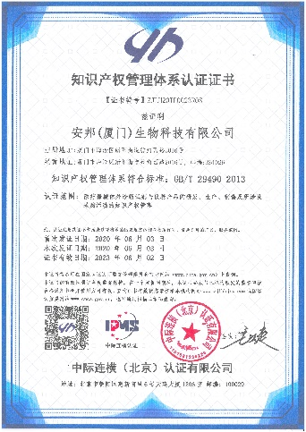
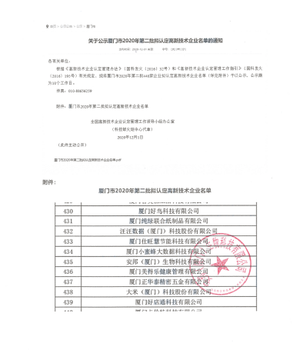
About Us
Anbio Biotechnology Co., Ltd founded in 2015, is located in No. 2016, Wengjiao West Road, Haicang, Xiamen, China.
It is a technology-based private enterprise focusing on research, production, sales and service of in vitro diagnostic products. At present, it has 30 technicians and a plant area of 11,300 m² .Anbio is National High Tech Enterprises
*Assembly line: 37 lines
*Employees: 2000+
*Capacity: > 12 million tests per day ，300million tests per month
*CE certificates: 11 SARS-CoV-2 Products
Anbio invests heavily in research to develop new products in response to market demands and continuously improve our POCT products.
Anbio Technology B

Slide 4
Our Mission
Enable our customers to make the world healthier & safer.
Anbio will offer an unique combination of continuous technology development and the most convenient options.
Our products and services will solve analytical challenges ranging from complex research to routine POCT testing to field applications.

Slide 5
Products Development
FIA POCT
CLIA POCT
PCR POCT
Cardiovascular
Inflammation
Diabetes
Kidney
Gastric
Thyroid
Blood borne
Sex Hormone
Kidney
Tumor
Tumor
Endocrinology
Respiratory pathogen
Blood borne
Genetic Gene
2015
2016
2017
2018
2019
2020
Dry chemistry POCT
DOA POCT
COVID-19 POCT
MET
MOP
THC
KET
RT PCR
IgG/IgM Antibody
Antigen test
Neutralizing Antibody
COVID19 Antigen Flu A/B combo
Kindergarten entrance check up
Blood screening

Slide 6
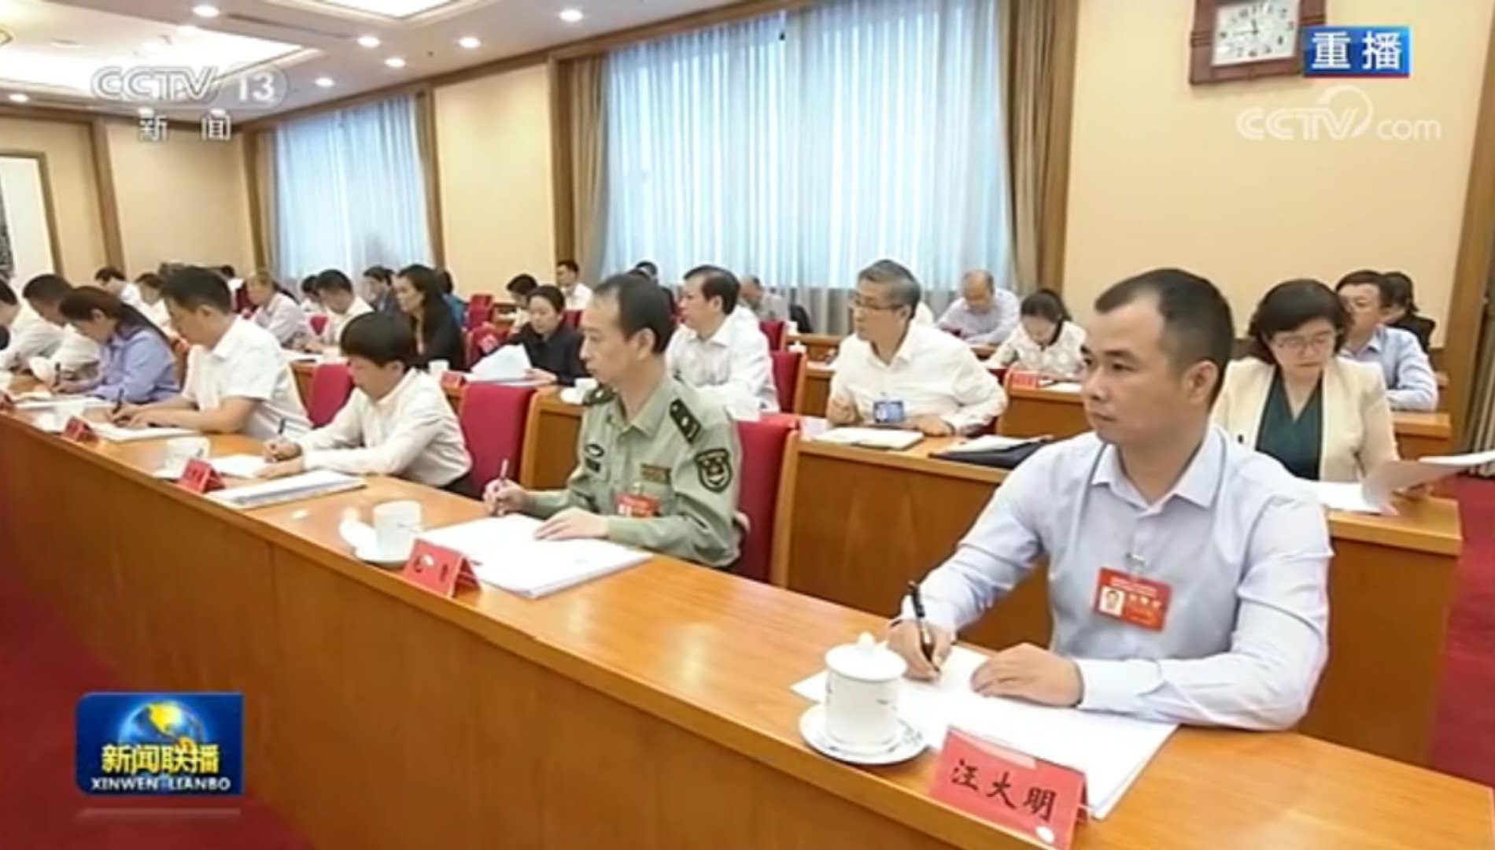
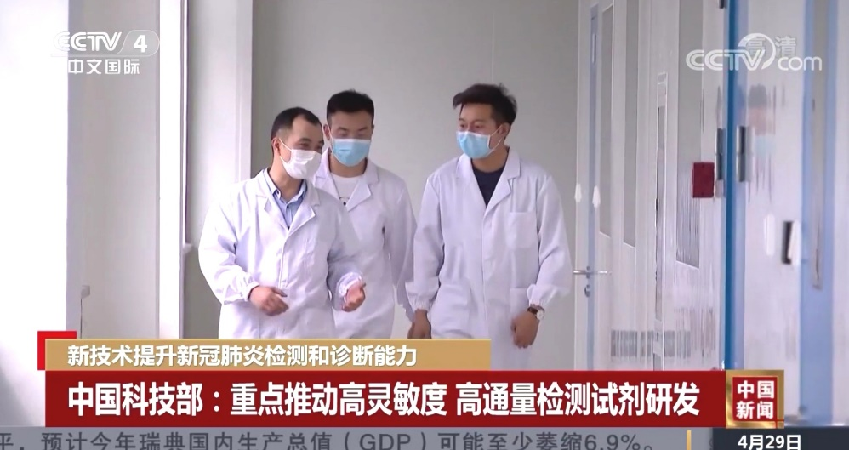
Company Founder
Daming Wang
-Professor in Chinese Academy of Science Suzhou
- President of Xiamen Health Research Institute
- National advanced individual in combating COVID-19 ；
- Projects director of Ministry of Science & Technology;
- Projects director of Ministry of Industry and Information Technology
Projects director of the People's Liberation Army ；
National recognition ：Daming Wang was awarded the national advanced individual in fighting against covid19.
Reward
-First Prize of Shanghai Science and Technology Progress Award
-First Prize of Henan Science and Technology Progress Award
-Xiamen Science and Technology Progress Award, etc.

Slide 7
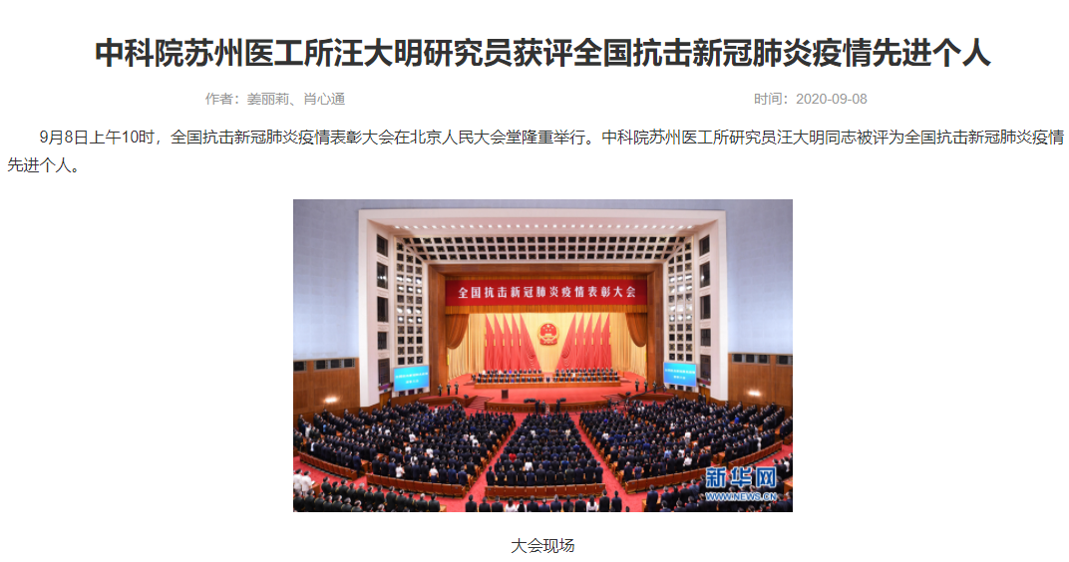
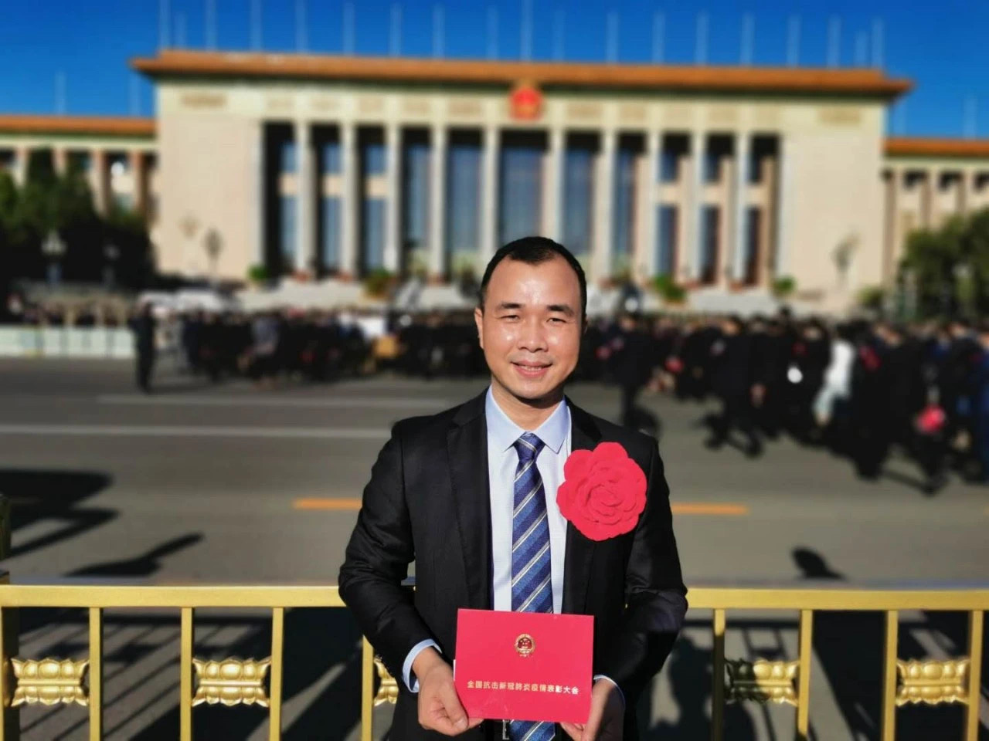
Company Reputation
National recognition ：Daming Wang was awarded the national advanced individual in fighting against covid19.
Reported and concerned by News broadcast China news, Xinhuanet.com, People's net, China Youth Daily
One of the five key enterprises of joint prevention and control mechanism of the State Council
Focused enterprise by he National Development and Reform Commission, the Ministry of Industry and Information Technology, the Ministry of Science and Technology, and the National Health Commission
high-tech enterprises in Xiamen
Fujian FDA precise help enterprises
Xiamen intellectual property standards compliance enterprises

Slide 8
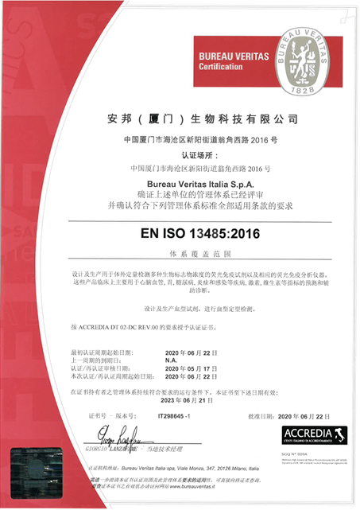
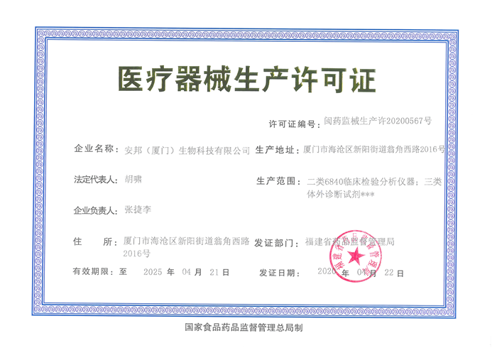
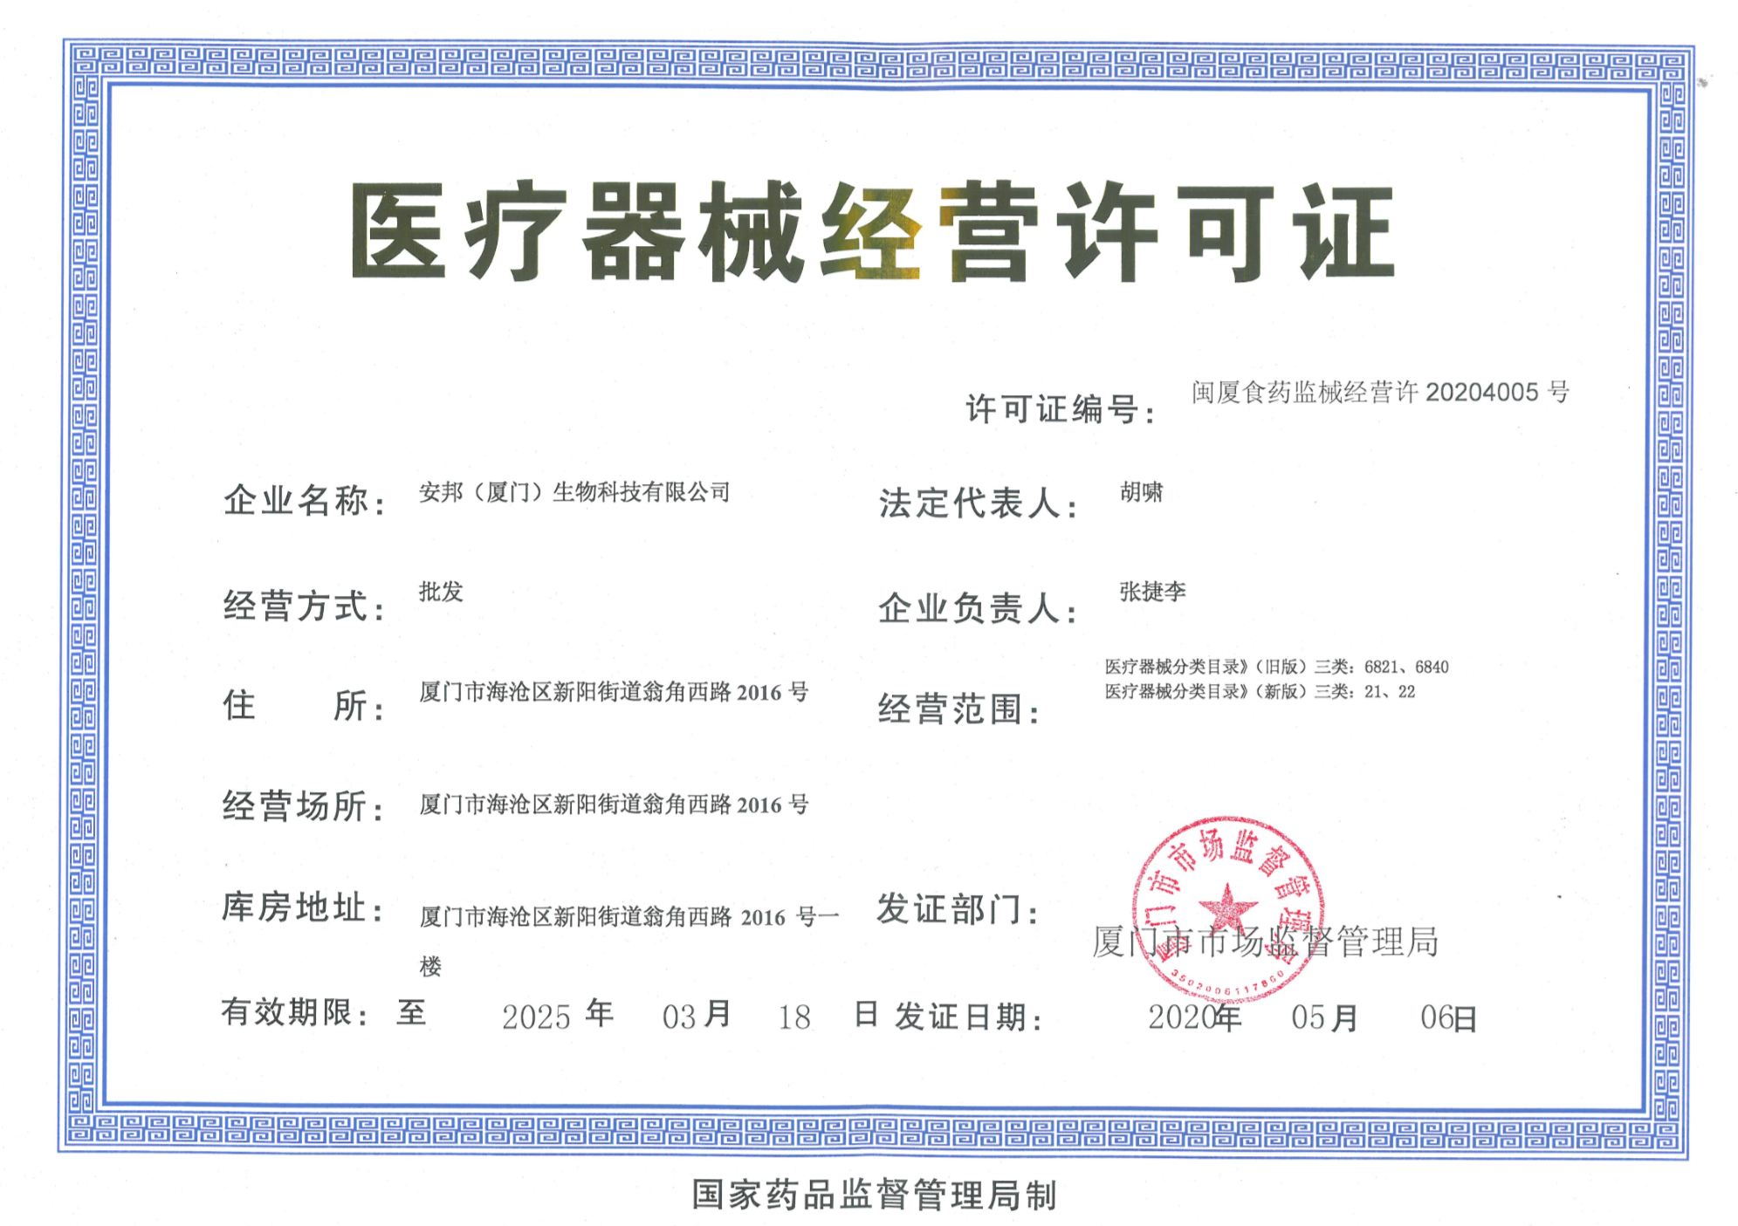
Certificate and Quality
TQM Quality Management
CFDA manufacturing License；
ISO13485(BV Italy)
Passed the flight inspection of quality system of National Bureau for every time

Slide 9
COVID19 Products with CE Mark
NO. | Product name | CE number
1 | Neutralizing Antibody of SARS-CoV-2 Test (Immuochromatographic Assay) | NL-CA002-2020-54641
2 | Rapid Neutralizing Antibody of SARS-CoV-2 Test (Colloidal Gold) | NL-CA002-2020-54641
3 | SARS-CoV-2 & influence A/B Multiplex Tset Kit（Real-time PCR） | NL-CA002-2020-54640
4 | Rapid Antigen Test for SARS-CoV-2&Flu A/B （Colloidal Gold） | NL-CA002-2020-54640
5 | COVID-19 Test Kit（ Real-time PCR） | NL-CA002-2020-53206
6 | Rapid COVID-19 Antigen Test（Colloidal Gold） | NL-CA002-2020-53206
7 | COVID-19 IgM/IgG Antibody Colloidal Gold Test | NL-CA002-2020-50112
8 | COVID-19 Hybrid Capture Fluorescence Immunoassay Test | NL-CA002-2020-50112
9 | Rapid FluA/B Test（Colloidal Gold） | NL-CA002-2020-54640
10 | Virus Sample And Extraction Kit | NL-CA002-2020-54640
11 | Immuofluorescence Analyzer | NL-CA002-2020-50112

Slide 10
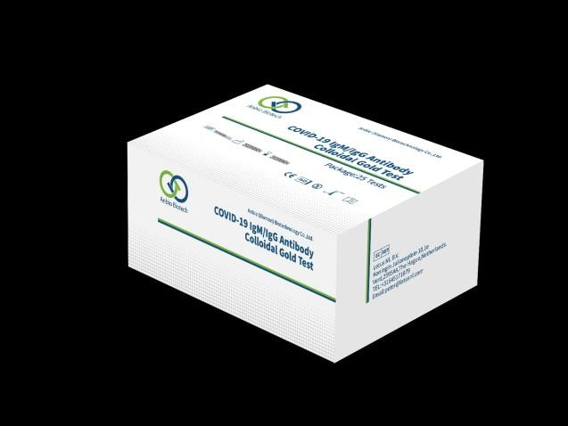
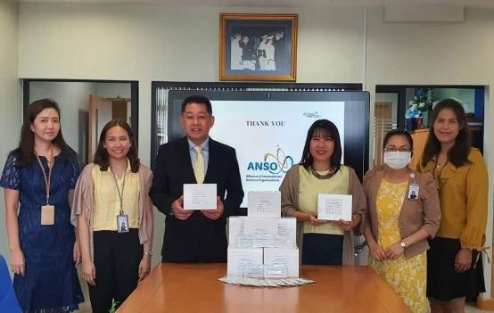
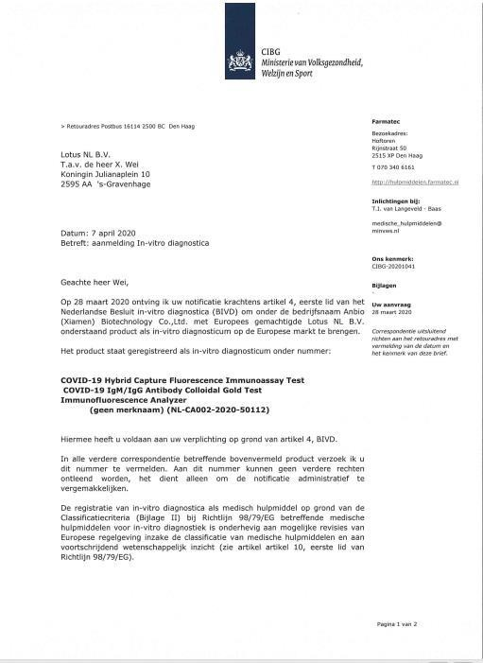
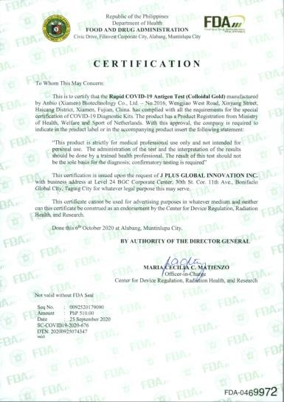
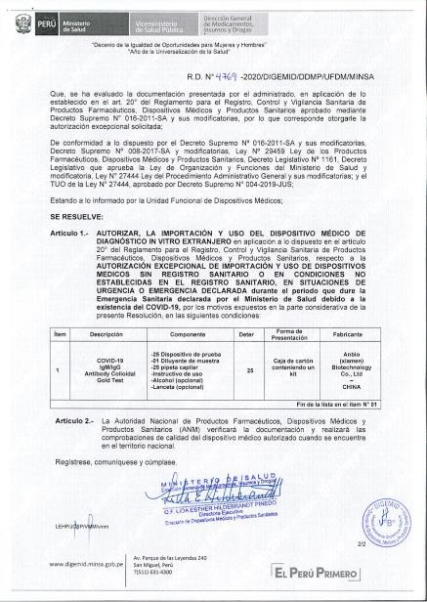
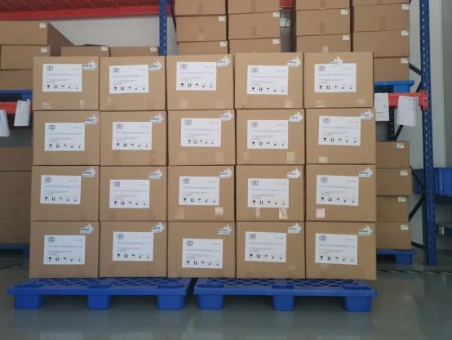
Product introduction 1 : Rapid Neutralizing Antibody of SARS-CoV-2 Test
The sample size of 10 μ l fingertip blood is small, and no instrument is needed;Fast: 15 minutes to produce results; room temperature transport and storage;IgM / IgG were shown separately
FDA EUA assessment passed
EU access, Peru, Philippines registration certificate passed，
Registered in other countries

Slide 11
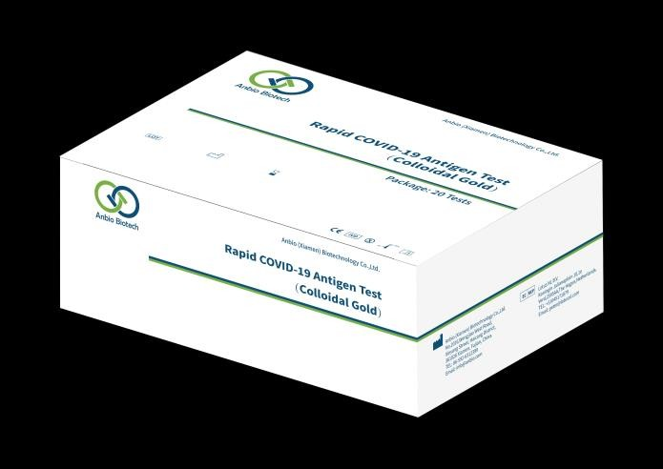
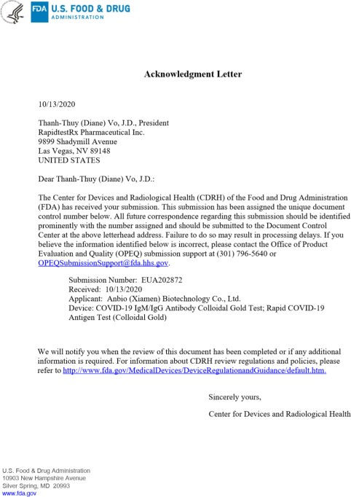
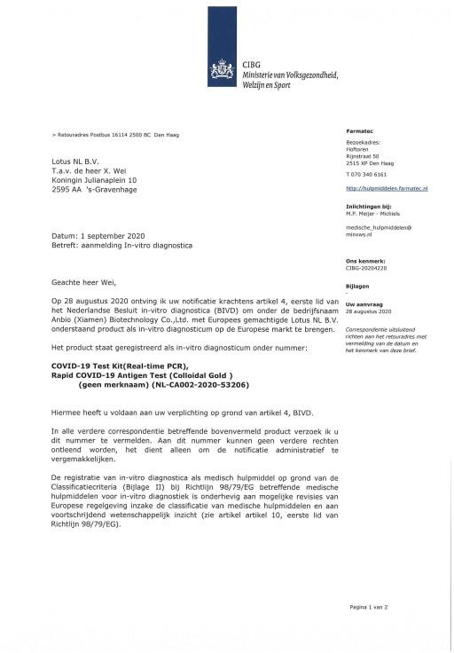
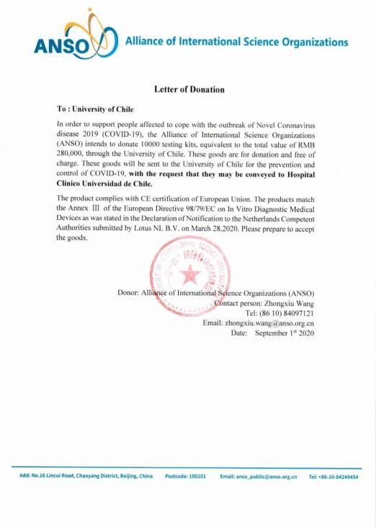
Product introduction 2 : Rapid COVID-19 Antigen Test
Fast: 15 minutes to produce results;
room temperature transport and storage;N protein + S protein can effectively reduce missed detection;
FDA peua of the United States; EU access has passed;
Pei laboratory evaluation of Germany has passed;
Saliva single package enters German supermarket for sale Registration in Philippines, Indonesia and other countries has been completed

Slide 12
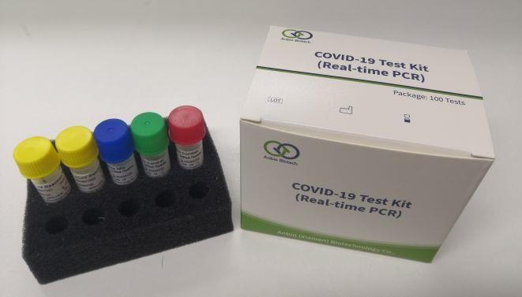
Product introduction 3： COVID-19 Test Kit（ Real-time PCR）
Company | Anbio | Fosun Med- Tech | Geneodx | ZJ Bio-Tech | DAAN GENE | Sunsure Biotech | Biogerm | BGI
Specimen type | Nasopharynge al swabs； pharynx swabs ；sputum； BALF | Nasopharyngea l swabs； pharynx swabs ；sputum； BALF | Nasopharyngea l swabs； sputum | Nasopharyngea l swabs； sputum； BALF | Nasophary -ngeal swabs； sputum | pharynx swabs； BALF | Nasopharynge -al swabs； pharynx swabs ；sputum； | pharynx swabs； BALF
Detection target | ORF1ab，N gene | ORF1ab，N gene | ORF1ab，N gene | ORF1ab，N gene | ORF1ab， N gene | ORF1ab ，N gene | ORF1ab，N gene | ORF1ab gene
TAT | 1.5h | 2h | 1h | 2h | 2h | 2h | 1.5h | 3h
Sensitivity | 100copies | 300copies | 500copies | 1000copies | 1000copies | 200copies | 1000copies | 100copies
Inter control | Yes | Yes | No | Yes | Yes | Yes | Yes | No
UNG Enzyme and dYTP | Yes | Yes | No | No | No | Yes | No | No

Slide 13


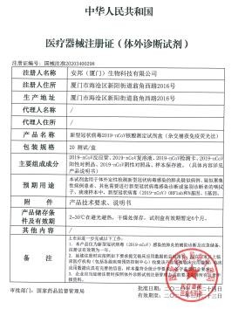
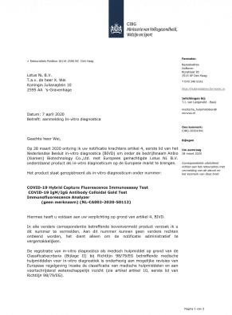
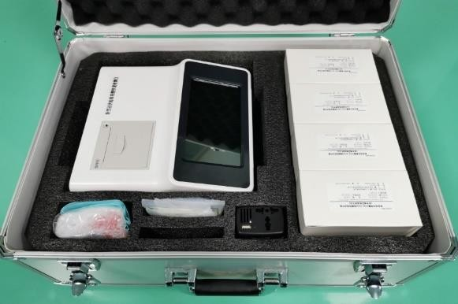
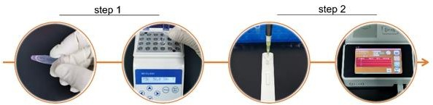
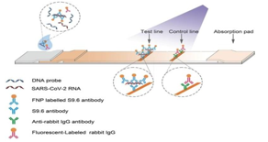
Product introduction 4： COVID-19 Hybrid Capture Test
NMPA registration certificate
Published in international top journals
《Nature nature biotechonology 》
11

Slide 14
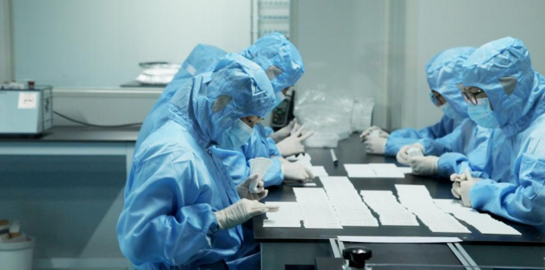
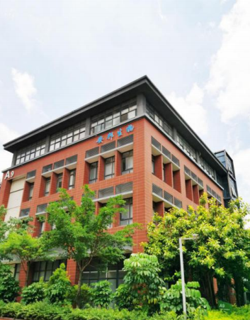
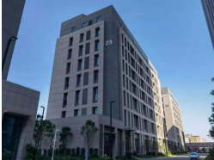
Our Facility ( 11,3000 M² )
Factory 1
Factory 2-5
GMP Factory

Slide 15
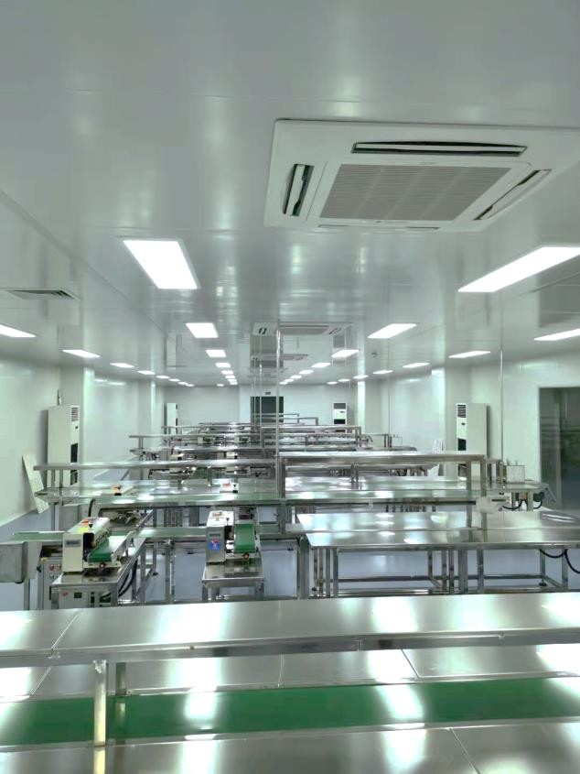
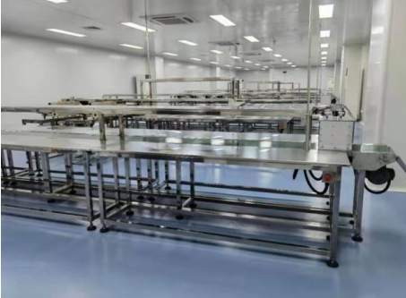
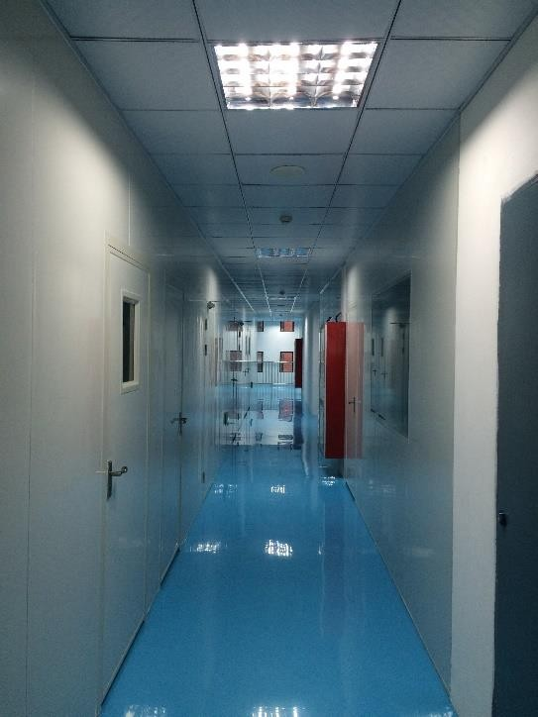
Factory And Capacity
project | content
Production line | 21 sets of clean workshop, 37 product lines, clean drying workshop 11,300 square meters；
Daily capacity | 12 millon tests per day
Month capacity | 300 million tests per month

Slide 16
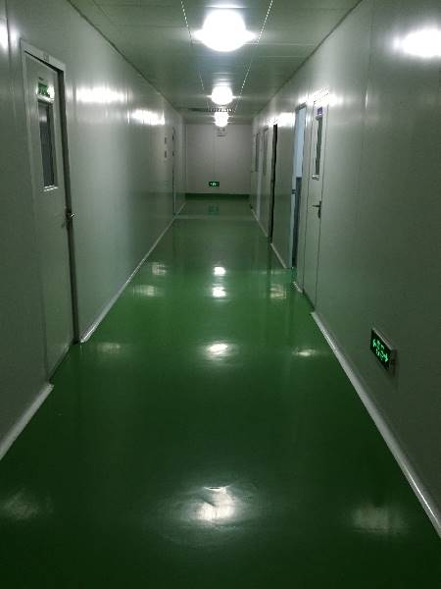
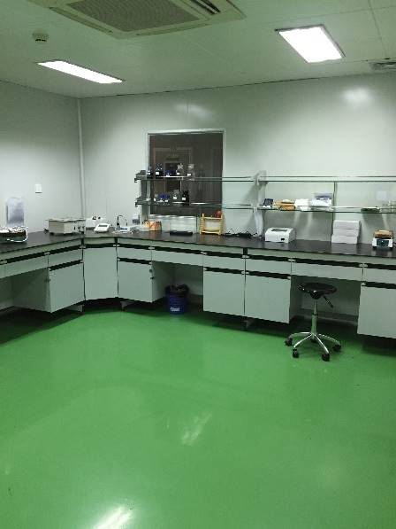
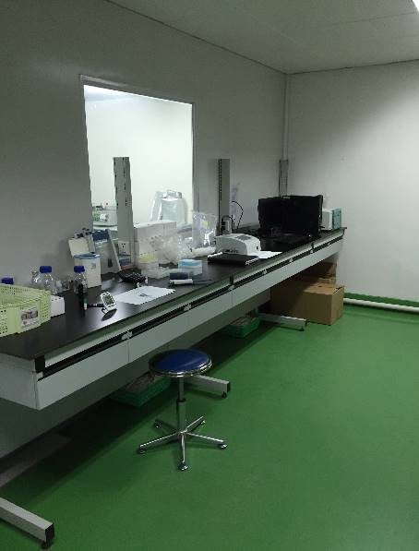
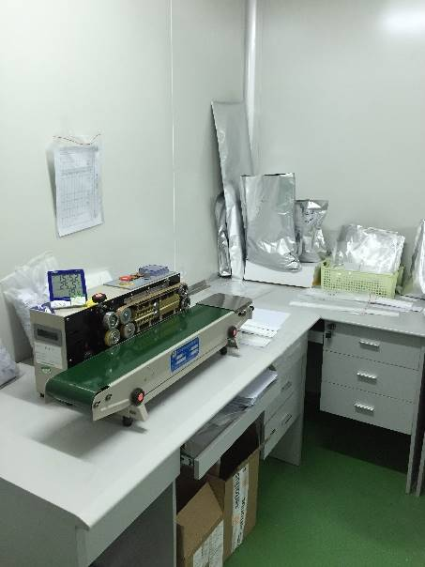
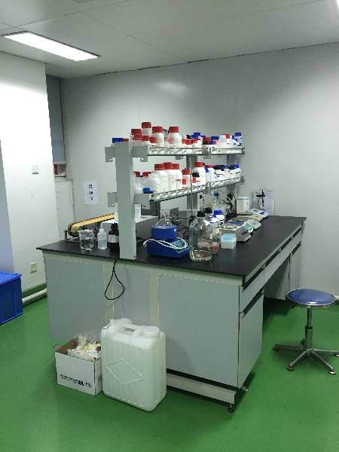
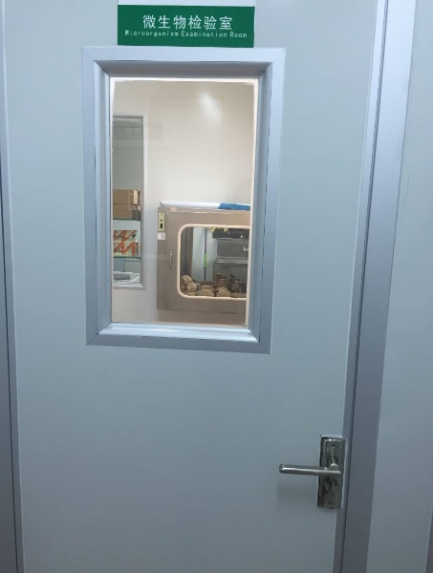
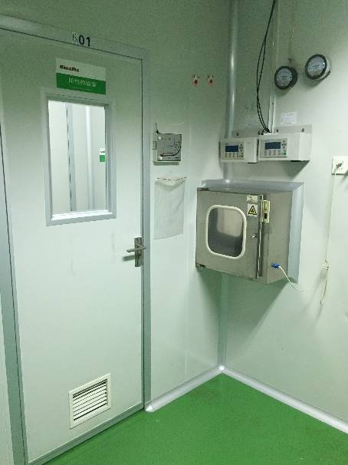
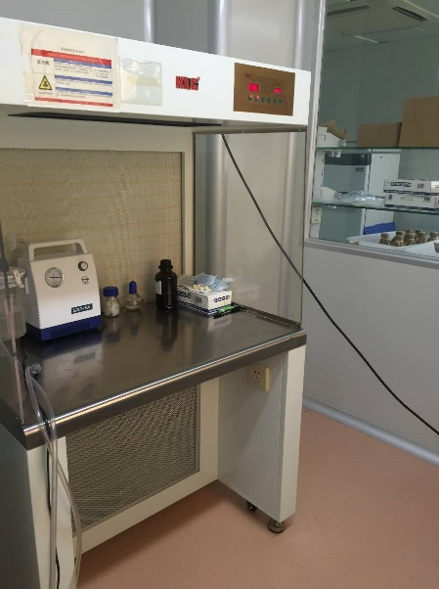
Our Laboratories ( 1000 M² )

Slide 17
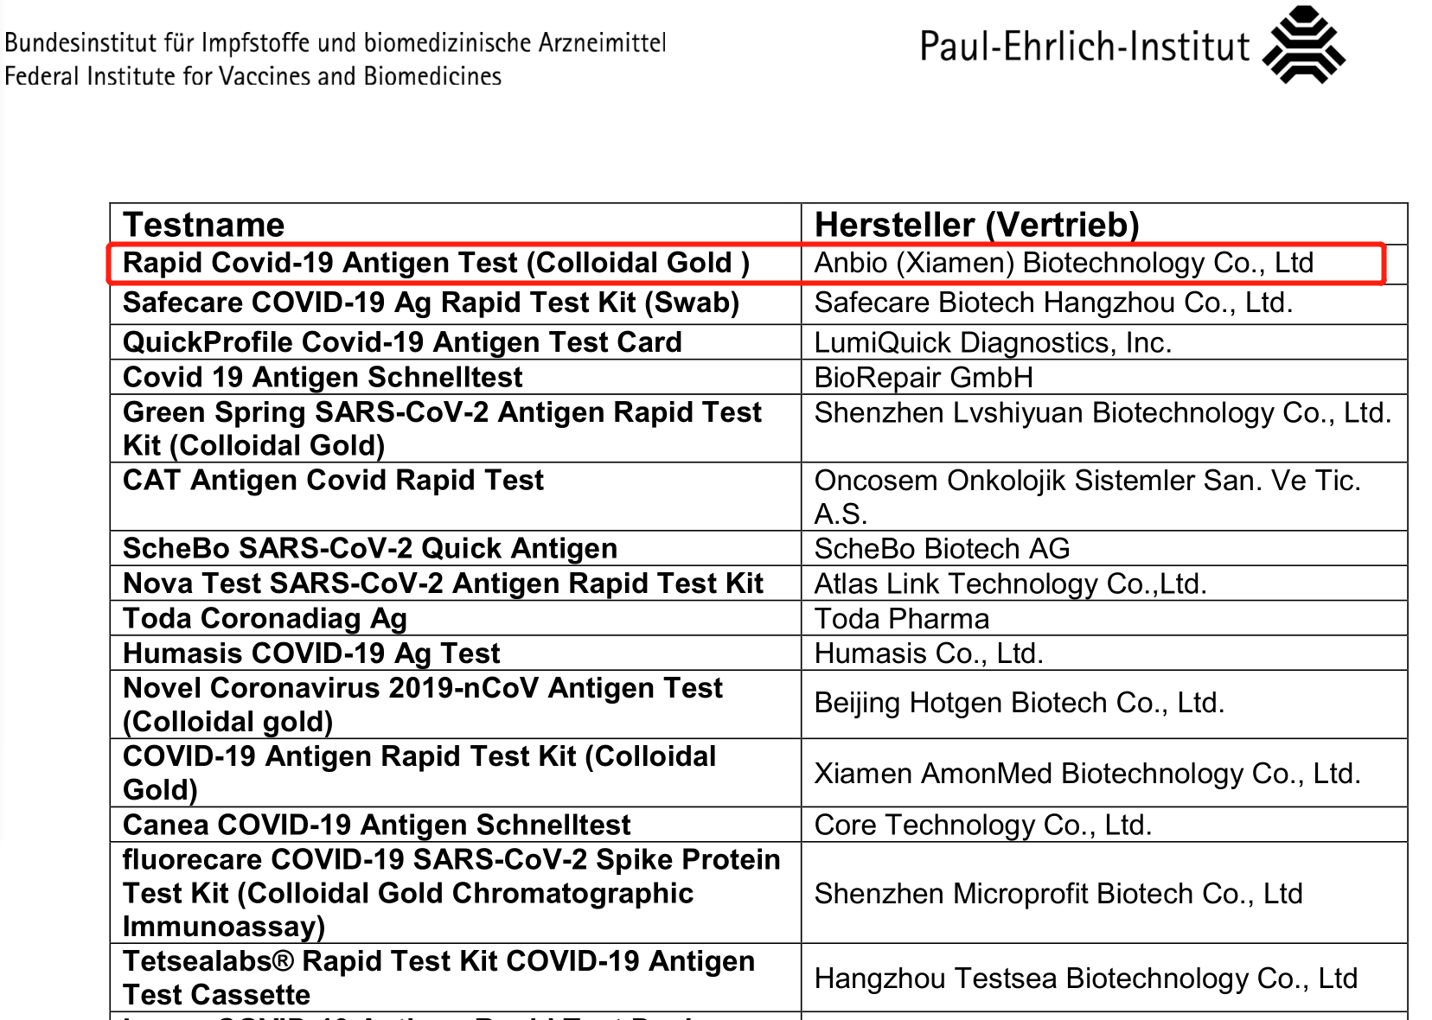
COVID19 Antigen test in Germany
Evaluated and approved by PEI country lab in Feb 2021.
Paul-Ehrlich-Institut
Paul-Ehrlich-Str. 51-59
63225 Langen, Germany
www.pei.de

Slide 18
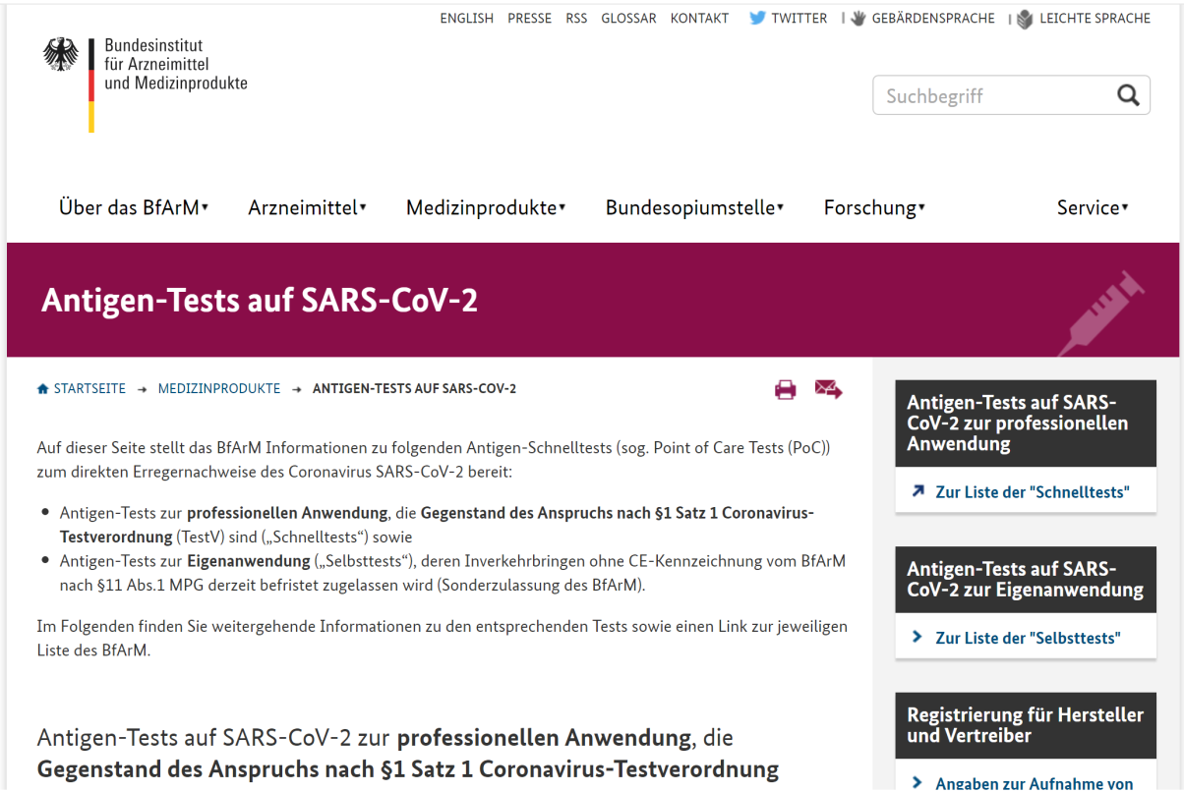
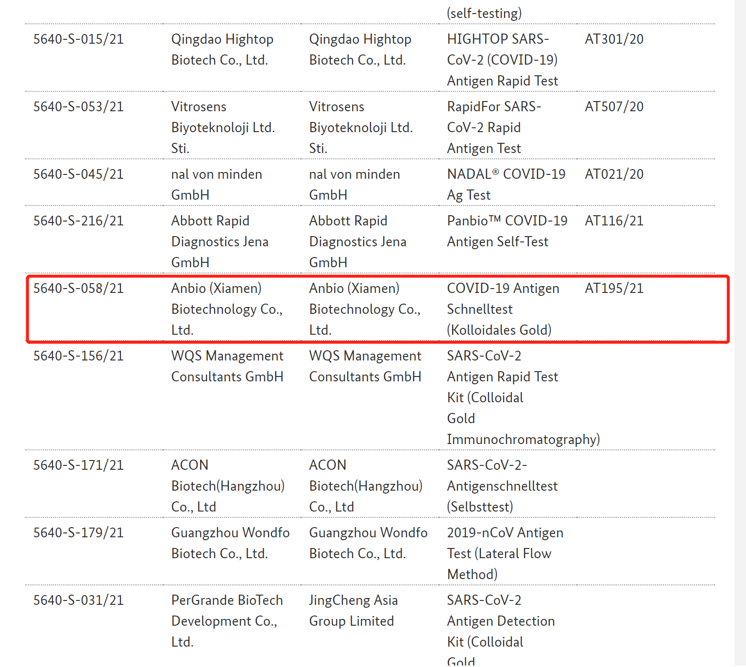
COVID19 Antigen test in Germany
Approved by Bfarm against Anbio’s COVID19 Antigen Self-Test since Mar, 2019

Slide 19
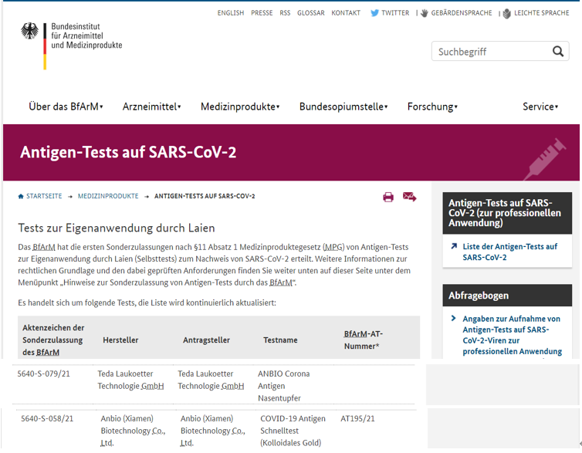
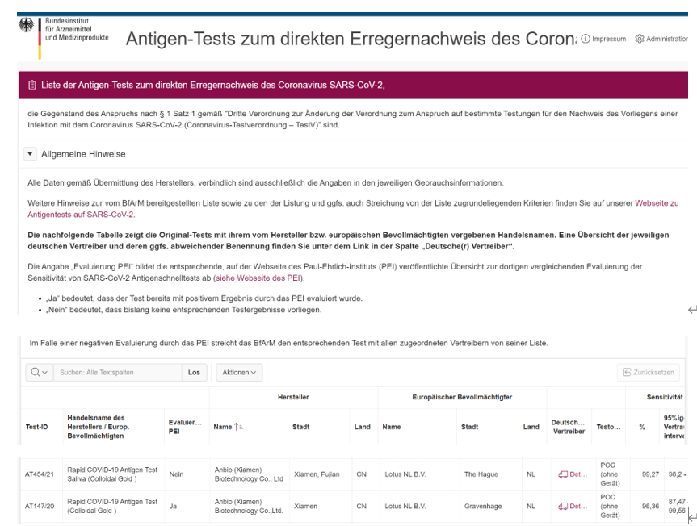
COVID19 Antigen test in Germany
BfArA List website of Professional Test in Germany:
https://antigentest.bfarm.de/ords/f?p=101:100:1985997517383:::::&tz=8:00
BfArA List website of Home Test in Germany:
https://www.bfarm.de/DE/Medizinprodukte/Antigentests/_node.html

Slide 20
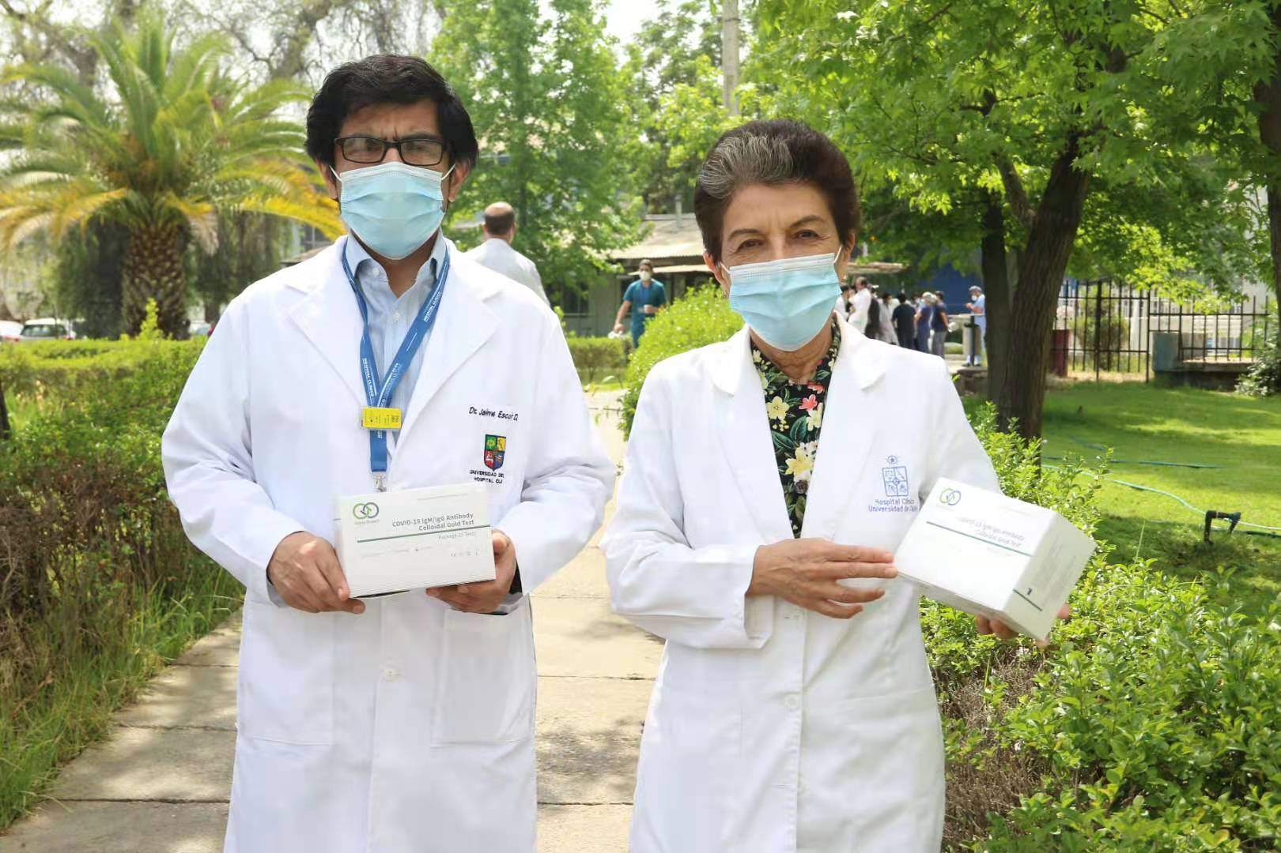
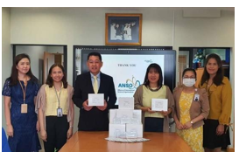
COVID19 Antigen test sales and donation in Germany
Our current sales in Germany: 150 million tests of home test reagents and 50 million tests of professional market reagents
At the same time we donated some home test reagents to Chile, Germany , Brazil, Thailand and so on.
Our orders for the next three months in Germany : 400 million tests of home test reagents and 100 million tests of professional market reagents

Slide 21
THANK YOU

