Slide 1
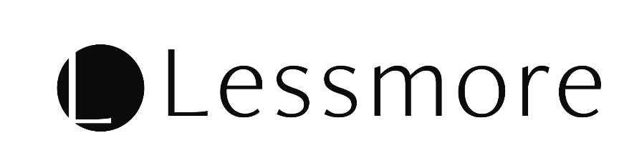


Top
Partner
Reputation
Blog
Estimate
Inquiry
Terms
Homepage using Subsidy
Subsidies can reduce costs by up to 67%
Project manager in Japan’s largest manufacturer proceeds as follows.

