Slide 1





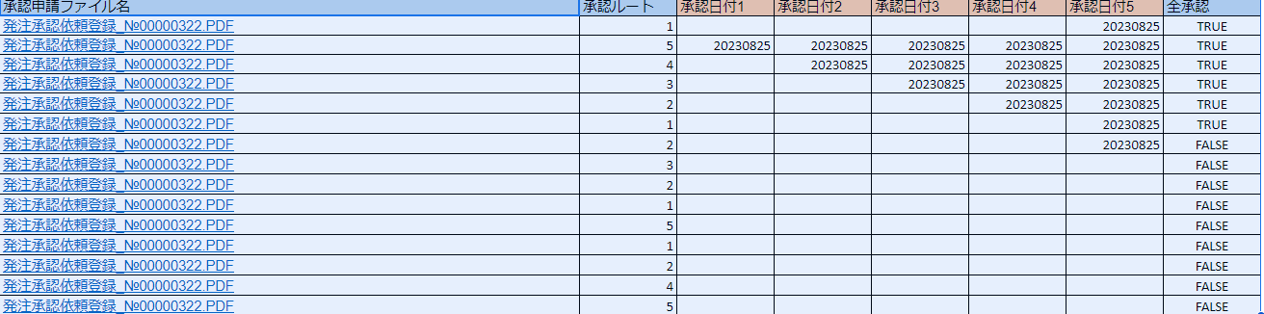
簡易Web申請フロー案
ファイルがアップロードされるたびに、 承認フロー画面にアップされる。
ファイル名は、以下の仕様は、以下の例です。
ファイル名の金額で、承認者のフローが変わります。図１
承認フローは、金額で承認者が、決まり、対象承認者に、メールで、承認URLを一斉送信、承認されたか、確認は、承認状況で確認
承認が完了（差し戻しも含む）次第、対象、ファイルをクラウド上から削除
承認された場合、CSVログの出力 図2
申請者
クラウドファイルサーバー
承認申請
承認者5名
承認状況
承認一覧
承認画面
承認依頼№0001
承認
承認依頼№0002
PDF
Excel or
スプレッドシート表示
差し戻し
図１
例）ファイル名
承認依頼_№00000305_事業所：C00_担当者：西村__20230519_金額:00000100000.PDF
発注金額が以下の場合
0から100000の場合、
承認者１のみ
100001から、200000
承認者１、２
200001から、500000
承認者１、２、３
500001から、1000000
承認者１、２、３、４
1000001以上
承認者１、２、３、４、５
承認依頼№0003
承認依頼№0004
・レスポンシブルデザイン
・承認状況日付で、わかる画面
・
・レスポンシブルデザイン
・承認一覧の承認依頼№ボタンを押下、して、承認画面に遷移
・レスポンシブルデザイン
・PDF、Excelなど、拡大、縮小ができる。
・承認、差し戻し処理が終われば、承認画面に戻る。
・承認されたら、承認依頼のPDF、Excelなどは、クラウドサーバーから削除される。
図２
"","","","","","","","承認完了","","00000000","","","","","","","","",00000336,"発注金額","0000000","0","20230627","20230625","20230624","20230623","20230622"
"","","","","","","","承認完了","","00000000","","","","","","","","",00000335,"発注金額","0000000","0","","20230625","20230624","20230623","20230622"
"","","","","","","","承認完了","","00000000","","","","","","","","",00000334,"発注金額","0000000","0","","","20230624","20230623","20230622"
"","","","","","","","承認完了","","00000000","","","","","","","","",00000333,"発注金額","0000000","0","","","","20230623","20230622"
"","","","","","","","承認完了","","00000000","","","","","","","","",00000332,"発注金額","0000000","0","","","","","20230622"

Slide 2
簡易Web申請フロー案
クラウドファイルにエクセルか、CSVをアップロード
差し戻しの場合もクラウドファイルから、対象ファイルの削除
承認処理
承認者５名
承認/差し戻し
CSVの作成
※１
承認完了の場合、承認ファイル（PDF,Excel等）の削除

