Slide 1



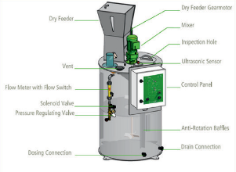
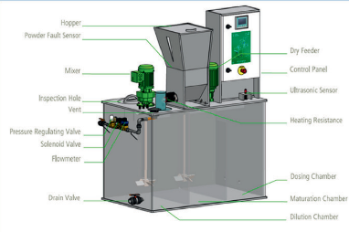
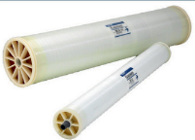
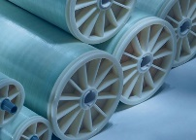
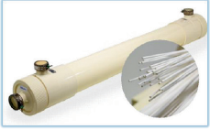
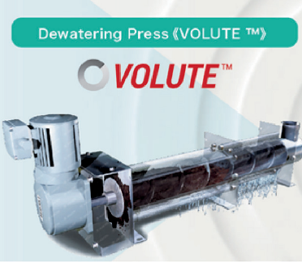
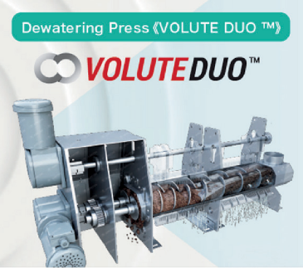

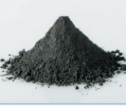
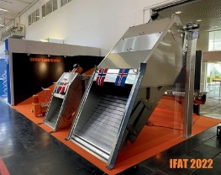
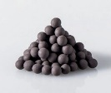

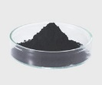
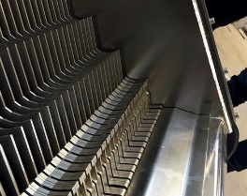
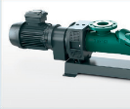

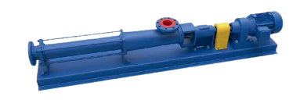
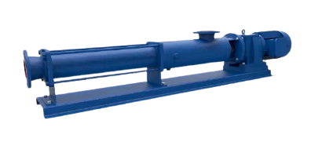


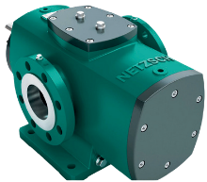

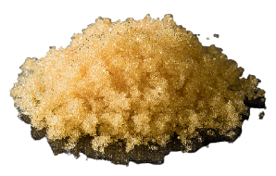

We offer a comprehensive range of membrane solutions tailored to diverse needs. From RO, NF, and UF membranes to advanced MBR technology, our innovative products ensure efficient and sustainable water treatment across various applications.
Granular Activated Carbon Powdered Activated Carbon Catalytic Processes Activated Carbon
Nanoparticle Activated Carbon For Electric Double Layer Capacitors
Photocatalytic Activated Carbon Activated Carbon for Respirators Magnetic Activated Carbon Activated Carbon Capsule
Strongly Acidic Cation – Exchange Resin Weakly Acidic Cation – Exchange Resin Strongly Basic Anion – Exchange Resin Weakly Basic Anion – Exchange Resin Fine Mesh (strongly basic anion – exchange resin) Fine Mesh (strongly basic anion – exchange resin) Chelate Resin
Specialty Ion – Exchange Resin Synthetic Adsorbent
Mixed Resin
Muromac Purified Resin
Polymer Preparation Systems
Batch Dilution Systems Measure and Control Ksense
Chlorine Dioxide Generator Dosing Skids
In – Line Systems Tanks
Mixers
AMCON PHILIPPINES PRODUCTS
Septic Sludge Receiver SSR Compact Combi Unit CCU Small Combi Unit SCU
Chain Scraper Skimmer CSS Progressive Stair Screen PSS Andersson Stair Screen ASS Channel Drum Screen CDS Through Flow Screen TFS
https://www.amcon-jp.com/ 09171049385 / 09171868266
09171446287 / 09628431028
amcon_philippine@amcon.co.jp
23F Tower6789 Ayala Avenue 6789, Makati City 1209 Manila, Philippines
CONTACT US
Progressing Cavity Pump
Progressing Cavity Pump
Multi Screw Pumps Grinding Systems Rotary Lobe Pumps Peristaltic Pumps Dosing and Emptying
Sludge Cake Pumps

Slide 2
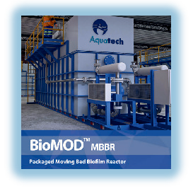

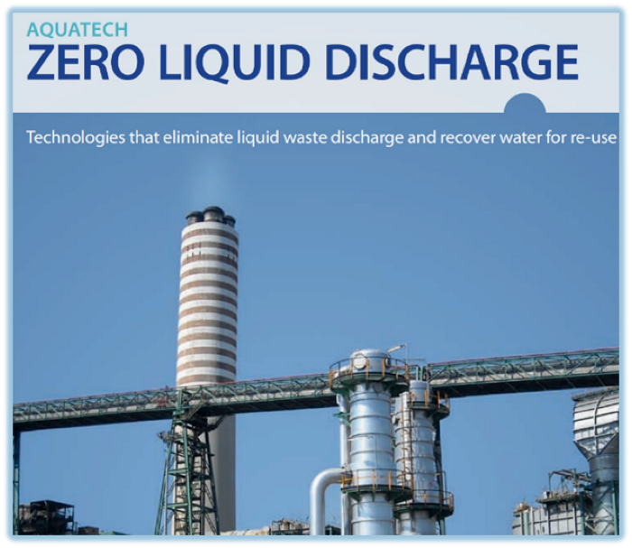


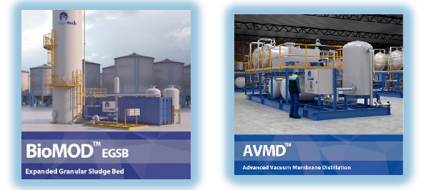
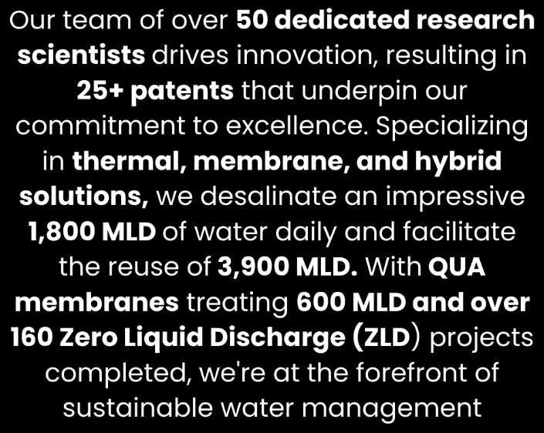
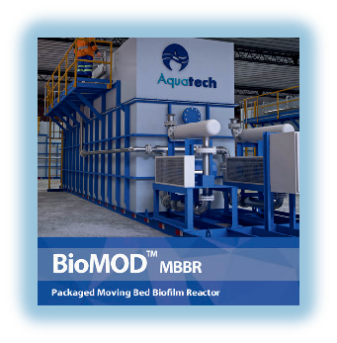
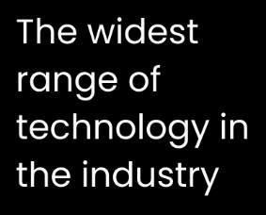
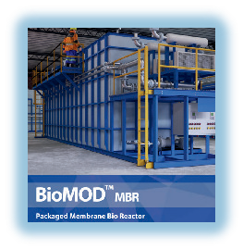
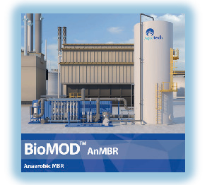
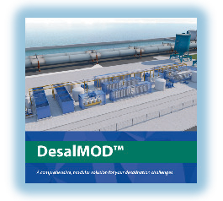
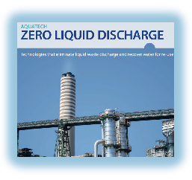


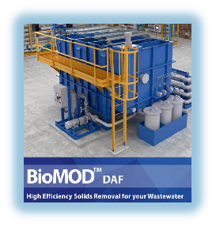






ABOUT US
Contact Us
Aquatech is a global leader in water technology and service that helps industrial and infrastructure markets solve water challenges
2000+ installations worldwide Global leaderin desalination 43+ years of innovation Presence across 60+ countries 50% Business from repeat customers
5 manufacturing facilities
650+ employees globally
Contact Us
09171049385 / 09171868266
09171446287 / 09628431028
amcon_philippine@amcon.co.jp
23F Tower Ayala Avenue 6789, Makati City 1209 Manila, Philippines
SUSTAINABLE MODULAR
E FICIENT
F

