Slide 1
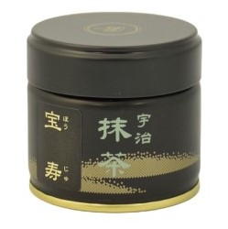
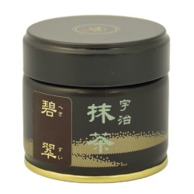
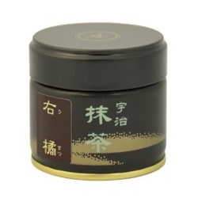
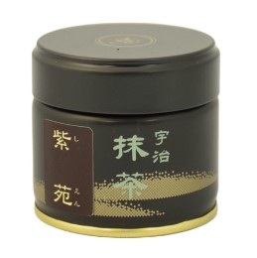

Non-organic Matcha Products
①提供可能な製品を全て記載し、一度に閲覧できるようにします。
②写真、製品・ブランド名、金額（単位）を記載し、
できるだけ端的に、商品PRを記載します。
③ピックアップしたい製品から上から並べましょう。
④製品数が増える場合は、このページをコピーして追加しましょう。
文字が小さすぎたり、多すぎない方が望ましいです。
Ceremonial Matcha
Ceremonial Matcha
Macha(Houjyu)
Weight :30g $70.9-$72.9/1peace
150g $340.3-$342.3/1pesce
Our top-grade matcha green tea
is made with a blend of tencha
(steamed green tea), which has
won top prizes at competitive
exhibitions, that is carefully
ground using a stone mortar.
Matcha(Hekisui)
Weight :30g $56.3-$58.3/1peace
150g $269.6-$271.6/1peace
It features an elegant, vibrant
aroma, rich flavor, and off-flavors
like bitterness and astringency
are barely noticeable. Its color is
reminiscent of bright, vivid fresh
greenery.
Ceremonial Matcha
Ceremonial Matcha
Macha(Ukitsu)
Weight:30g $41.8-$43.8/1peace
150g $198.9-$200.9/1peace
This tea is a blend of teas
entered in the tea competition
and rich-tasting tencha tea
harvested along the Kizugawa
River, then carefully ground in a
stone mill. Recommended for
those looking for a rich flavor.
Macha(Shien)
Weight:30g $34.5-$36.5/1peace
150g $163.5-$165.5/1peace
This matcha is placed between
Ukitsu and Tenko. It is made
from a wide range of hand-
picked tea leaves and has a
strong, rich flavor.
WEEup Co.,Ltd

Slide 2
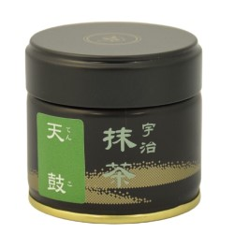
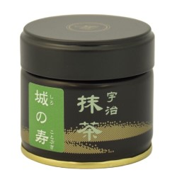
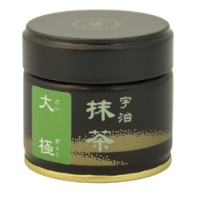
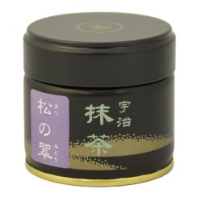
Premium Matcha
Premium Matcha
Matcha(Tenko)
Weigh: 30g $29.7-$31.7/1peace
150g $139.8-$141.8/1peace
300g $270.5-$272.5/1peace
Features a strong flavor with
depth. This product is particularly
popular as a matcha green tea
used for "koicha," a thick, dark
matcha used for Japanese
tea ceremonies.
Macha
(Shiro-no-kotobuki)
Weight :30g $24.3-$26.3/1peace
150g $113.5-$115.5/1peace
300g $219.5-$221.5/1peace
It is a slightly complex matcha
made from a blend of mainly
hand-picked and machine-picked
ingredients. It can be used as a
thick tea, but we recommend
using it as a thin tea.
Premium Matcha
Premium Matcha
Macha(Daigyoku)
Weight :30g $18.9-$20.9/1peace
150g $87.3-$89.3/1peace
300g $168.5-$170.5/1peace
Daigyoku is a product we are
proud of, with a good balance of
umami and bitterness. We
recommend this matcha to those
who are drinking matcha for the
first time.
Macha(Matsu-no-midori)
Weight :30g $15.0-$17.0/1peace
150g $68.5-$70.5/1peace
300g $132.1-$134.1/1peace
Matsu no Midori is a matcha with
a good balance of umami and
bitterness. (Compared to
Daigyoku, the umami is slightly
weaker and the bitterness is
slightly stronger.) It is a
particularly popular product as a
matcha for thin tea.
WEEup Co.,Ltd

Slide 3
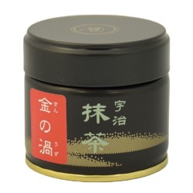
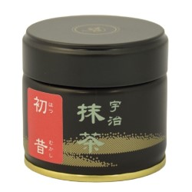
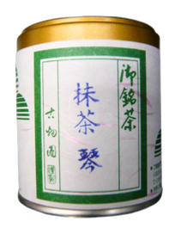
Cafe Matcha
Cafe Matcha
Macha(Kin-no-uzu)
Weight :30g $12.7-$14.7/1peace
150g $57.3-$59.3/1peace
300g $110.2-$112.2/1peace
This matcha has a light taste and
a subtle aroma.
Macha(Hatsu-mukashi)
Weight :30g $11.5-$13.5/1peace
150g $49.8-$51.8/1peace
300g $95.7-$98.7/1peace
Hatsu-mukashi is a matcha that
is easy to use and is suitable for
thin tea. It has a light texture and
aroma, and a relatively
refreshing taste.
Premium Matcha
Macha(Koto)
Weight :40g $43.70-$45.70/1peace
This matcha for the tea ceremony has a high level of harmony
between the color, taste, and aroma. It is a proud product that can
be used as a light tea or a thick tea. When you drink it, it is
characterized by the flavor and aroma that spreads in your mouth,
and the lingering flavor that remains in your mouth. A globally
recognized product. It won the highest gold award at the 2016
World Tea Union competition.
WEEup Co.,Ltd

Slide 4
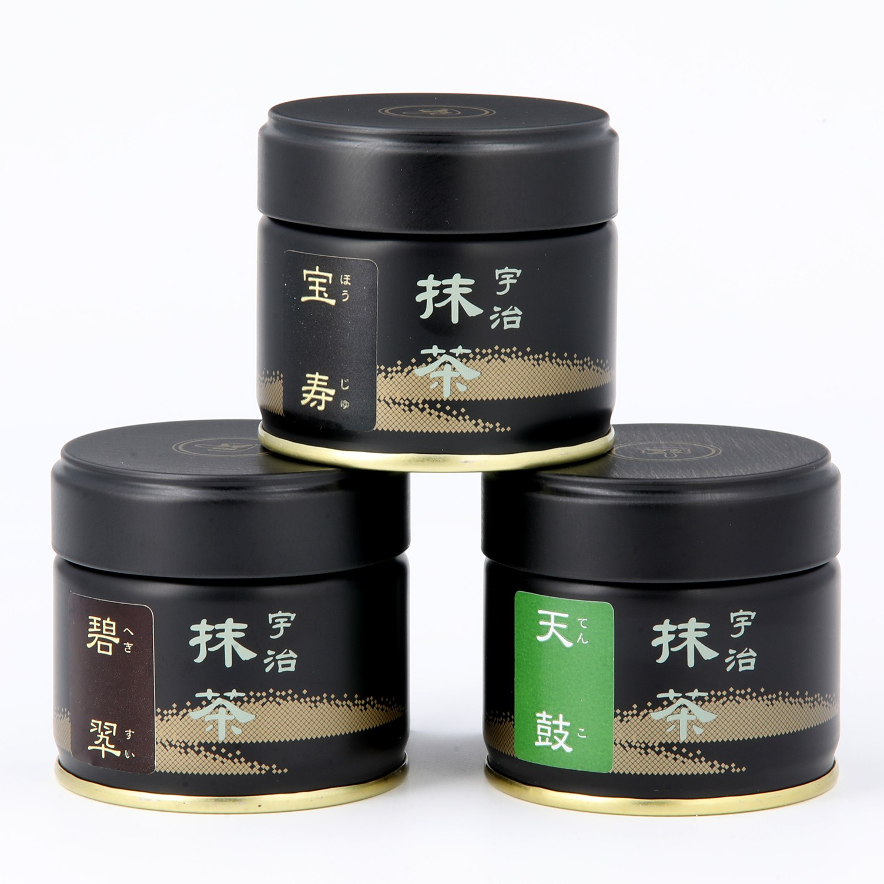
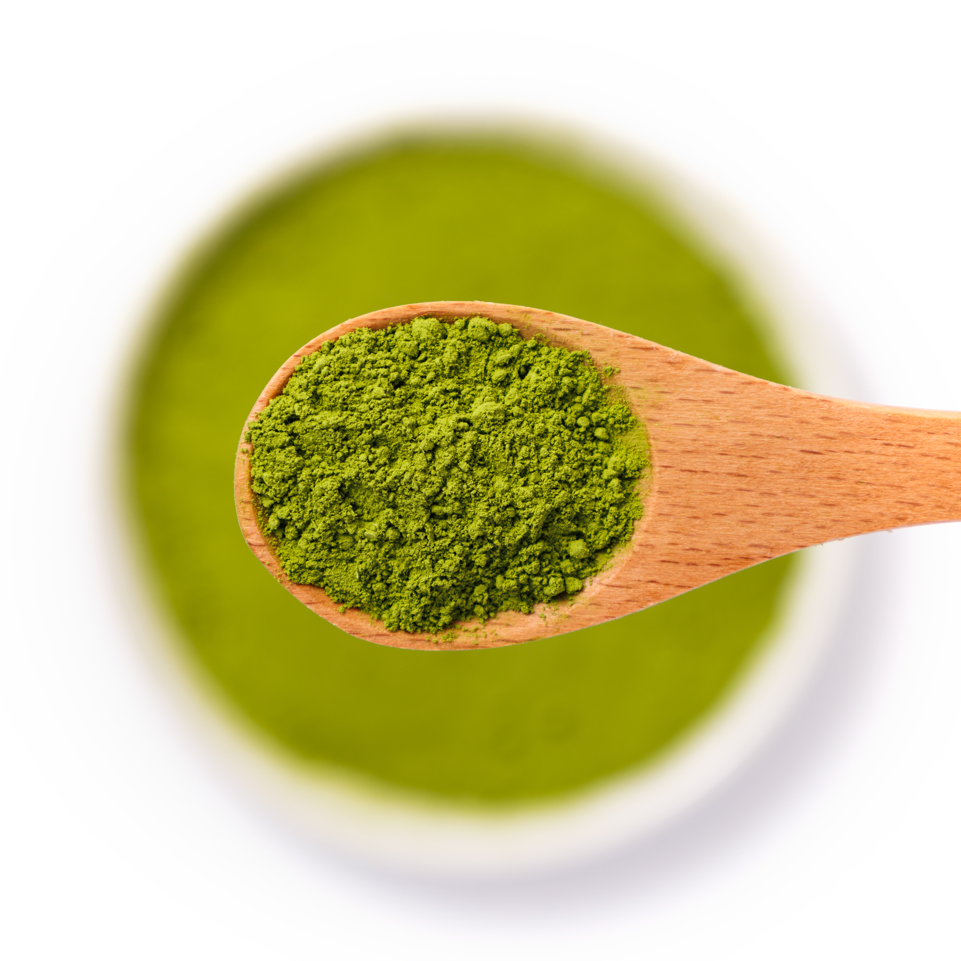
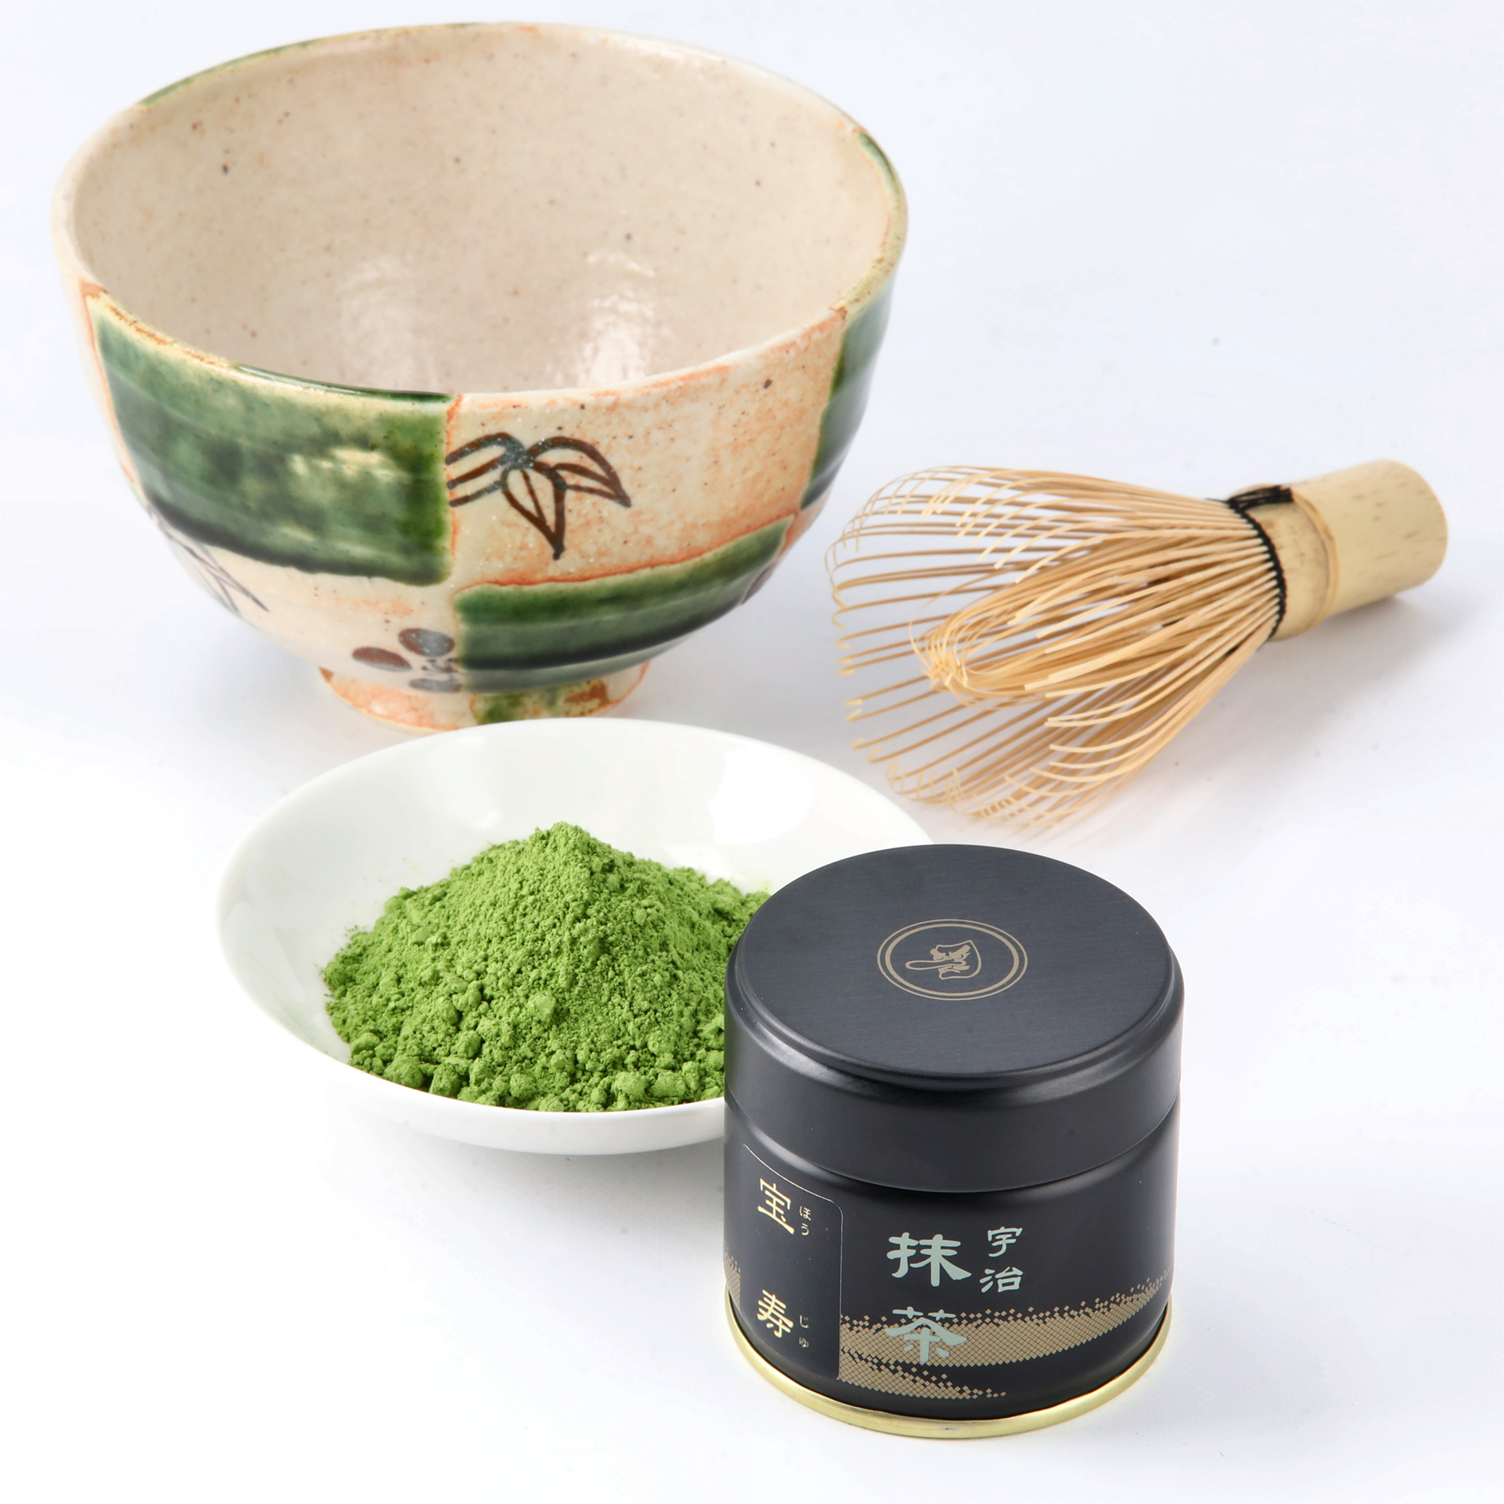
Non-organic Matcha Products
The health benefits of matcha
Benefits of Matcha 1. Prevents obesity
Matcha contains a lot of tea catechins, which help reduce the absorption of fat from the diet and burn body fat.
In addition, soluble dietary fiber is said to slow down the absorption of sugar, and insoluble dietary fiber helps relieve and prevent constipation.
The synergistic effects of these ingredients make matcha effective in preventing obesity and dieting.
Benefits of Matcha 2: Anti-aging
Tea catechins, found in large amounts in matcha, have a strong antioxidant effect. They work to remove active oxygen, which causes aging, and help prevent arteriosclerosis.
Like tea catechins, vitamin E has also been attracting attention for its antioxidant effects. It is said that matcha contains more vitamin E than almonds and taking it together with vitamin C increases its effectiveness. Matcha contains both.
Beta-carotene (vitamin A), which is found in large amounts in green and yellow vegetables such as carrots and spinach, is also a powerful antioxidant. Of course, matcha contains it too!
Benefits of Matcha 3: Relaxation effect
Theanine, a flavor component contained in matcha, has the effect of relaxing the mood and improving the quality of sleep. It is said to have 10 times more of this effect than sencha, so it might be a good idea to enjoy a cup of matcha on days when you want to relax.
Theanine also has the effect of slowing down the effects of caffeine, so it is recommended to drink it before going to bed. When you wake up, the caffeine will kick in, helping you feel more alert.
In addition, it has been found that the mellow aroma of matcha also has a relaxing effect.
WEEup Co.,Ltd

Slide 5
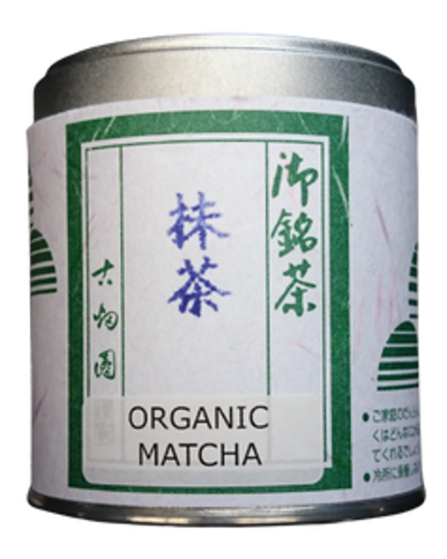
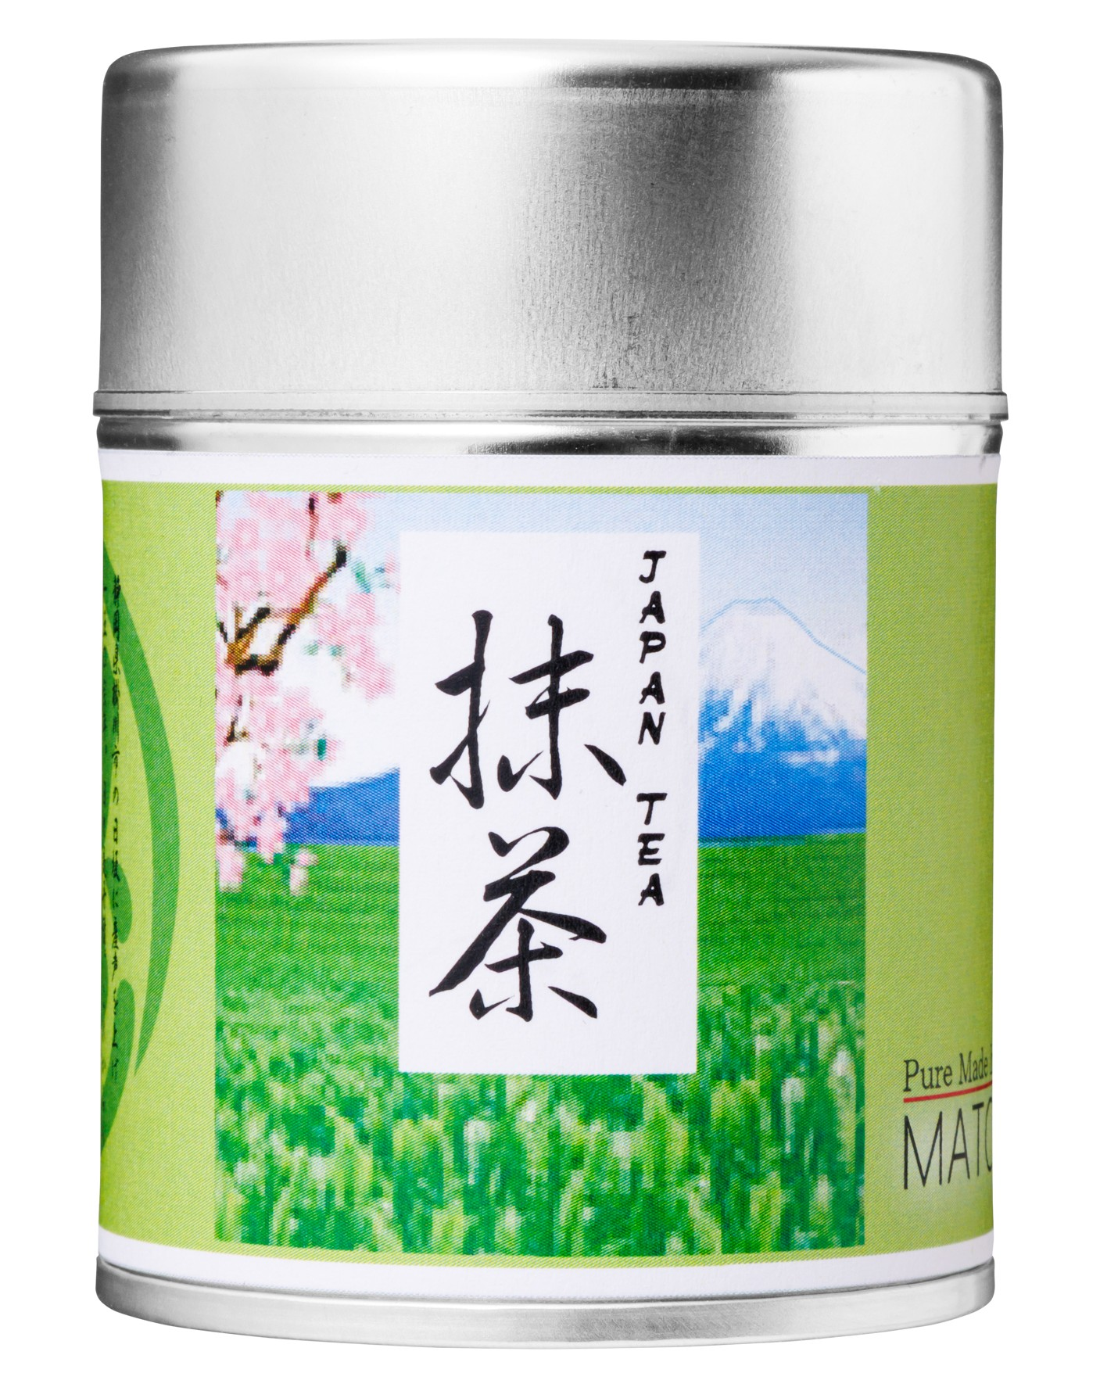
Organic Matcha Products
Premium Matcha
Organic Macha(KYOTO)
Weight :40g $17.40-$19.4/1peace
This is matcha made using organic farming, which still produces a
small amount of tea. The tea is grown under cover and dried
without rolling, and the stems and veins are removed before being
ground into powder using a stone mill. You can experience the
traditional, simple flavor and aroma that only organic farming can
provide, as well as the strength of the earth. In addition to
dissolving it in hot water and drinking it as matcha, you can also
use it to make sweets (bread, ice cream, cafe au lait, etc.).
Premium Matcha
Organic Macha(FUJISAN)
Weight :30g $8.9-$10.9/1peace
You can enjoy matcha at home.
This matcha is made using high-quality tencha tea with a vibrant
blue hue, and has a rich aroma and a strong sweetness.
It can be used to make matcha lattes, sweets, and as a topping for
ice cream, etc.
WEEup Co.,Ltd

Slide 6
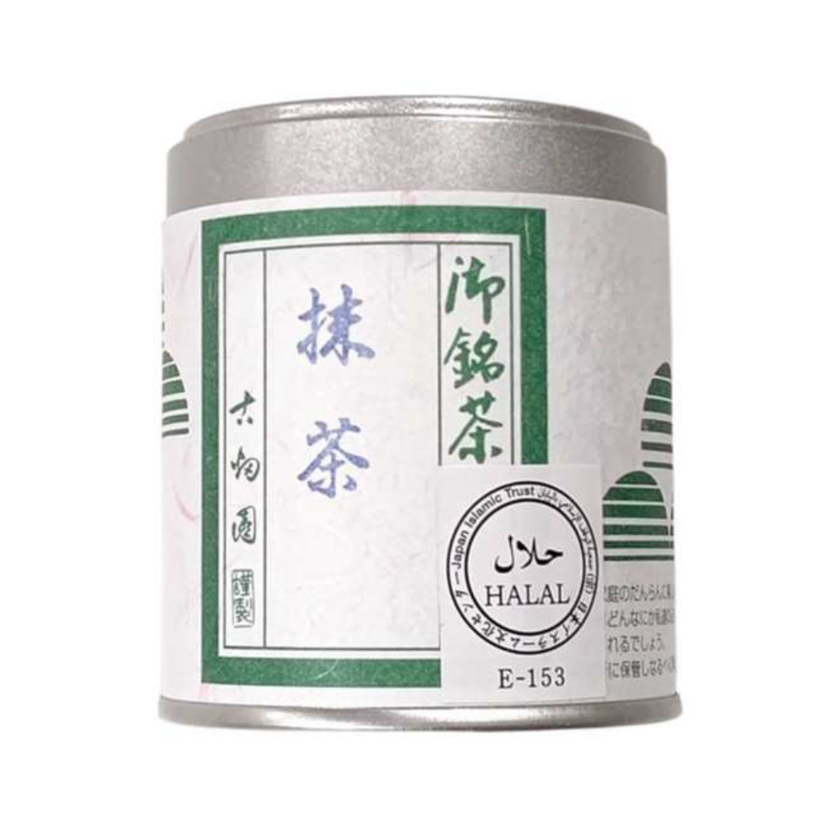
HALAL Matcha Products
①提供可能な製品を全て記載し、一度に閲覧できるようにします。
②写真、製品・ブランド名、金額（単位）を記載し、
できるだけ端的に、商品PRを記載します。
③ピックアップしたい製品から上から並べましょう。
④製品数が増える場合は、このページをコピーして追加しましょう。
文字が小さすぎたり、多すぎない方が望ましいです。
Premium Matcha
HALAL Macha(KYOTO)
Weight :40g $12.2-$14.2/1peace
Delicious and healthy,made with careful manufacturing
techniquesTea leaves (tencha) grown under cover are
dried, then ground in a precise stone mill to produce
powdered matcha.
By removing the stems and veins, a full-bodied aroma
and flavor with less unwanted flavors are created.
As the tea leaves are consumed as they are, they
contain healthy ingredients and are attracting attention
around the world.
The matcha in this product is halal certified.
WEEup Co.,Ltd

Slide 7
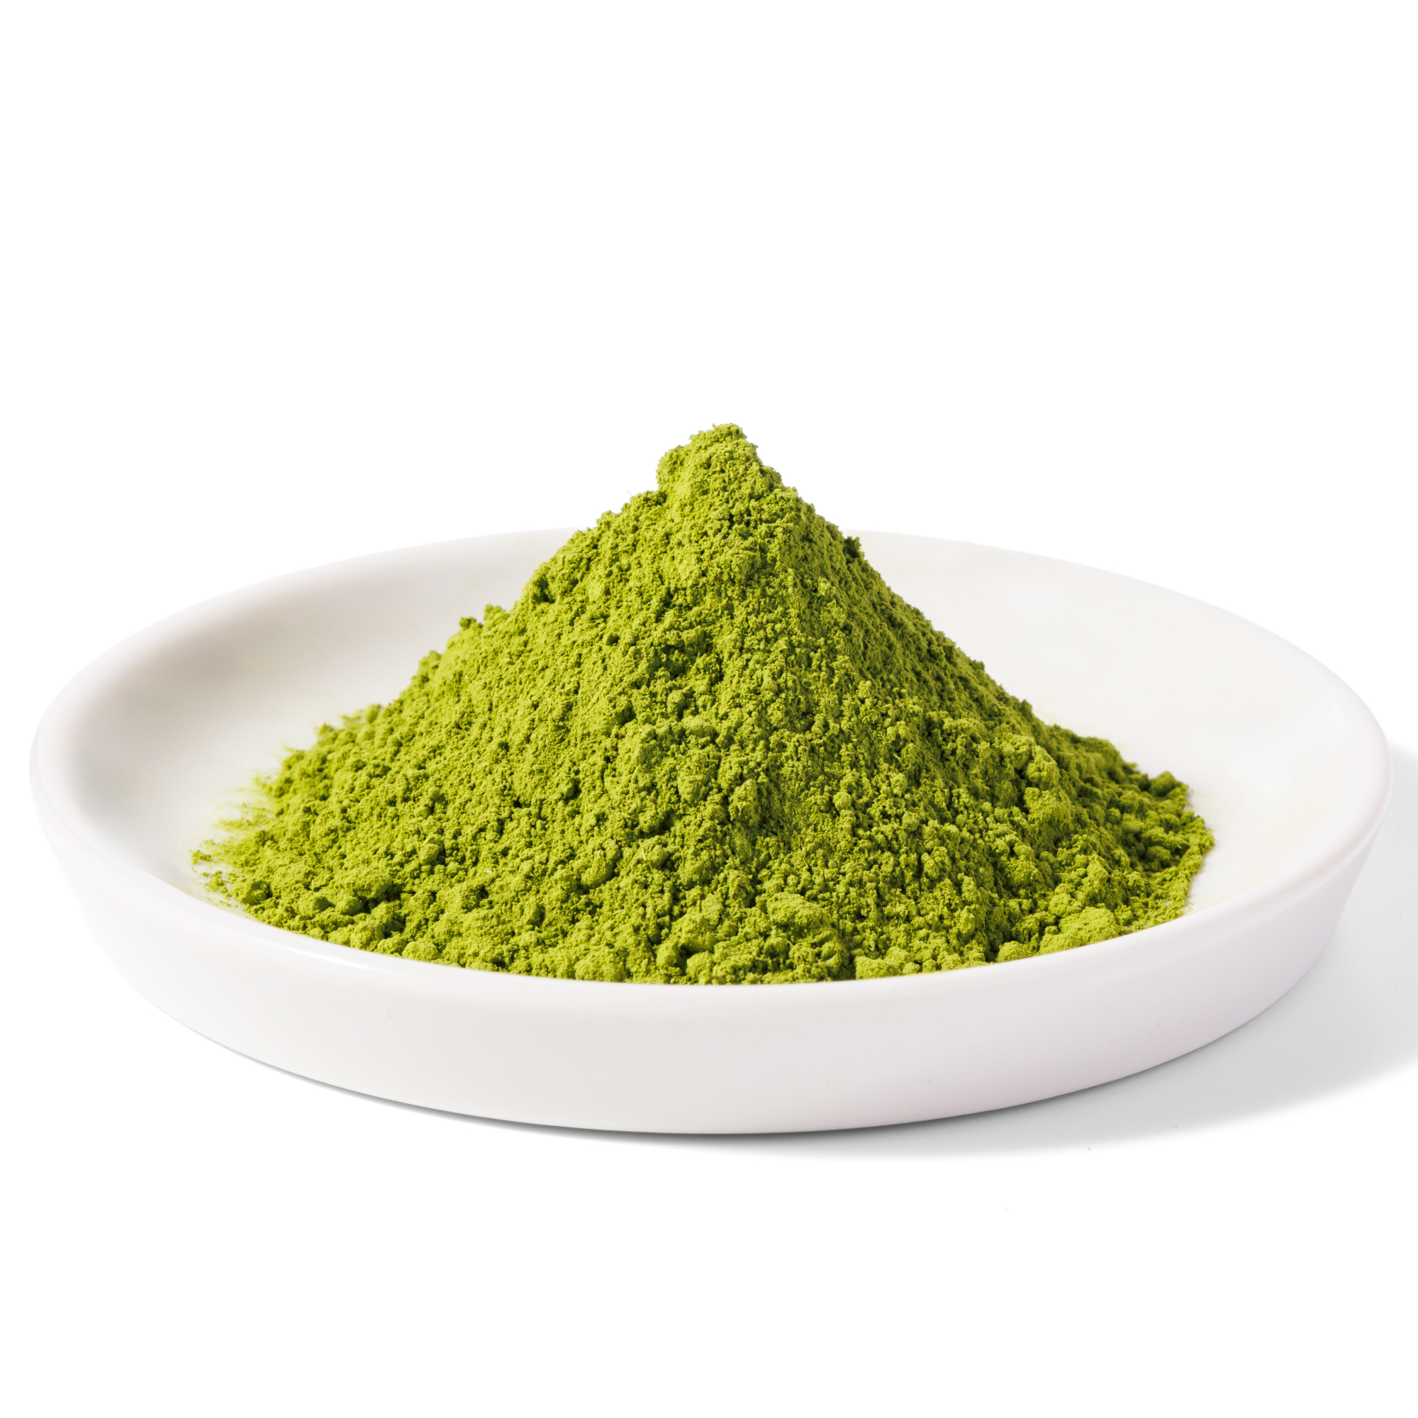
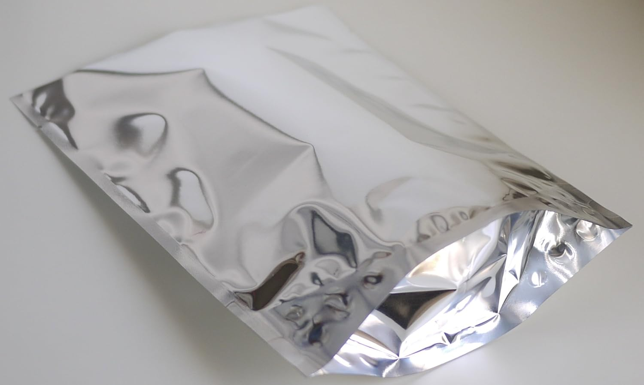
Organic Price list by kg
Origin | KYOTO Matcha | FUJISAN Matcha
Grade | Premium Grade | Premium Grade
Sales price | 1㎏/$250.8 | 1㎏/$194.3
MOQ | 10㎏ | 1㎏
WEEup Co.,Ltd

Slide 8
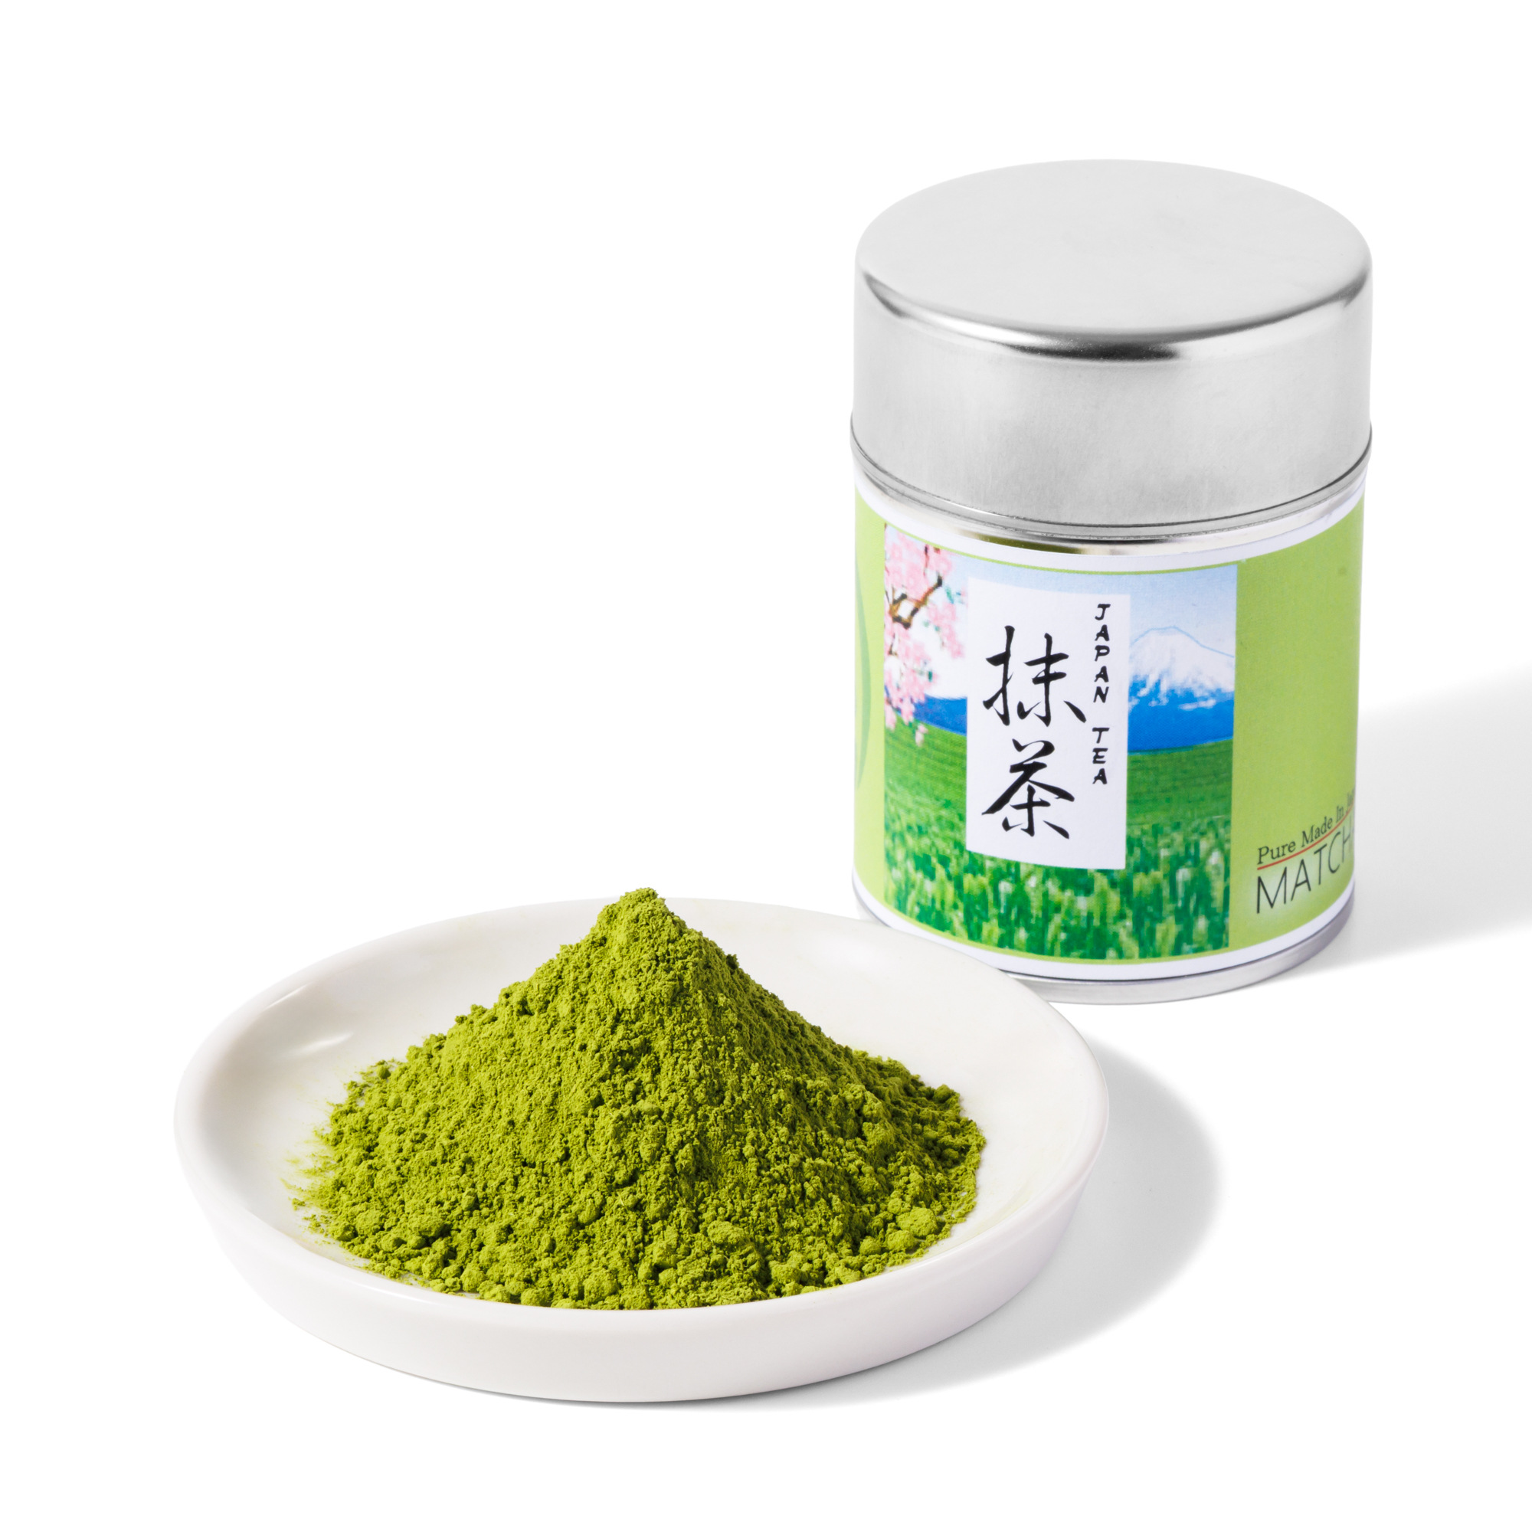
Non-Organic Price list by kg
Origin | KYOTO Matcha | FUJISAN Matcha
Grade | Premium Grade | Premium Grade
Sales price | 1kg/$231.5 | 1kg/$121.4
MOQ | 10㎏ | 1ｋｇ
Origin | KYOTO Matcha
Grade | Premium Grade | Premium Cafe Grade | Cafe Grade
Sales price | 1kg/＄147.9 | 1kg/$108.6 | 1kg/$74.3
MOQ | 10kg | 10kg | 20kg
WEEup Co.,Ltd

Slide 9
Non-Organic Price list by kg
Origin | ONSHITSU | SAGANO | TAKAMINE | SHIBANO
Grade | Premium Grade | Premium Grade | Premium Grade | Premium Cafe Grade
Sales price | 1kg/$205.8 | 1kg/$154.3 | 1kg/$115.8 | 1kg/$90.0
MOQ | 10㎏ | 10kg | 10ｋｇ | 10kg
Origin | KUMOGA BATAKE | KIYOTAKI | GENTAKU
Grade | Premium Cafe Grade | Cafe Grade | Cafe Grade
Sales price | 1kg/＄70.8 | 1kg/$57.9 | 1kg/$45.0
MOQ | 10kg | 10kg | 10kg
WEEup Co.,Ltd

