Slide 1
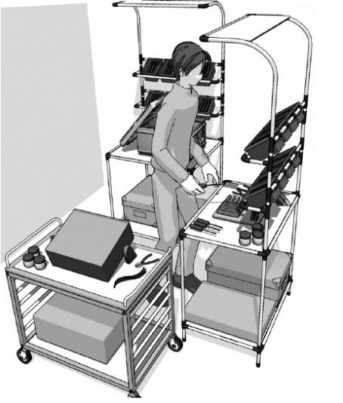
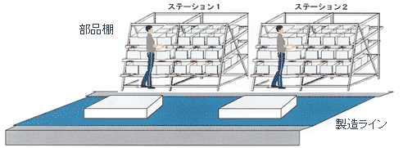
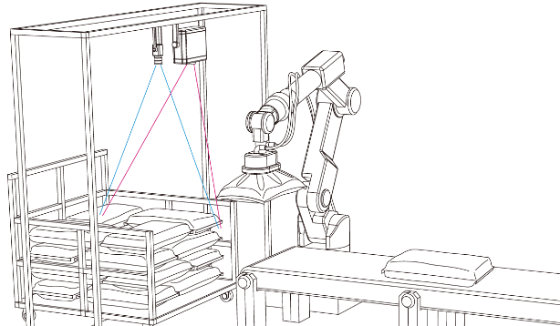
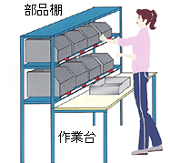

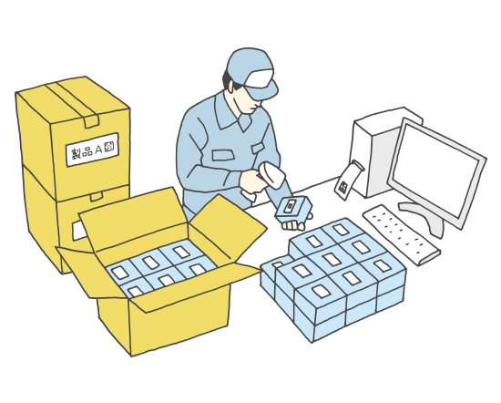
https://www.inrevium.com/product/trimath/
https://www.open-innovation-portal.com/university/buhinbako.html
https://business.atengineer.com/pic1/jirei1.htm
https://www.denso-wave.com/ja/adcd/katsuyou/scene/kojo_inner6.html
https://www.ac-illust.com/main/search_result.php?word=%E7%AE%B1%E8%A9%B0%E3%82%81%E4%BD%9C%E6%A5%AD

