Slide 1
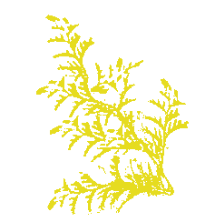


産地証明書
東濃ひのき
Species：
Origin：
Date：
Administrator：
Registration Number：
Japanese Cypress
Shirakawa, Kamo District,Gifu
2021/03/02
Tono hinoki timber industrial cooperative
030027

Slide 2

産地証明書
東濃ひのき
Species：
Origin：
Date：
Administrator：
Registration Number：
Japanese Cypress
Shirakawa, Kamo District,Gifu
2021/03/02
Tono hinoki timber industrial cooperative
030027

Slide 3

Certificate
of
Origin
東濃ひのき
This document certifies that the good is wholly obtained, produced, manufactured or processed in a particular district, Gifu prefecture.
Japanese cypress grown in Tono area is called Tono-hinoki, and famous for its quality in Japanese timber industry.
Its scent, appearance, and toughness is
one of the best timber in Japan.

