Slide 1
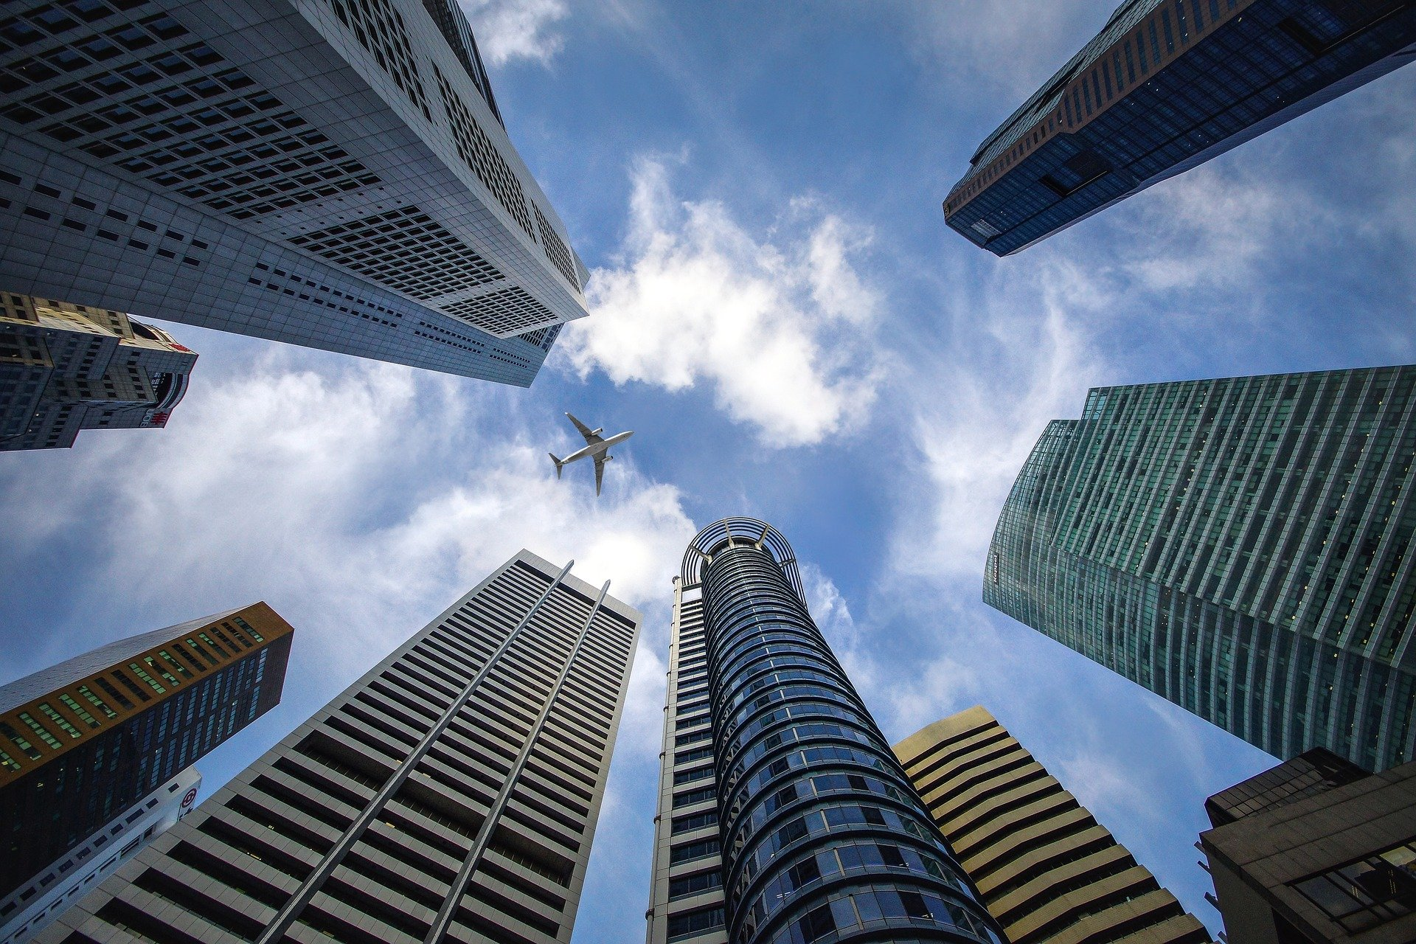
Company Profile

Slide 2

About __________________
Company Digest
Distributors and retailer
Brand in Nagasaki Japan
Annual sales in 2020:450000 USD

Slide 3

Our Mission
"Pursue only the real thing."
Our company finds good products from all over the world and
delivers them to Japanese customers.
We will deliver only really good products to all customers and peers.

Slide 4
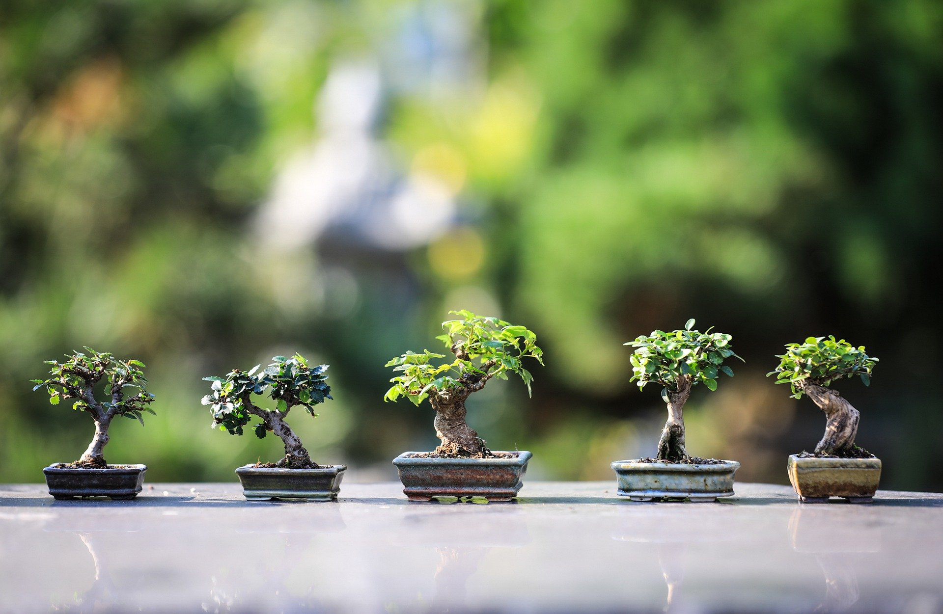
Our Management Policy
Product distribution and retail
To sell your products
With our __ years of experience, we promise the best results.

Slide 5



The Brands
We distributing
The world's smallest cutlery set
The best-selling disaster
prevention light in crowdfunding
Japan's smallest and smartest
projector

Slide 6
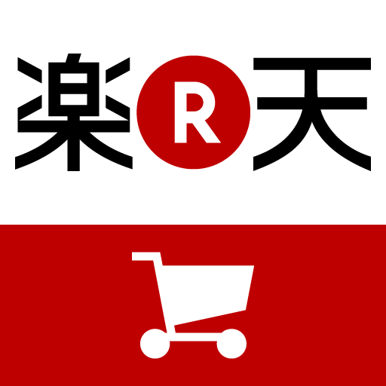








Our customers

Slide 7

Future Plans
Crowdfunding
Trending opportunity to products.
Expansion to Tokyo Gift Show
Introduce products to Japanese buyers.
Distribute
Introduce products to our existing customers
Retailing
Create a brand website in Japan

Slide 8
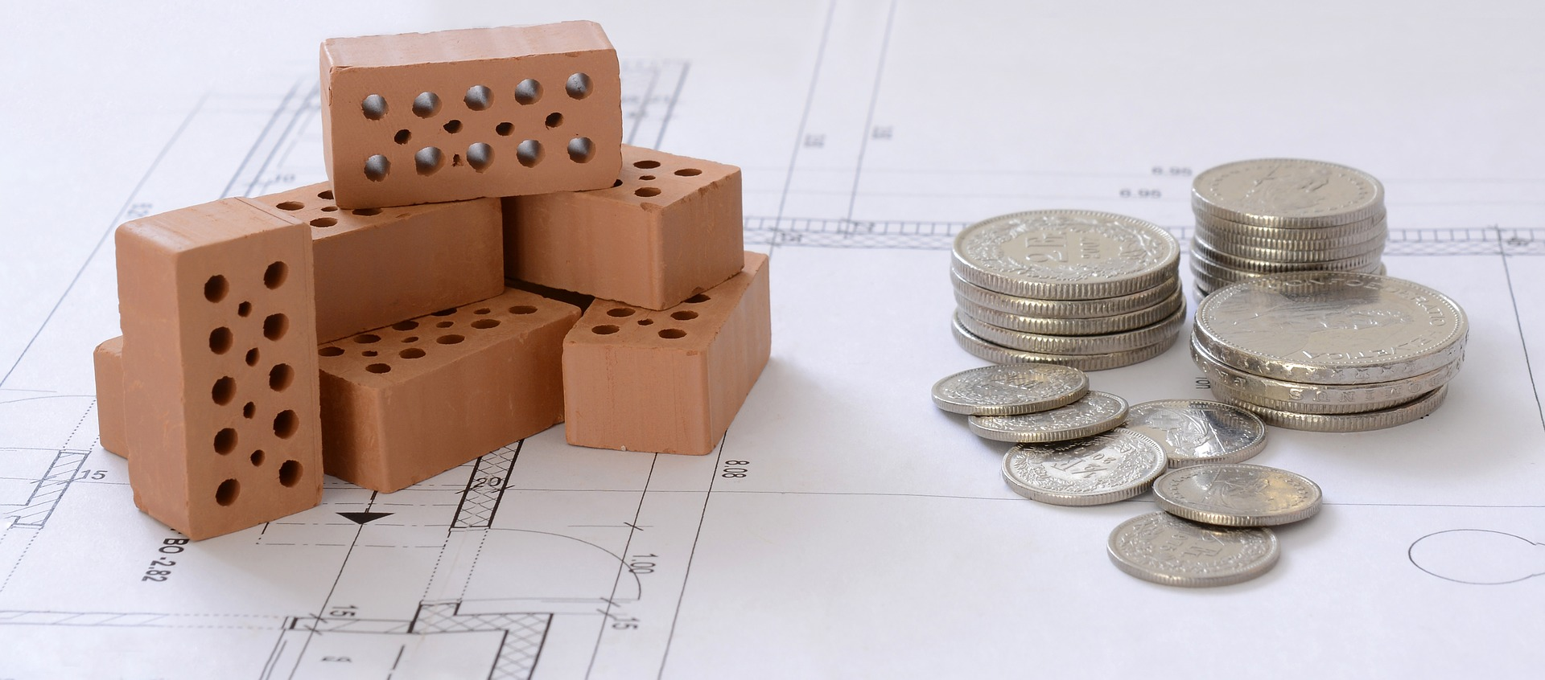
Why crowdfunding?
Crowdfunding is a great PR opportunity.
Many Japanese companies are paying attention.
Crowdfunding will be advantageous for subsequent sales.

Slide 9


_________
×
Strong connection
Makuake is our partner and the largest crowdfunding site in Japan.
We have many successful projects at Makuake.

Slide 10

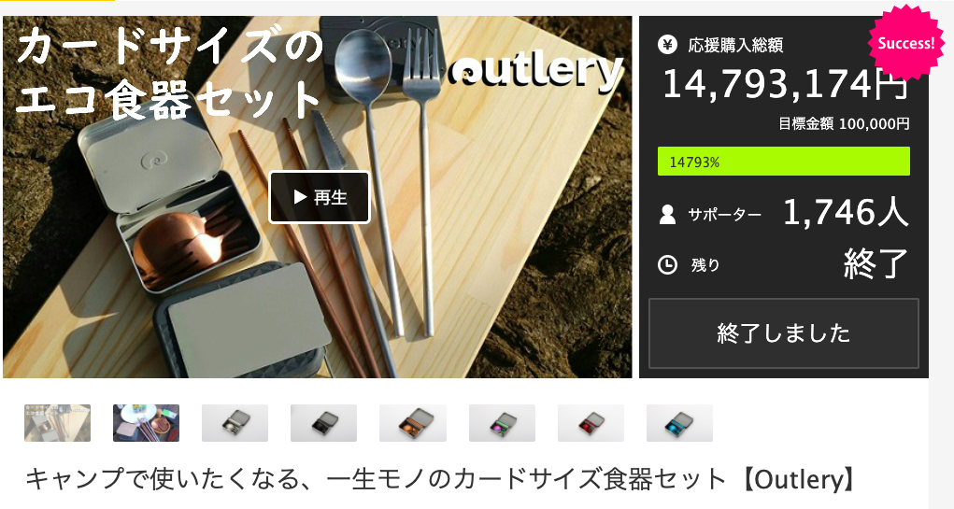
CASE

Slide 11
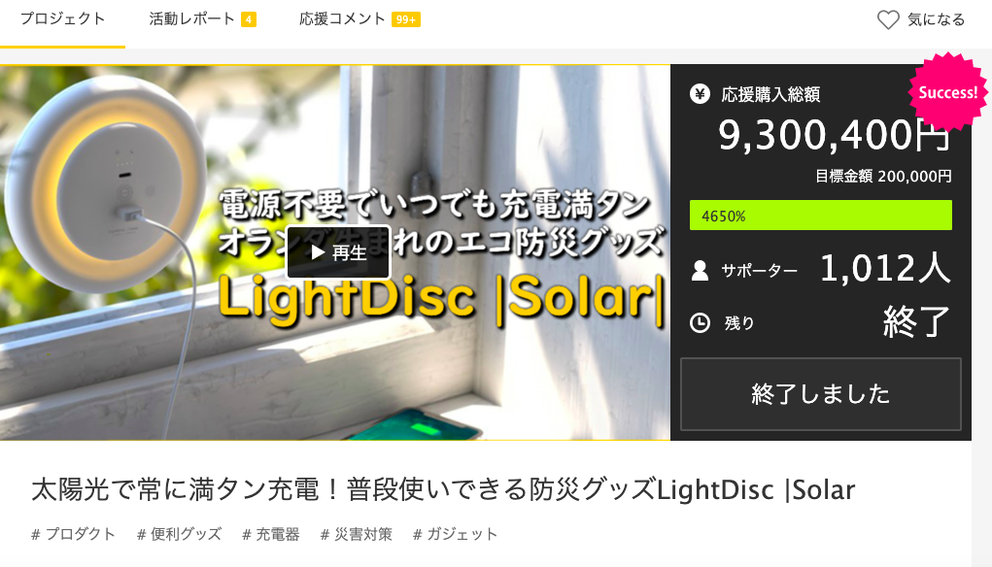

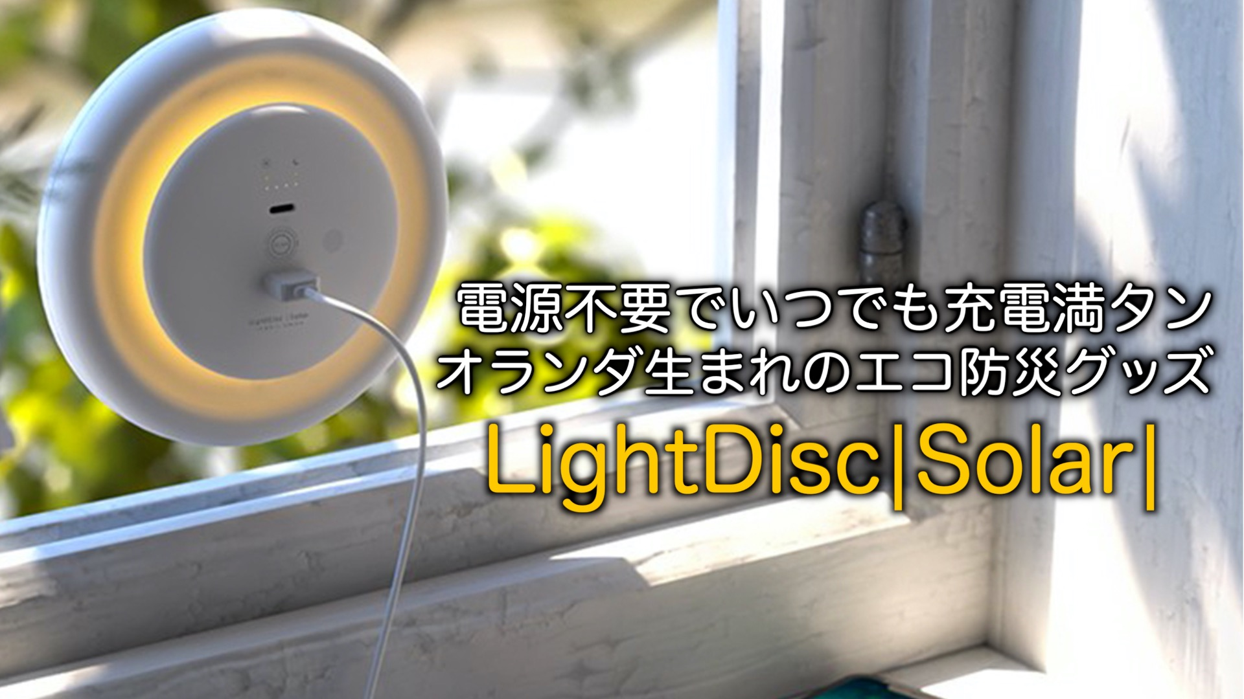
CASE

Slide 12
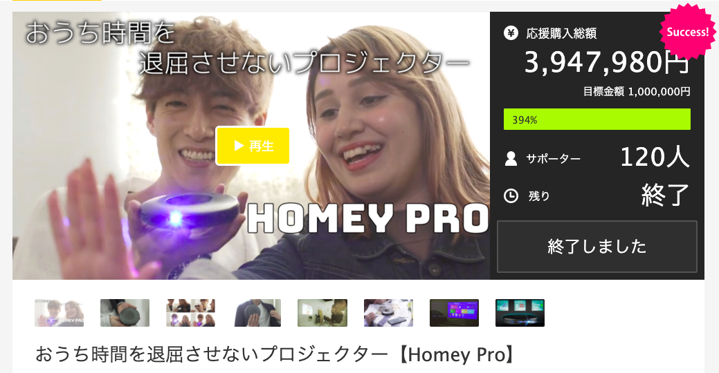
CASE

Slide 13
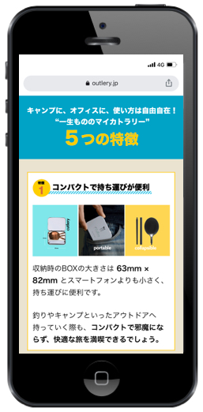
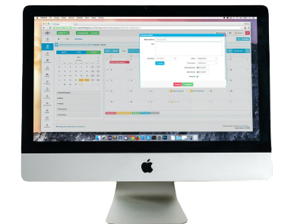
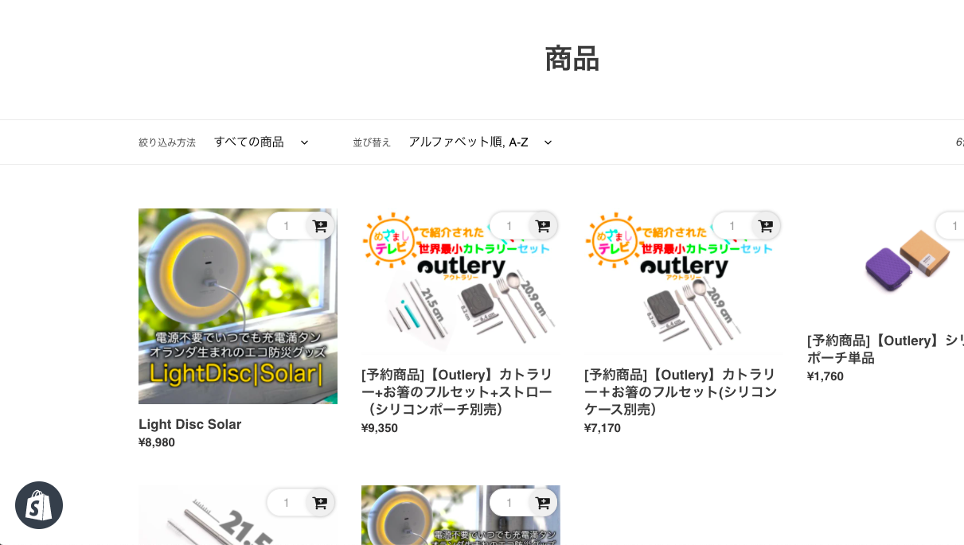
Retailing
Create a branded website and sell it directly to your customers.

Slide 14
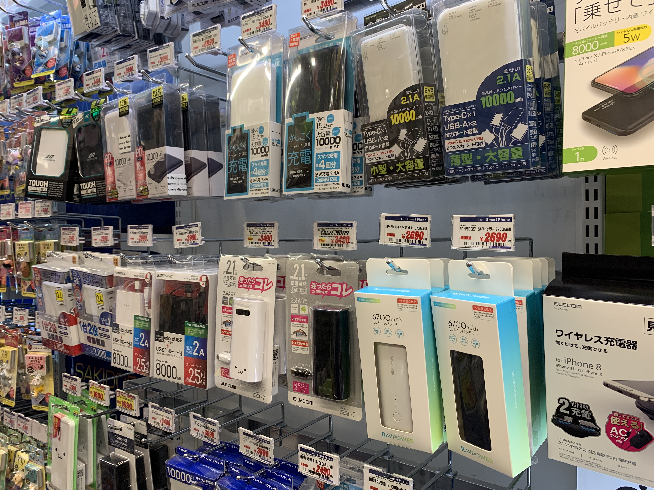
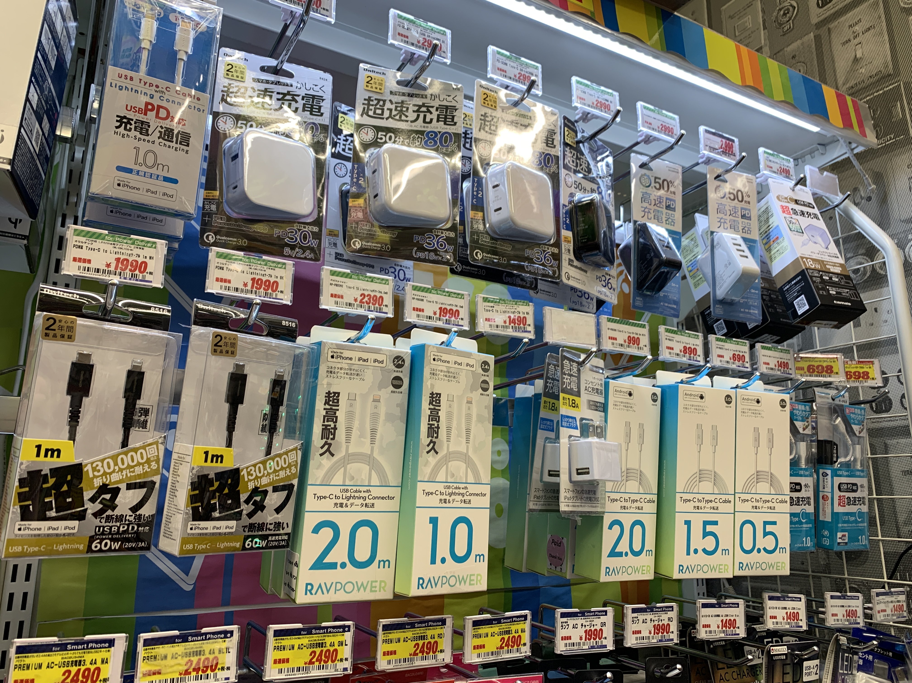
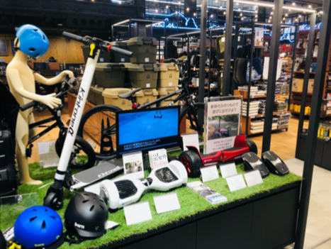
Distributing
Distribute to our potential customers

Slide 15

Company information
Nagasaki Japan
NAME
sb-advance
Tel: +8150 7108 5144
Email: crowdfunding2021advc@gmail.com
1201-30，kureishibaru-machi，
shimabara-city，Nagasaki，
855-0026，JAPAN

