Slide 1
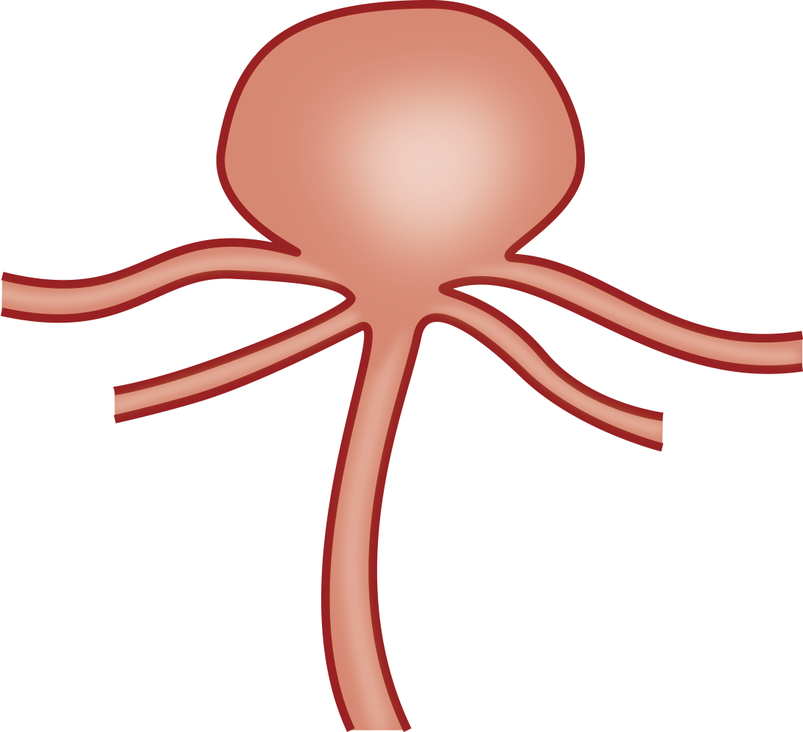
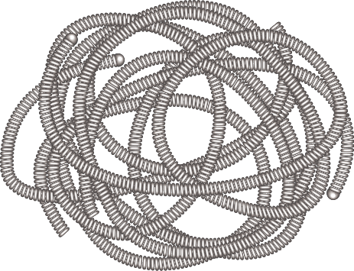
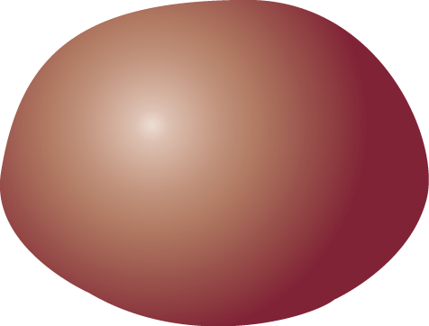
Coil embolization
Ruptured cerebral aneurysm
Coil
Notes:
Let`s move on the concept of Statin eluting coil.
First coil embolization, next thrombus formation, third drug release, fourth drug invades surrounding tissue,
finally complete organization and neck endothelialization will be achieved.
This is our concept.

Slide 2
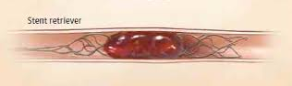
Mechanical thrombectomy

