Slide 1
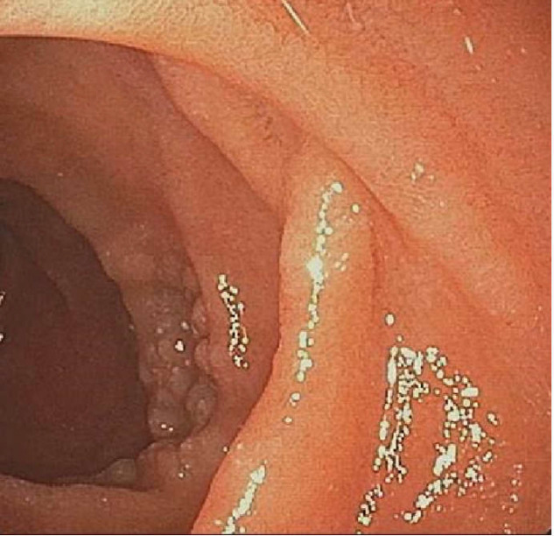
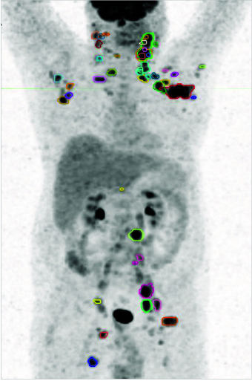
Figure 2. Integrated assessment and treatment algorithm for gastrointestinal follicular lymphoma
Clinical, molecular and microenvironmental factors guide risk stratification and treatment selection.
Clinical assessment
Molecular and genetic features
Tumour microenvironment / immune context
Patient-related factors
(disease extent and symptoms)
(tumour-intrinsic biology)
• Ann Arbor / Lugano stage
• Gastrointestinal extent (solitary vs multifocal)
• Nodal involvement
• Bone marrow involvement
• Symptoms / tumour burden
• Prior treatment history
• BCL2 rearrangement (t(14;18))
• Mutations (EZH2, CREBBP, EP300, KMT2D, etc.)
• BCR signalling pathway activity
• Additional genomic alterations
• Use molecular markers only where clinically validated
• Immune cell composition (Tfh, T cells, macrophages, etc.)
• Immune checkpoint expression
• Cytokine / chemokine milieu
• Microenvironmental support
• Age / performance status
• Comorbidities
• Patient preference
• Organ function
• Risk of treatment toxicity
• Access to specialised therapy
• Quality-of-life considerations
GI
DNA
TME
Pt
Integrated risk stratification and treatment requirement
Stage + biology + microenvironment + patient factors
Low-risk / localised disease
Intermediate-risk disease
High-risk / systemic-treatment-eligible disease
(no systemic treatment requirement)
(multifocal or locally advanced)
(advanced, relapsed/refractory, or transformed)
Typical scenario
Typical scenario
Typical scenario
• Localised, limited gastrointestinal lesions
• Stage I–II (usually)
• Asymptomatic or minimal symptoms
• Low tumour burden
• Multiple gastrointestinal sites
• Stage I–III
• Variable symptoms / tumour burden
• Selected patients with nodal involvement
• Extensive gastrointestinal involvement
• Nodal and/or bone marrow disease
• Stage III–IV
• Relapsed or refractory disease
• Histological transformation
• Symptomatic / high tumour burden
Management
Management
Management
• Observation in selected cases
• Endoscopic or local management where appropriate
• Radiotherapy in selected cases
• Individualised approach
• Anti-CD20 antibody where indicated
• Immunochemotherapy or R² according to indication
• Validated targeted therapy in selected systemic FL settings
• Systemic FL-directed therapy
• Anti-CD20 / immunochemotherapy / R²
• Targeted agents according to established indications
• CD20 × CD3 bispecific antibodies
• CAR-T-cell therapy in eligible patients
• Clinical trial enrolment
Organ-preserving / less intensive therapy
Therapeutic strategy adapted to disease extent and treatment requirement
Systemic / novel immunotherapies
Therapeutic convergence does not imply a proven biological transition between GI-FL and nodal FL.

