Slide 1
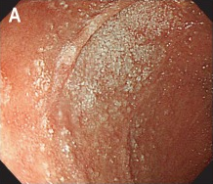
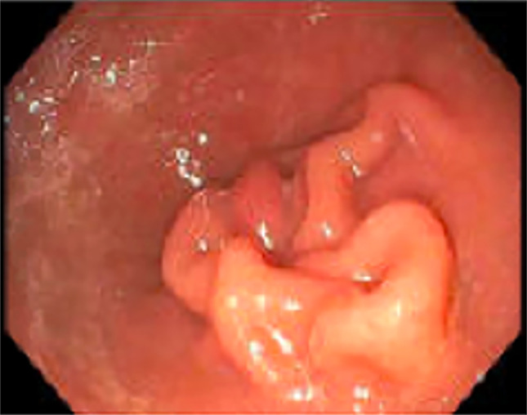
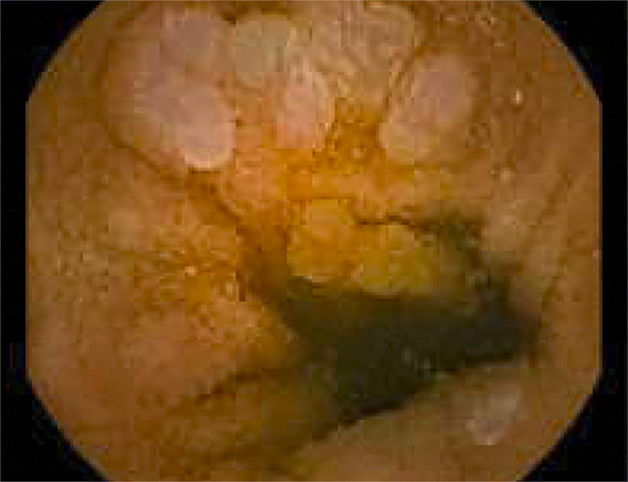
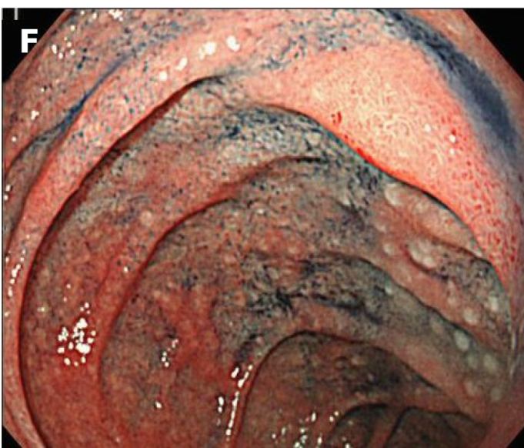
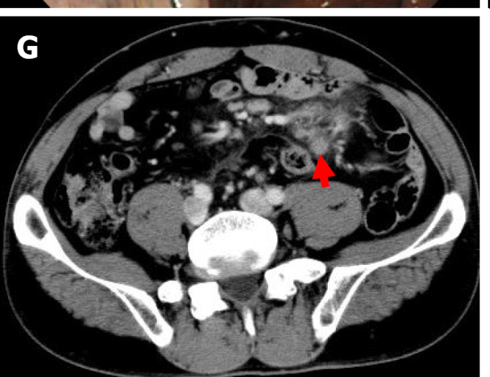
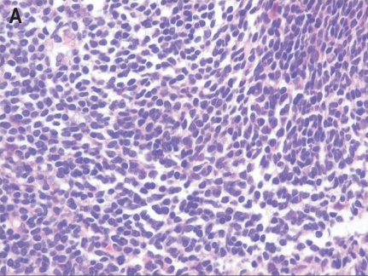
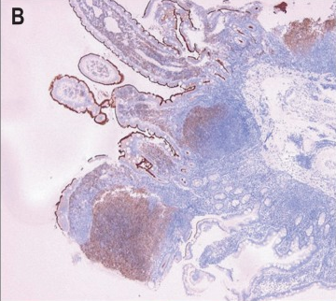
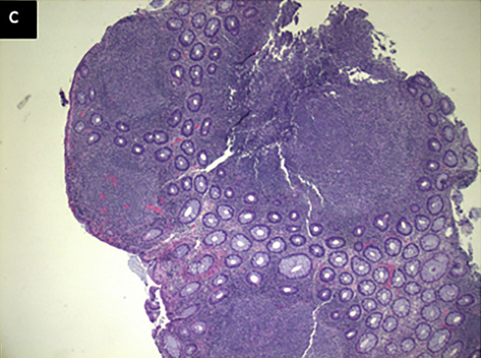
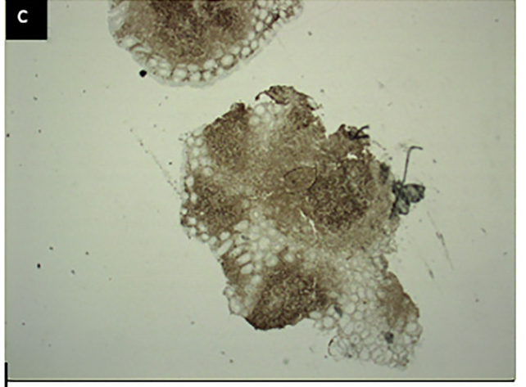
Figure 1. Spectrum, biology and therapeutic positioning of gastrointestinal follicular lymphoma
Distinct clinical presentations with partially overlapping biology; no direct biological transition is implied.
Localized duodenal-type FL
Multifocal / intestinal GI-FL
Advanced / systemically involved GI-FL
Anatomical
presentation
(typical)
(WHO/ICC-defined entity)
(broader clinical entity)
(including nodal, bone marrow, or disseminated disease)
Duodenum
Jejunum
Duodenum (F)
Mesenteric LN CT (G)
Histology
Case 3: Saito et al., WJGO 2022, Fig. 1F–G
H&E / IHC
(Iwamuro 2013)
H&E
IHC
Colonic FL biopsy
(Garcia 2023)
Stage IV • Grade 1 • Bone marrow involvement
Key features
Mesenteric LN biopsy positive; marrow FISH positive
• Predominantly localised (stage I–II)
• Excellent long-term prognosis
• Distinctive phenotype (IgA+ / CD27+)
• Low tumour burden
• Multiple gastrointestinal sites
• May be localised or regionally advanced
• FL-typical genetic alterations
• Heterogeneous molecular landscape
• Extensive GI ± nodal / marrow disease
• Advanced stage, relapse or transformation may occur
• FL-typical molecular alterations
• Greater clinical and molecular heterogeneity
Key signalling
pathways
Partially overlapping biological features
BCR signalling (relatively low activity)
BTK PI3K NF-κB MAPK
BCR signalling (variable activation)
BTK PI3K NF-κB MAPK
BCR-related signalling pathways
BTK PI3K NF-κB MAPK
Genetic / epigenetic
landscape
BCL2 rearrangement (t(14;18))
EZH2 / CREBBP / EP300 alterations may occur
BCL2 rearrangement (t(14;18))
EZH2 CREBBP KMT2D EP300
BCL2 rearrangement and recurrent epigenetic alterations
No stepwise molecular progression is assumed
Tumour
microenvironment
Relatively preserved immune architecture
Heterogeneous immune composition
Immune-modulated / dysfunctional TME may occur
Typical therapeutic
approach
Observation or local therapy
Individualised approach
Systemic FL-directed therapy
selected localised disease
stage, symptoms, burden and validated biology
according to established systemic FL indications
Clinical and biological heterogeneity — not a linear progression
• Localized DTFL, multifocal intestinal GI-FL and advanced/systemically involved GI-FL are distinct clinical presentations with shared but non-identical biological features.
• The apparent rarity of advanced GI-FL may partly reflect ascertainment, referral and classification biases.
• Therapeutic convergence occurs at the level of treatment requirement, not because of proven biological transition.
Localized
DTFL
Multifocal
GI-FL
Advanced
GI-FL
Overlapping biology ≠ direct transition

