Slide 1
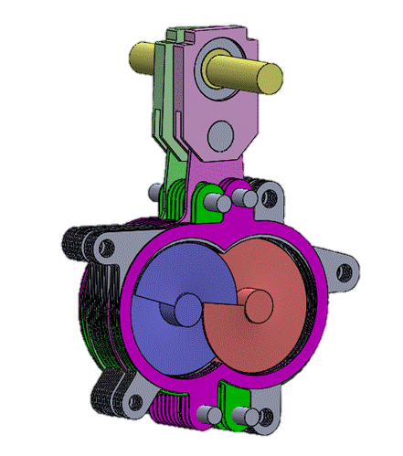
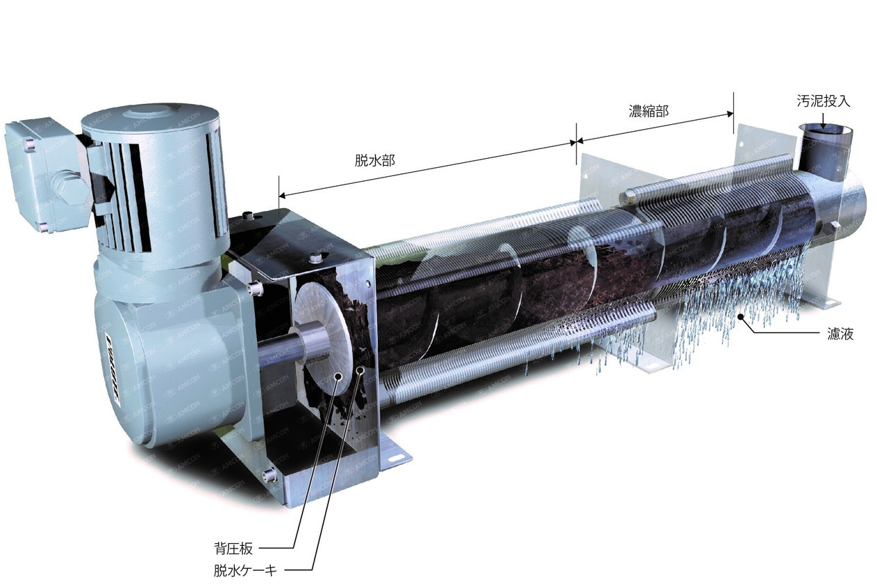
VOLUTE DUO Performance Potential
Features of VOLUTE DUO
Features of VOLUTE (1–axis)
Keep the same advantages of 1-axis VOLUTE
The screws and rings do not come into contact with each other, thereby reducing the production of metal particles.
The twin screw features of the equipment provide advantages for fiber-rich, raw wastewater and sludge
→ which enable dewater them without chemicals (coagulant, polymer etc.) or a screen.
Equipped with a self-cleaning mechanism for the filter medium, it enables continuous operation without relying on cleaning water.
It is capable of dewatering a wide range of sludge, from oily sludge to low-concentration sludge.
This is opening up a potential for installation in a wider range of industries such as:
1. Industries recycle solids or liquid (any types of sludge)
\\
It is also possible to reuse the separated liquid and solids due to the small amount of large metal debris contained in the solid-liquid separation material.
2. Industries produce oil and fiber rich sludge (includes Raw Wastewater)
\\
It is possible to operate the equipment stably without performance degradation, thanks to the self-cleaning mechanism and two screws that prevent clogging and blockages. Also serve as a primary treatment for raw water process.
3. Industries produce high concentration of sludge(Liquidity is required)
\\
One of the distinctive features of VOLUTE is its ability to process not only low-concentration sludge (TS: 0.2%), but also high-concentration sludge (TS: 10% or higher) with high viscosity (prone to sticking) without clogging issues.

Slide 2
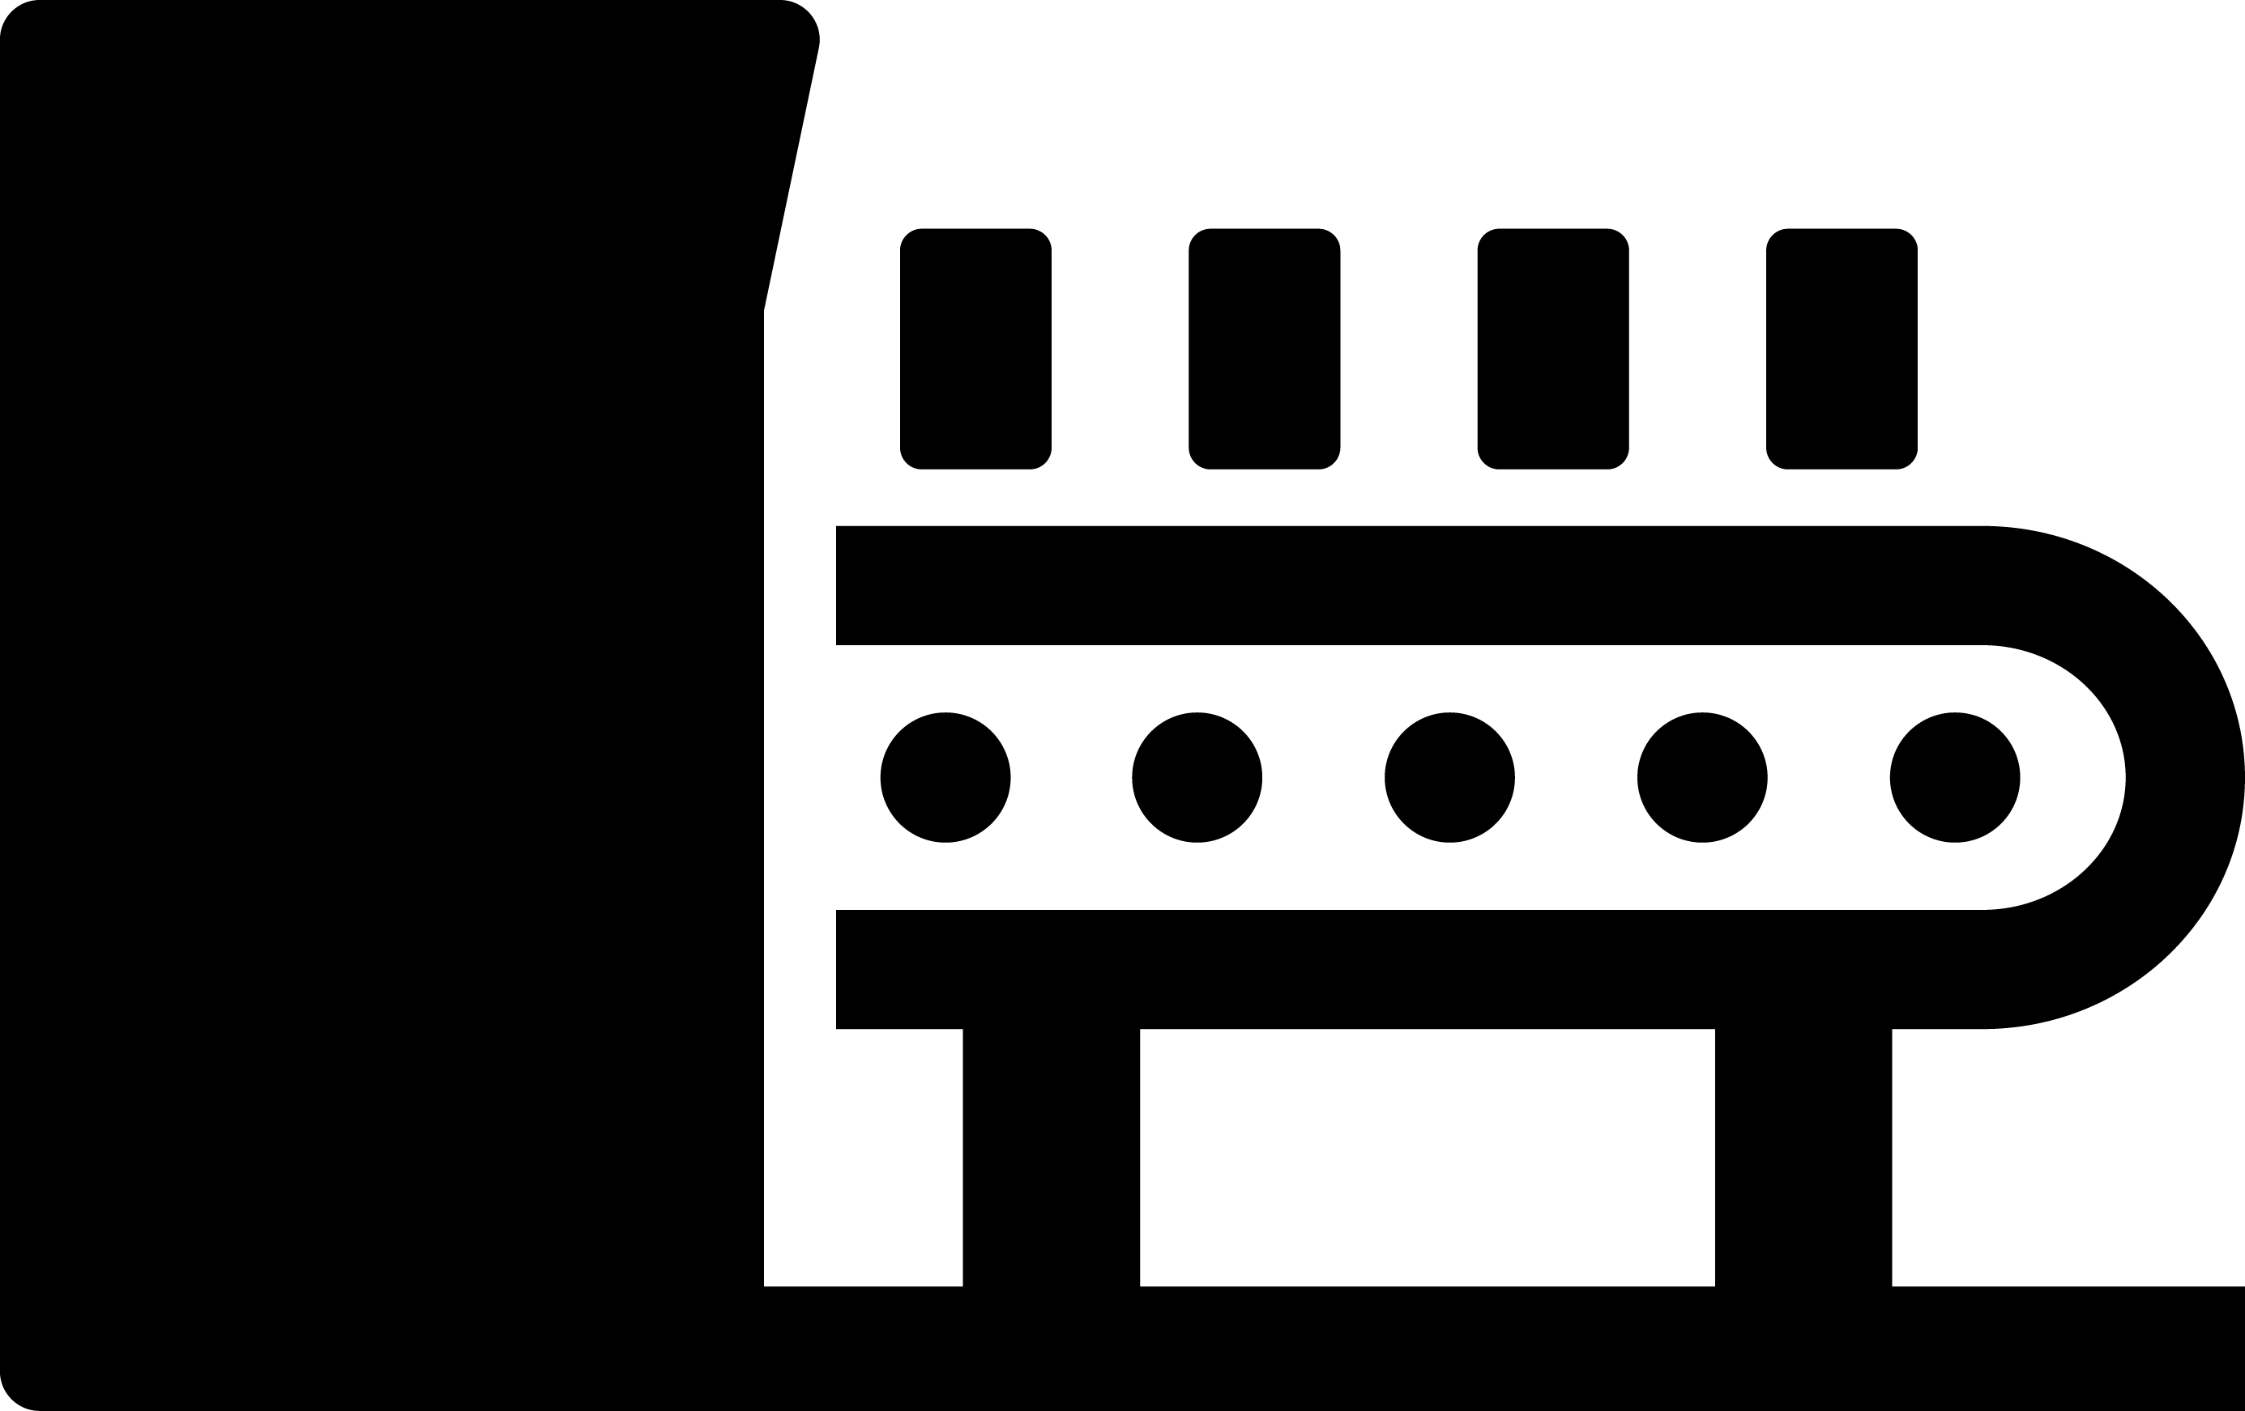


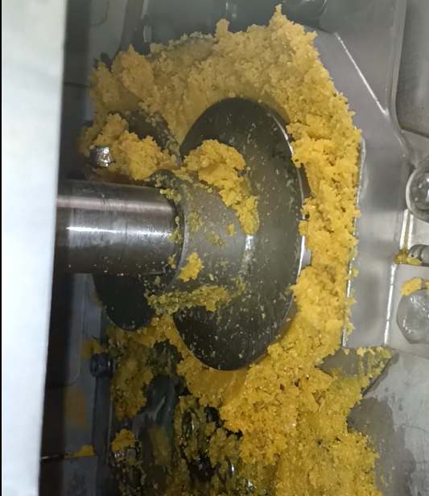
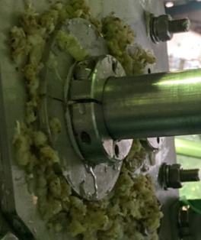
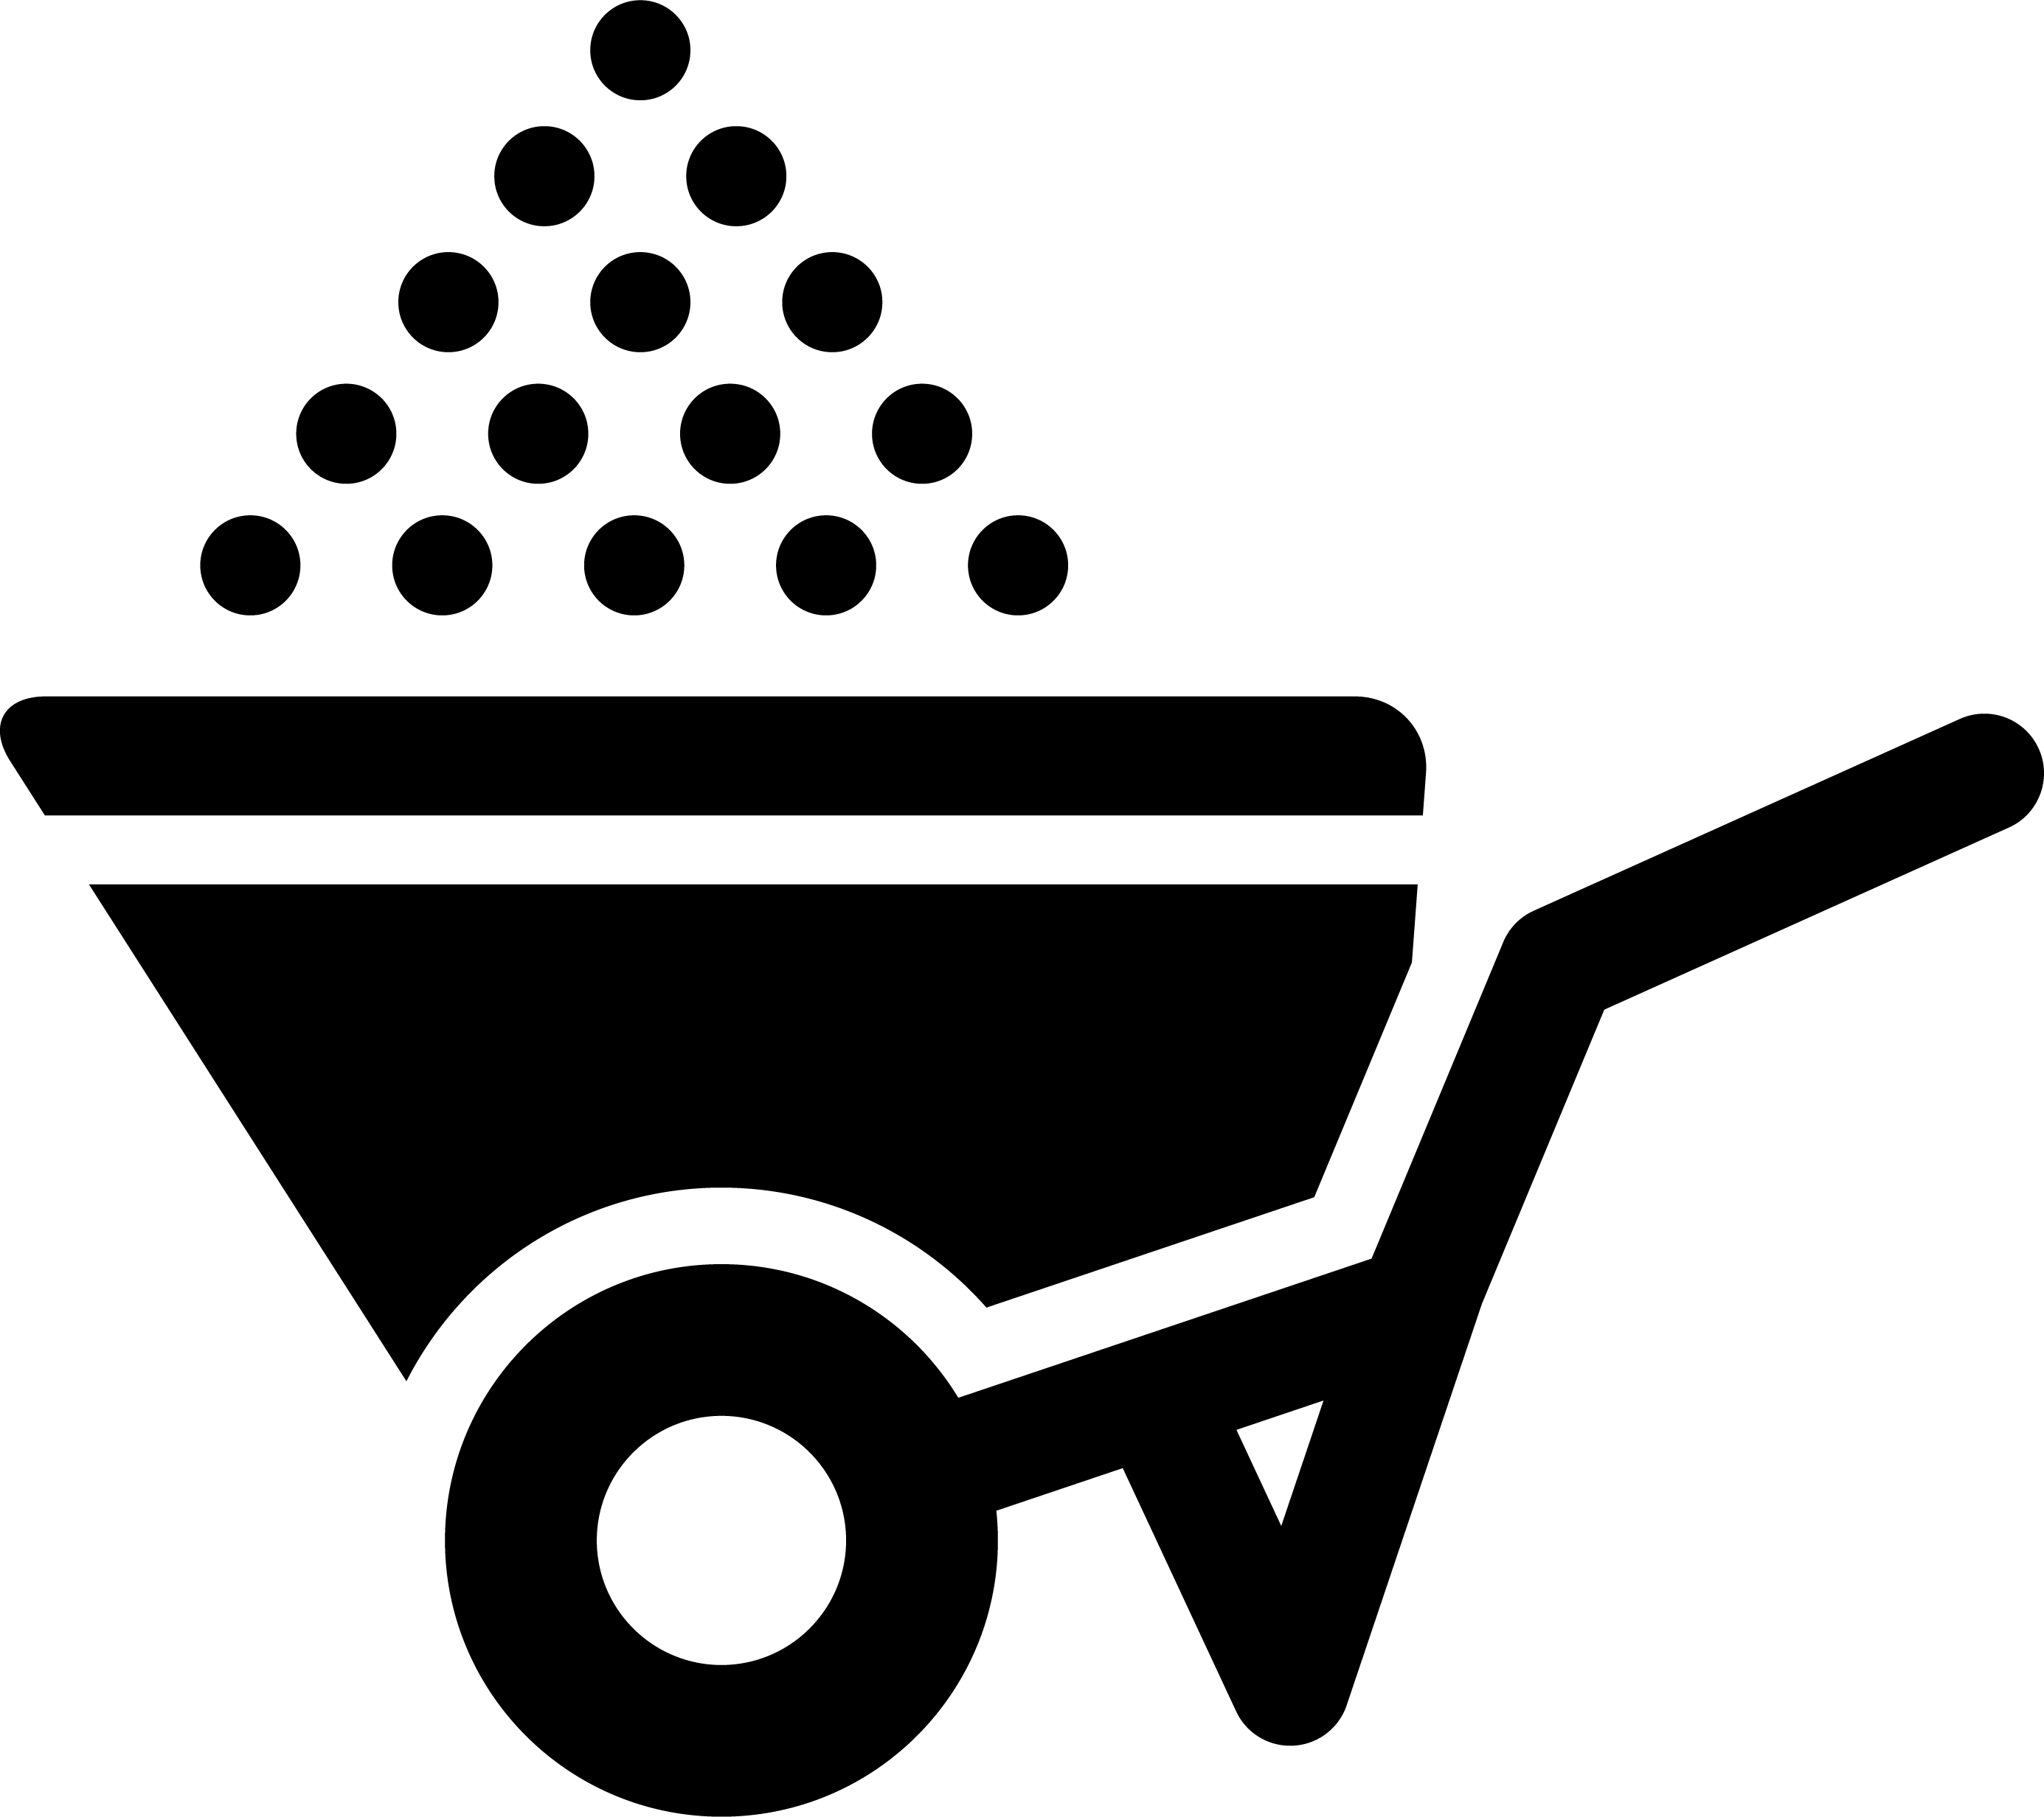
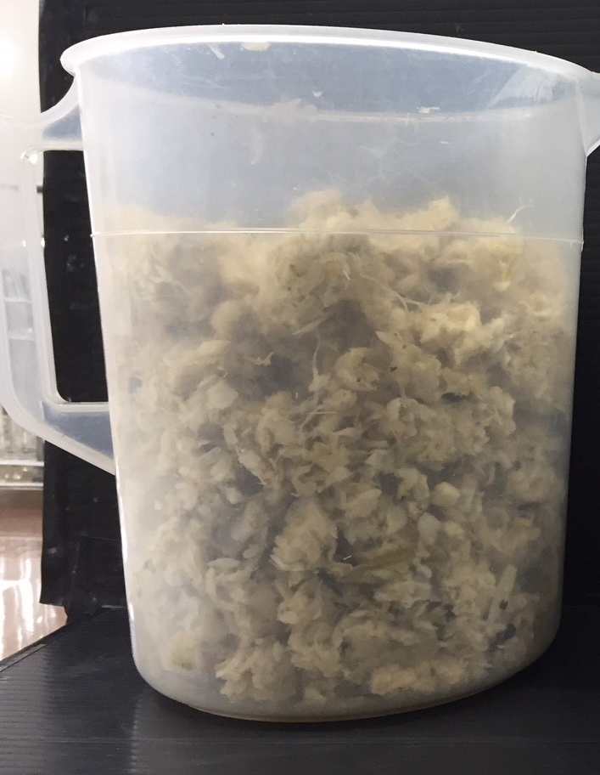
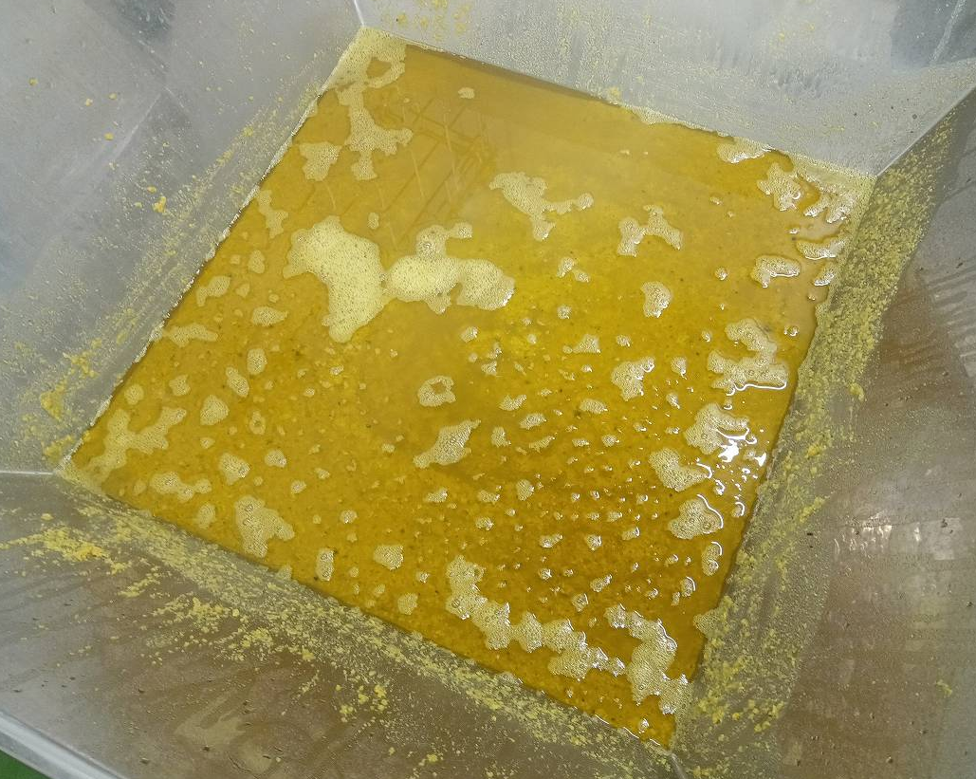
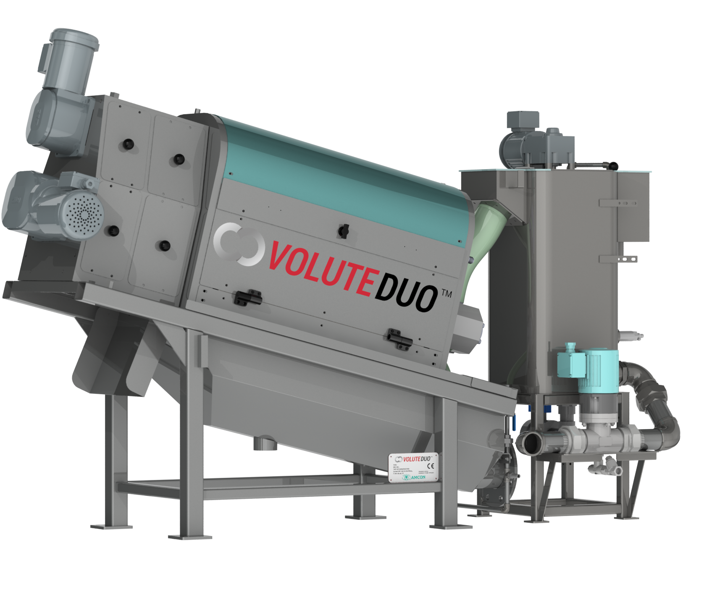
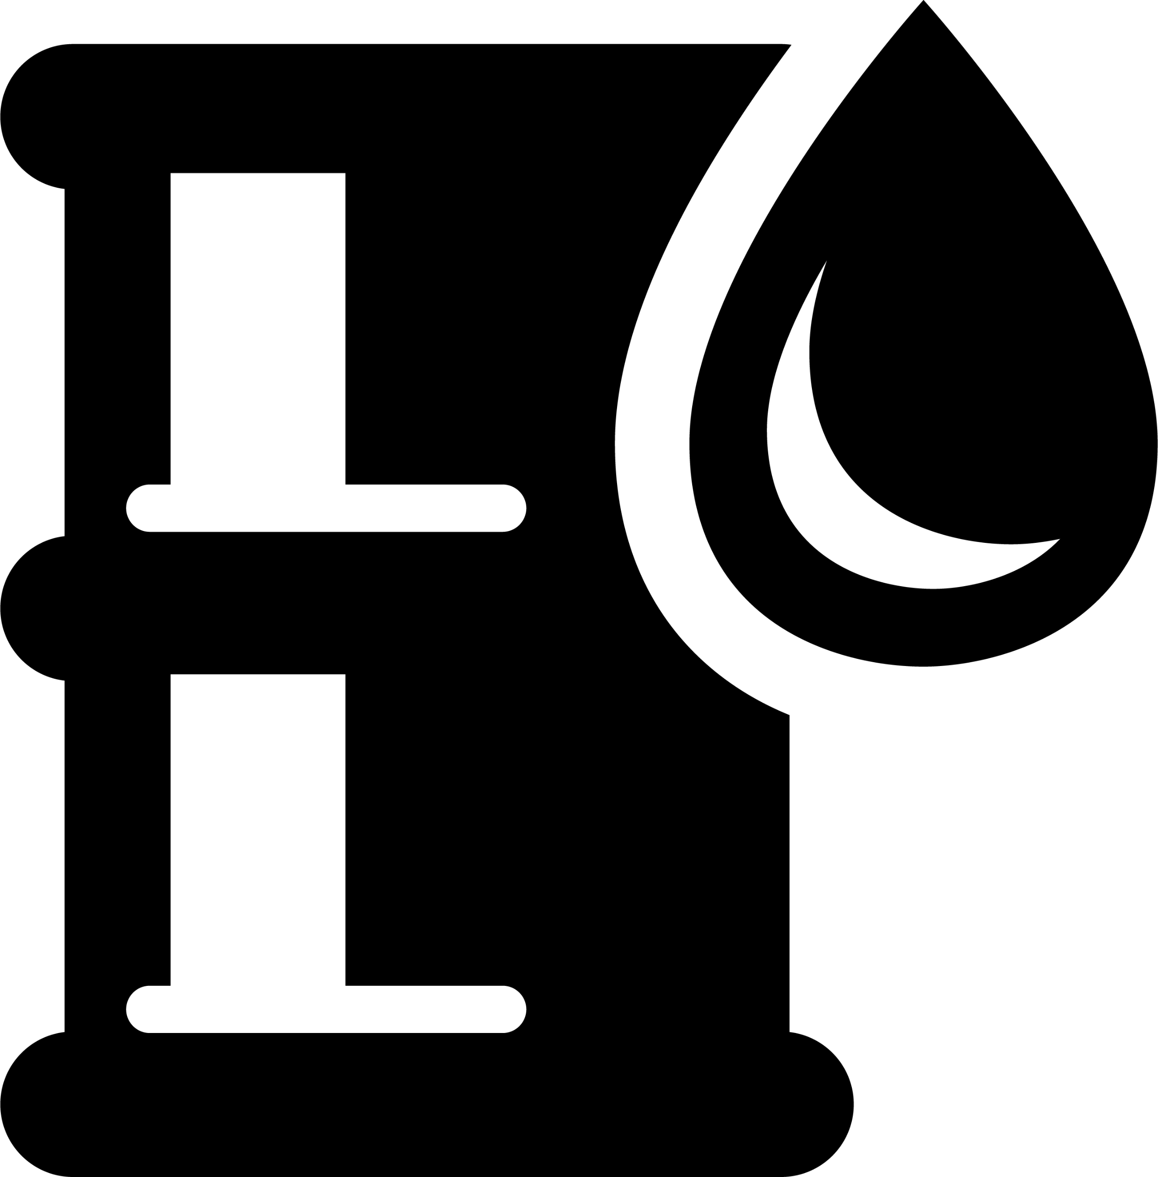
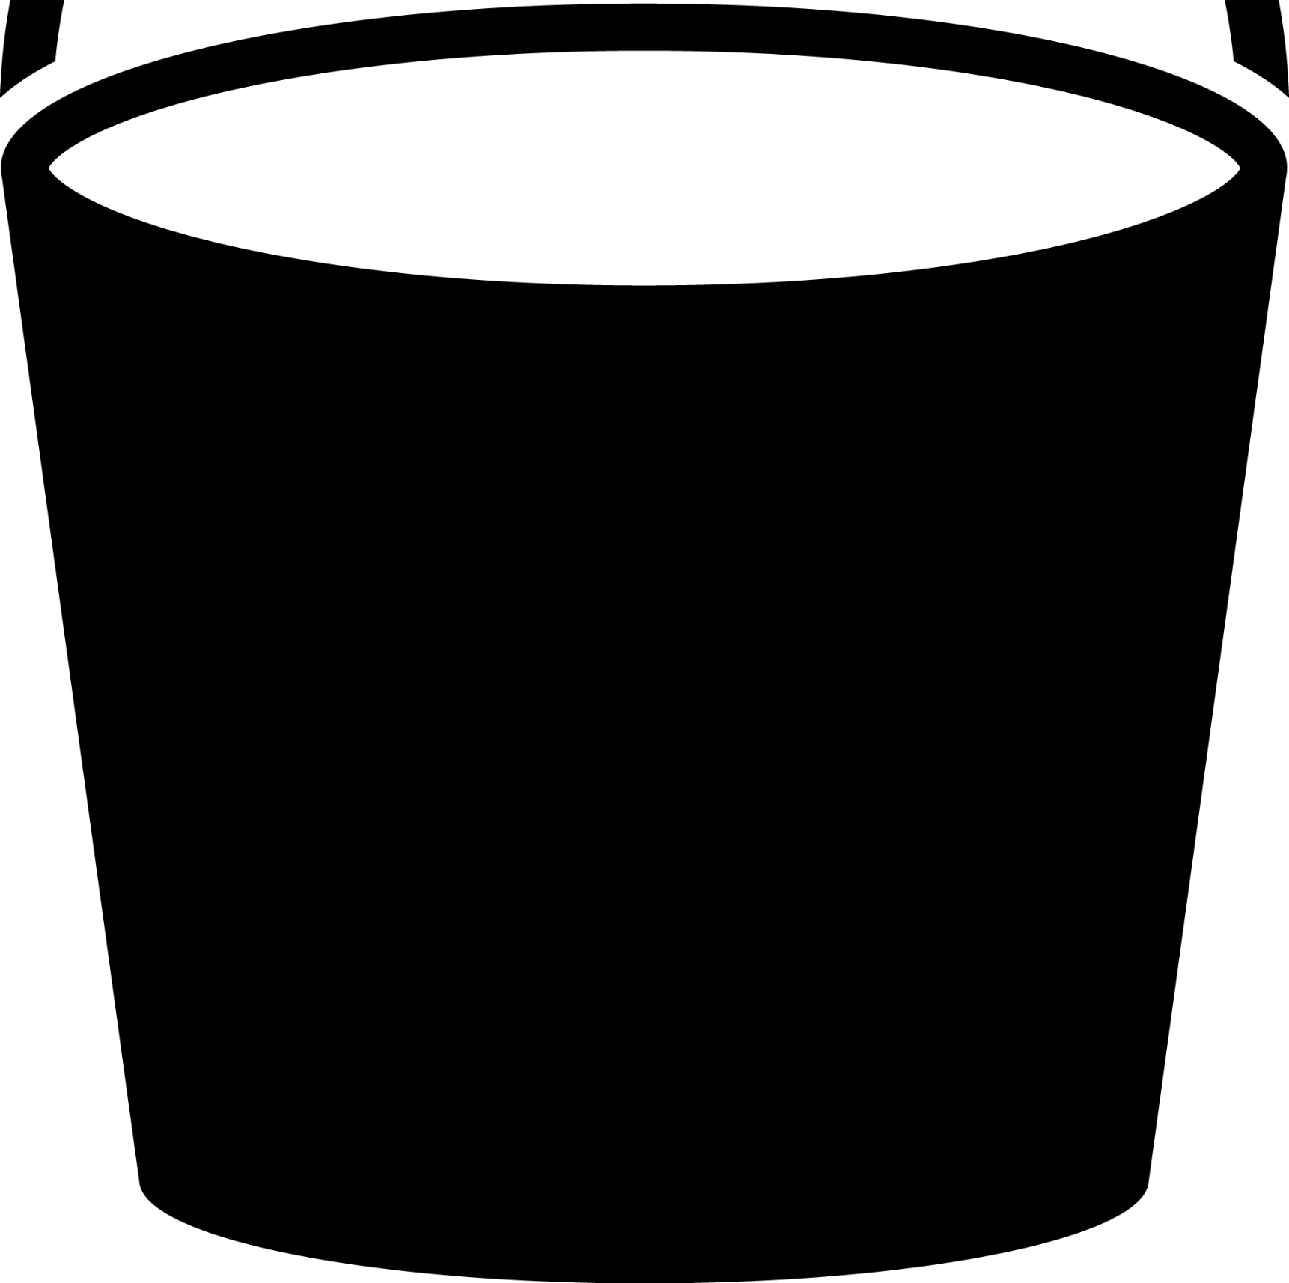
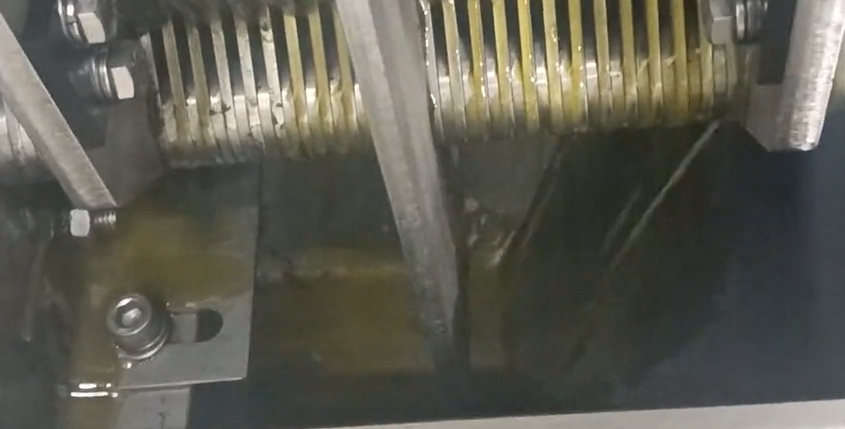
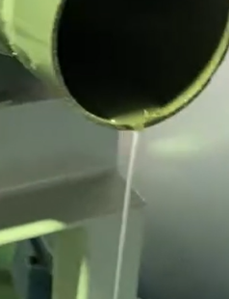
VOLUTE DUO Performance Potential
Potential 1 (Separating solid and oil, then recycling residue)
Industry: Food Processing | Sludge type: By-product of beans processing
It is possible to separate the oil from the residue (such as soybean press cake) generated during food processing, thereby achieving separation between the oil and solid components (fibrous material). This allows for the reutilization of oil within the manufacturing process. ※ No chemical dosage
Potential 2 (Processing the volume fiber rich residue)
Industry: Food Processing | Sludge type: By-product of beans processing
It is possible to separate the residue generated from food processing (such as vegetable washing) into water and solid components. ※ No chemical dosage
Food Process
Food Process
Beans
Onion
Beans + Oil
Onions
+
Water
Oil
Water
Result
Result

Slide 3
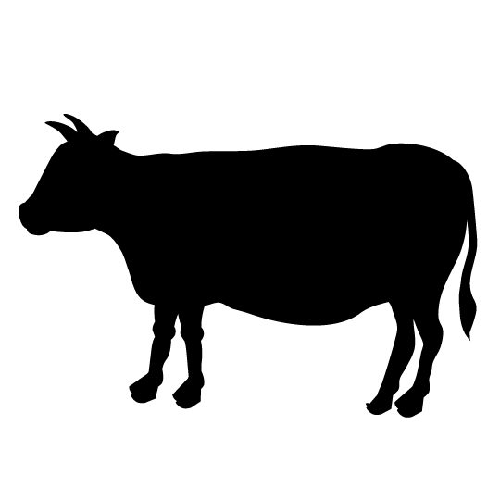

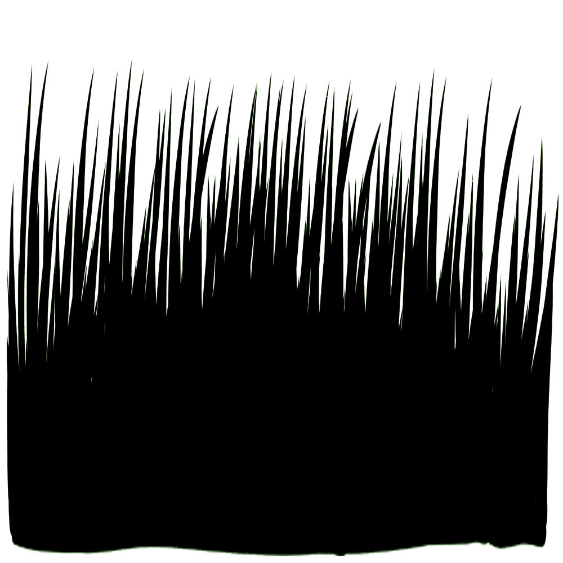
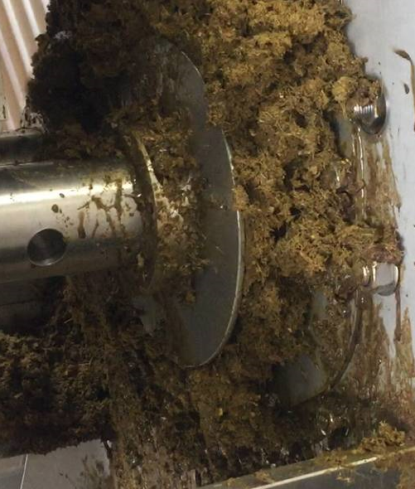

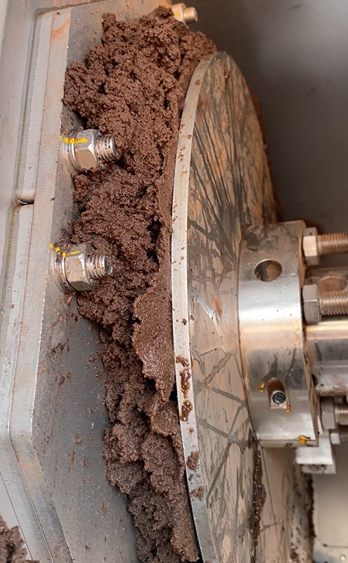
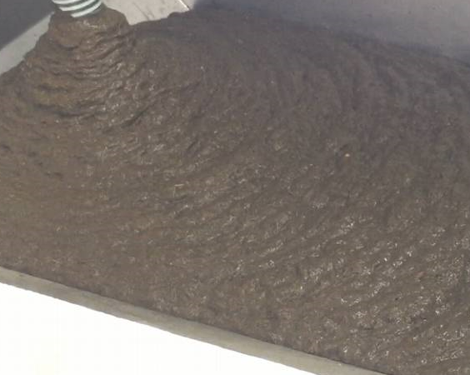
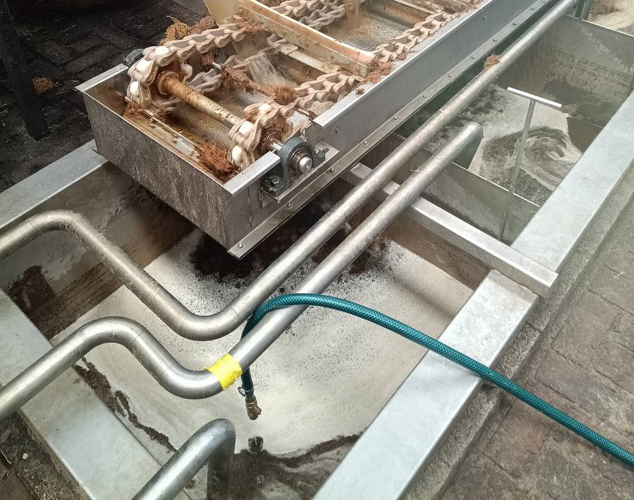
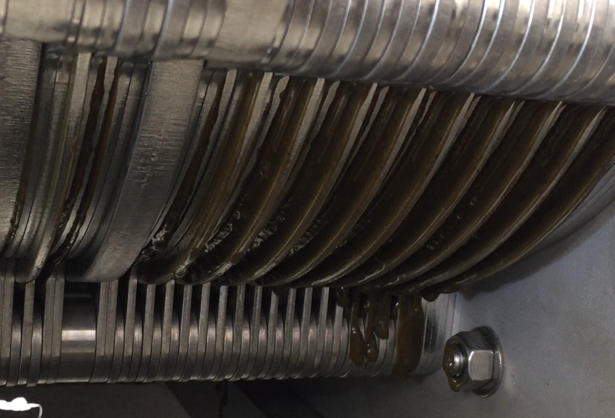
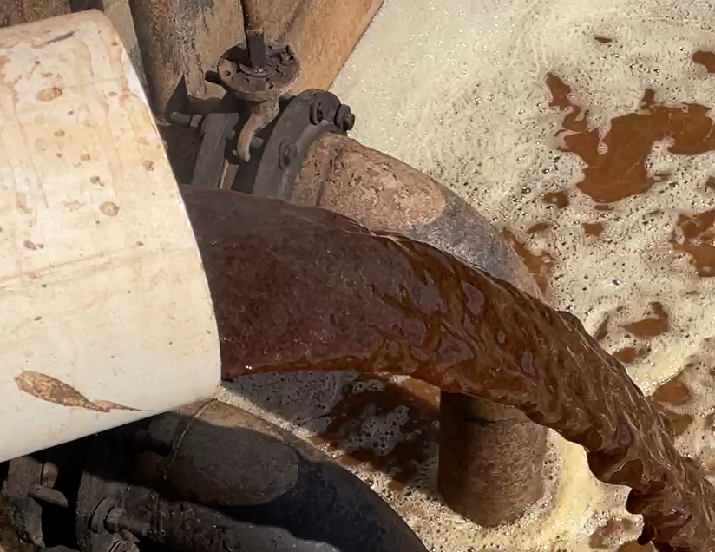
VOLUTE DUO Performance Potential
Potential 3 (Processing the volume of thick and fiber rich sludge)
Industry: Livestock (Cowshed) | Sludge type: Livestock Manure
To compost manure, the high moisture content of the waste (TS: 10% or higher) necessitates solid-liquid separation to achieve the desired moisture content for composting. Furthermore, since the slurry can be dehydrated, it can be used not only for primary treatment but also for secondary treatment, enabling dual functionality. *no chemicals are added in the process.
Potential 4 (Reducing the volume of fiber rich raw wastewater)
Industry: Spirits | Sludge Type: Raw-Wastewater from Vinasse
Due to the large volume of sludge generated, exceeding the processing capacity of primary treatment using coagulation and sedimentation, the high-fiber raw water is directly treated by VOLUTE DUO. This helps alleviate the burden on secondary processes (the actual primary treatment). Additionally, VOLUTE can be installed even in the secondary process. *No screens / 2 chemicals dosage (Coagulant, Polymer)
Cowshed
Vinasse
Fermen-
tation
Sludge
Cake
Livestock
Manure
Vinasse
Slurry
Secondary Clarifier
(Sedimentation Tank)
Result
Result

Slide 4
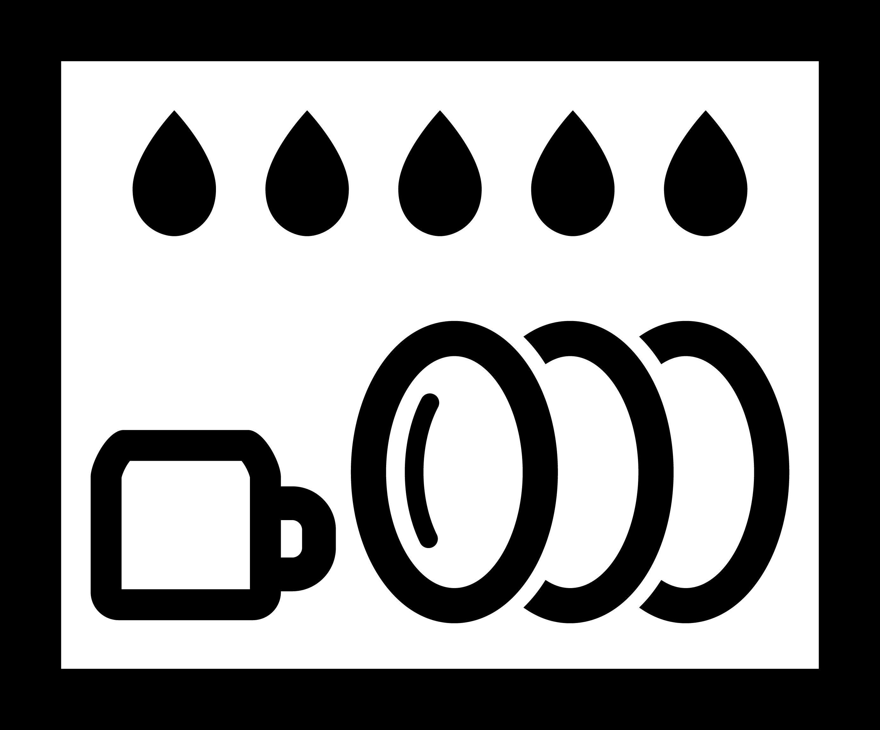
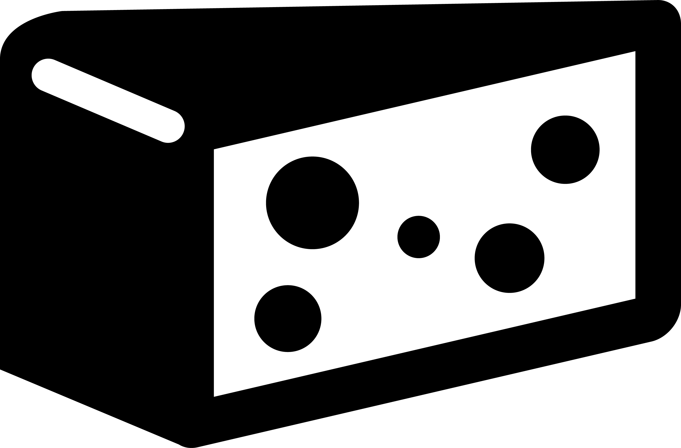
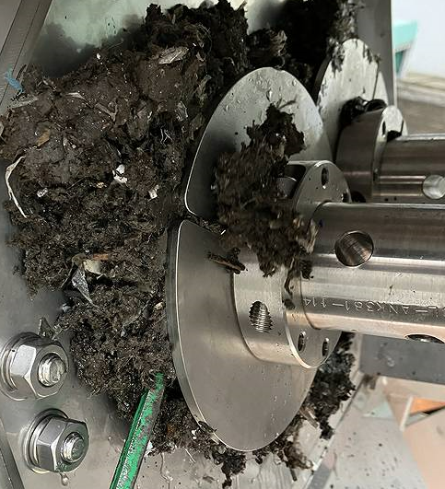
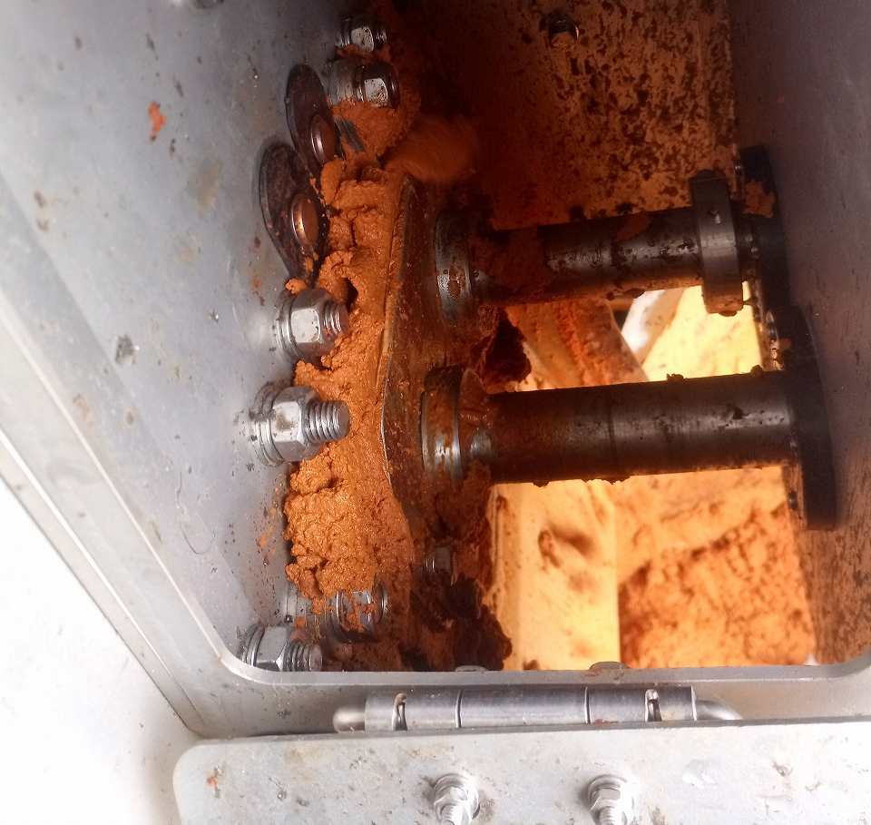
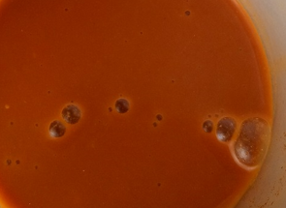
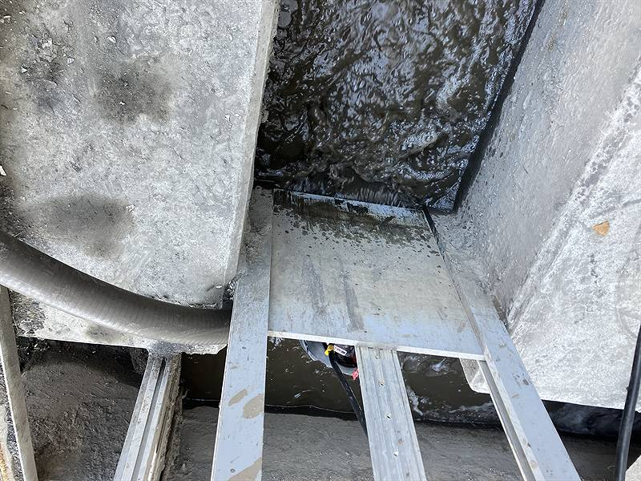
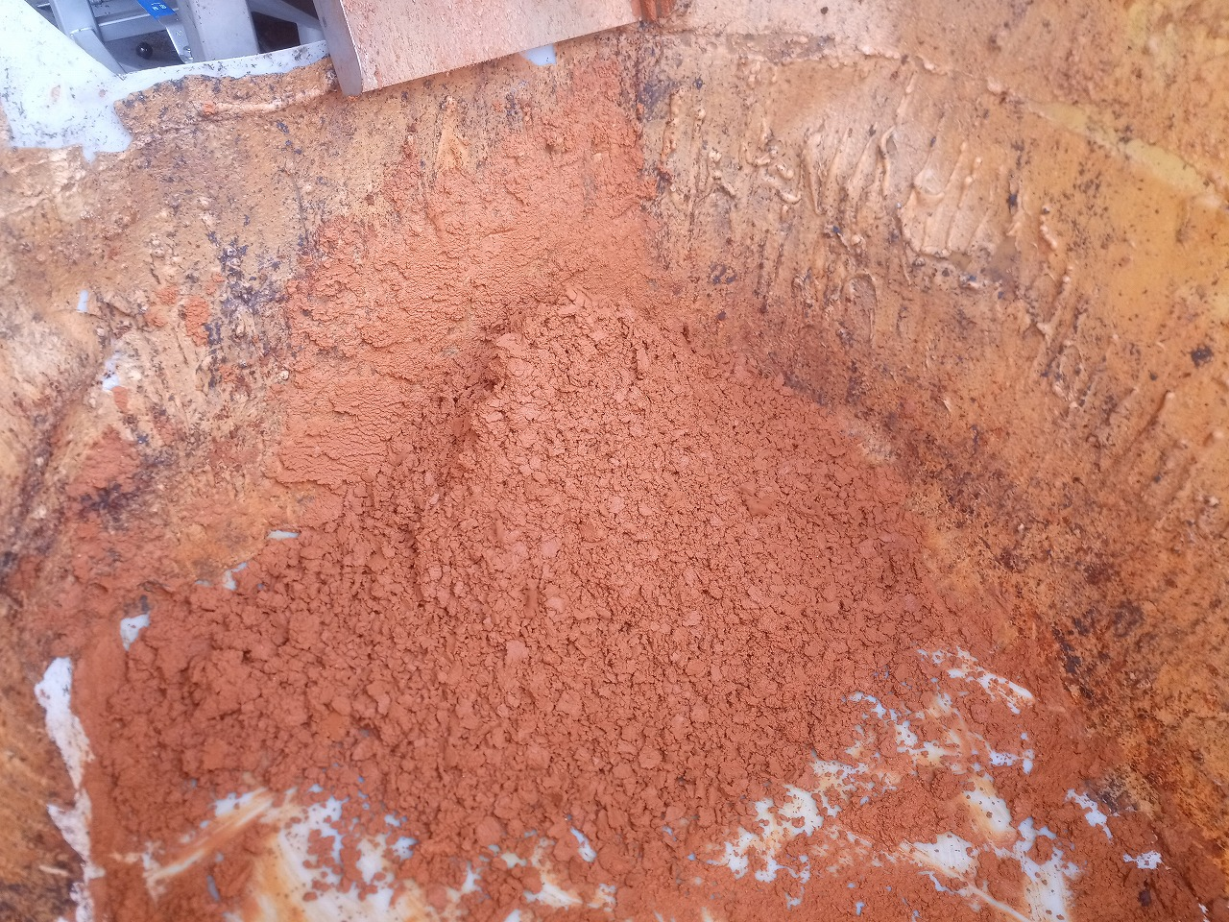
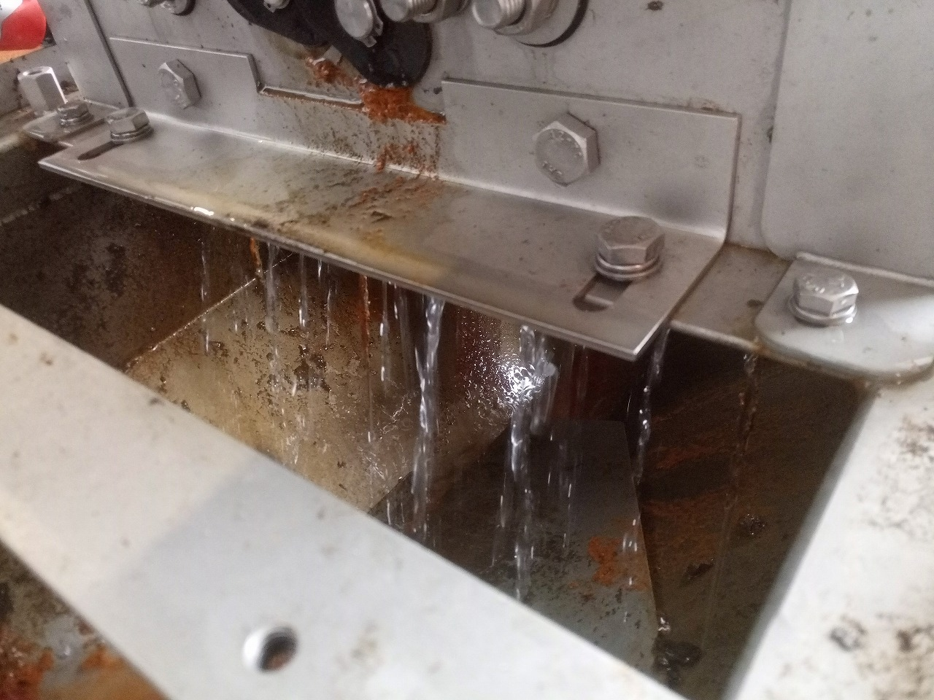
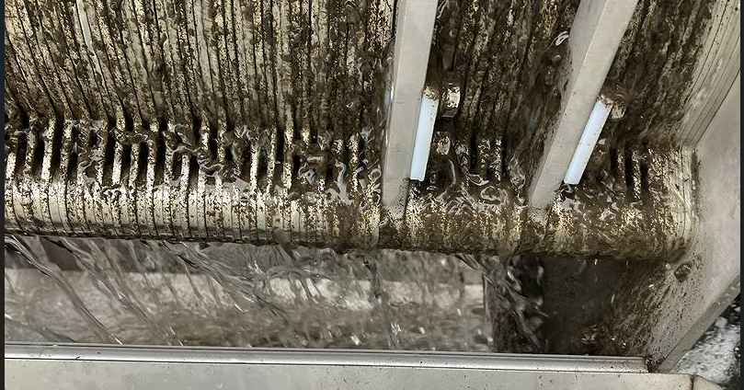
VOLUTE DUO Performance Potential
Potential 5 (Reducing the volume of fiber rich raw wastewater)
Industry: Aluminum Ingot | Sludge Type: Raw-wastewater from Aluminum washing process
By installing DUO in an environment without wastewater treatment facilities, it becomes possible to perform solid-liquid separation between the raw water and fibrous materials, reducing the volume of sludge while simultaneously enabling immediate reuse of the treated water as wash water. 2 polymer dosage
Potential 6 (Dewatering thick sludge with the mobile unit)
Industry: Dairy Product | Sludge Type: DAF sludge
For dairy product manufacturing wastewater, which contains high concentrations of oil and has high viscosity, making it prone to adhesion and forming high-viscosity sludge, the dual-axis screw mechanism enables dewatering without clogging issues. 1 to 2 polymer dosage
Washing Process
Food Process
Sludge
Cake
The Line
of
Wastewater
Sludge Tank
Recycle
water
Sludge
Cake
Result
Result

