Slide 1
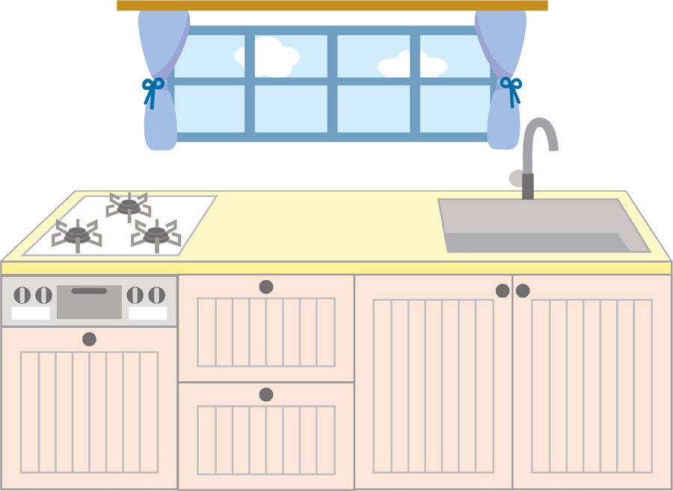

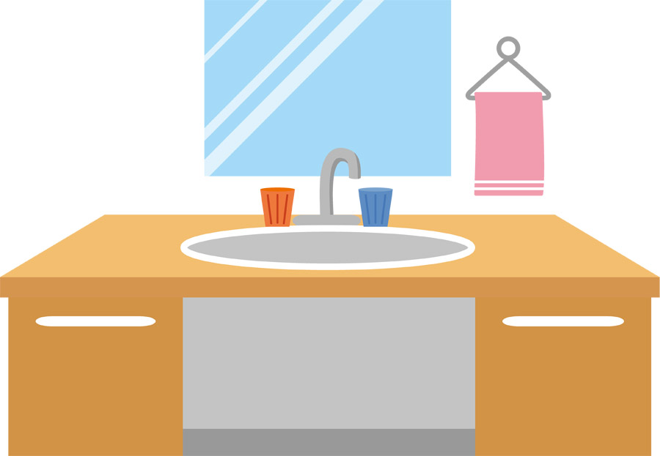
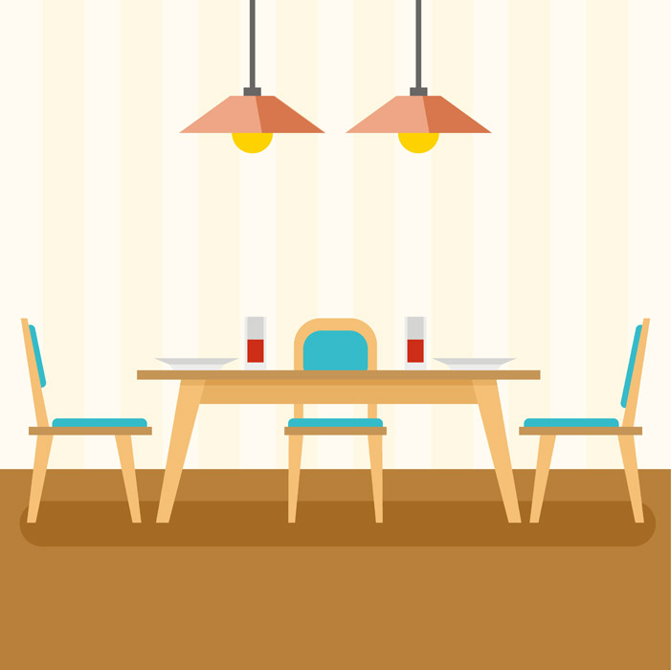


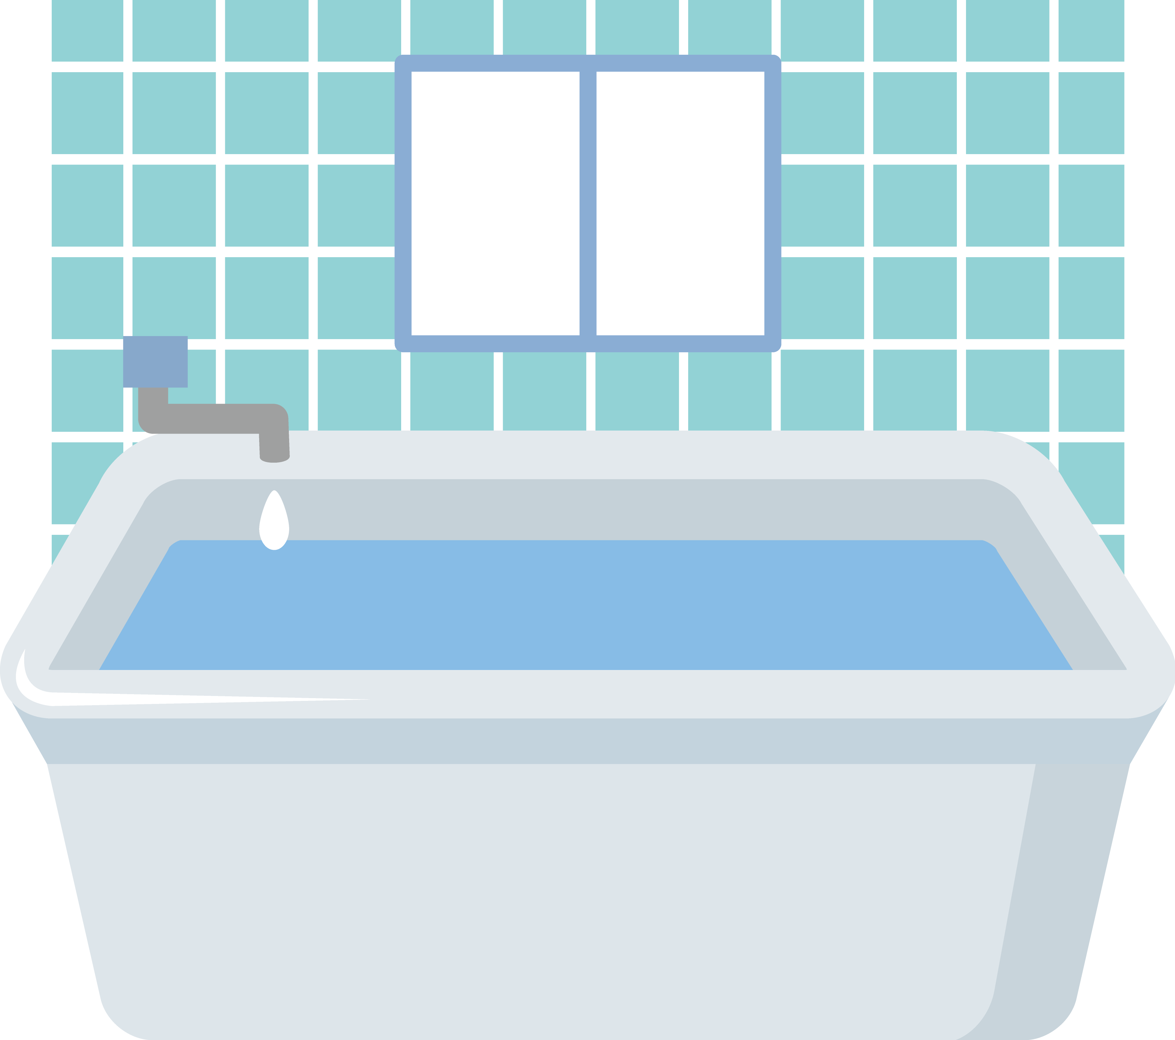
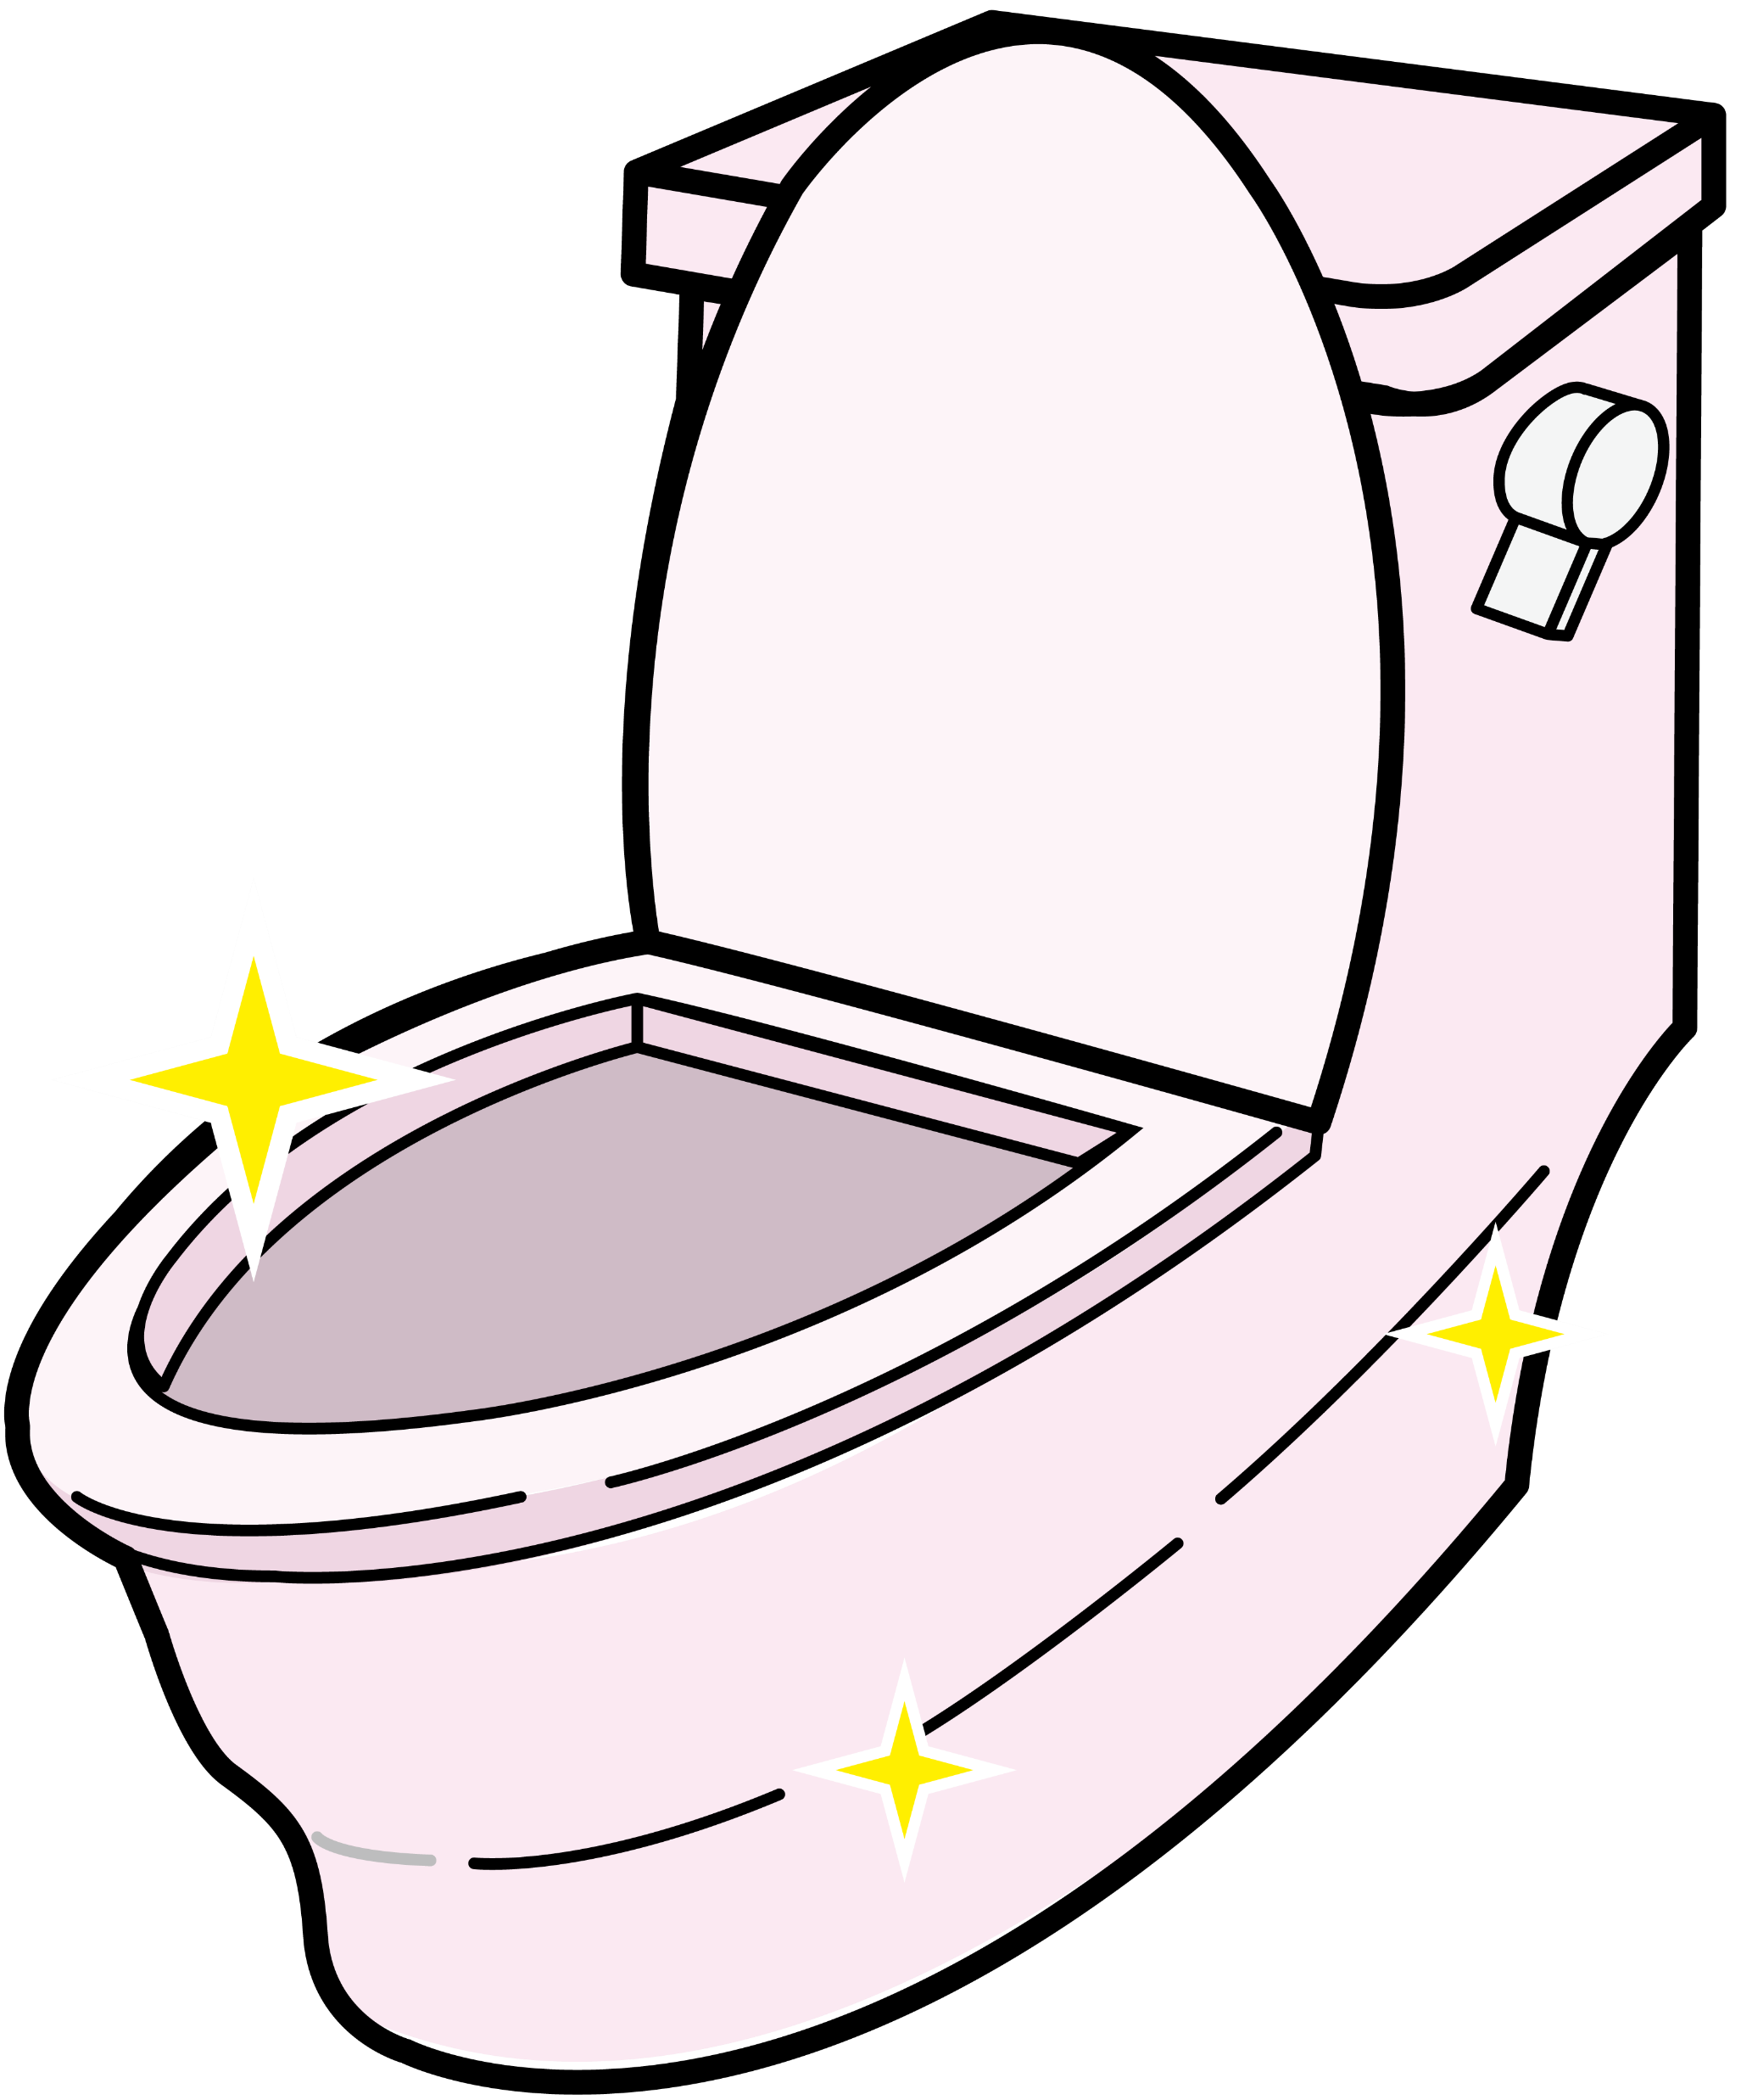
天然除菌
Sommelier Glass
All In One Eco-friendly
Natural Liquid Soap
Ａｎｔｉ-ｂａｃｔｅｒｉａｌ ｈｏｕｓｅ ｗａｓｈｉｎｇ５００

