Slide 1

Pure raw honey
made from soil grown in Kyoto
ORG.inc

Slide 2
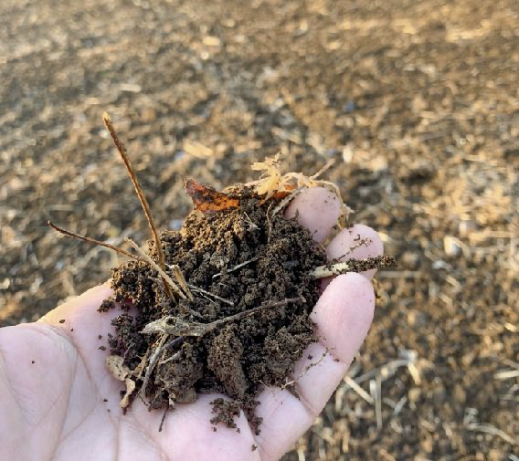
Beginning of beekeeping
Drawing on many years of expertise in the field of professional agricultural production across the country.
We confronted the global problem of bee decline from Kyoto.
The quality of honey is determined by the nectar source environment and nectar plants.
Truly delicious honey is not found in vast farmlands or areas with many wild flowers.
2

Slide 3
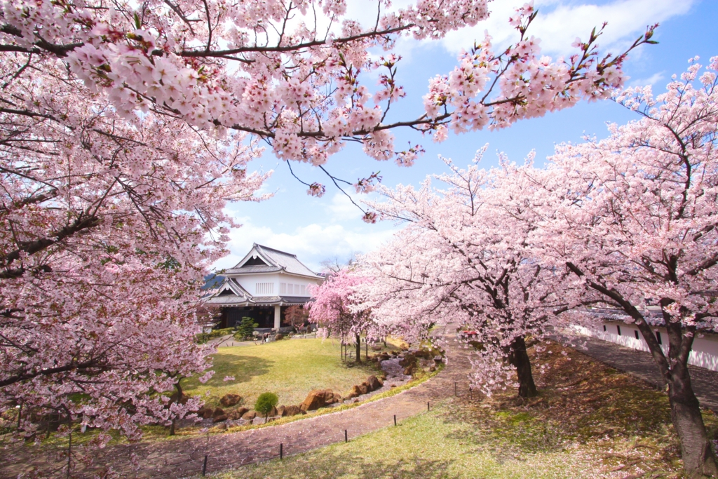
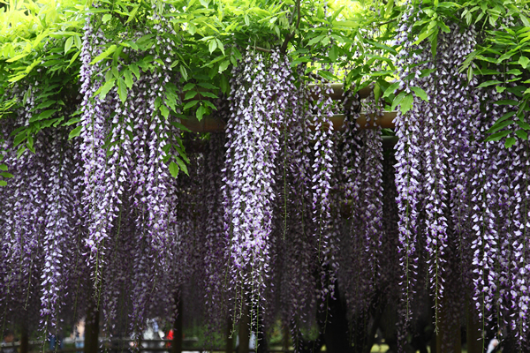
Potential of honey from the satoyama around Kyoto's sightseeing spots, where only the nectar plants you really want can be collected.
It is rare to find a region in the world where it is possible to collect such pure monofloral nectar from cherry and Fuji trees.
3

Slide 4
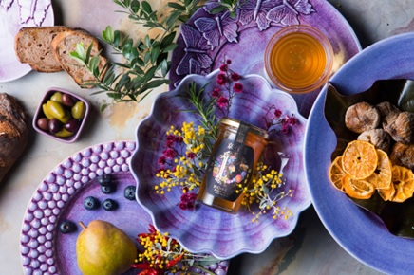
Hyakka nectar in Kyoto City
“KyoHyakka”
It is a honey with a heavy floral fragrance that comes from an area where there are few wild flowers that we do not want to enter, or farmland that has been forcibly cultivated and forced.
4

Slide 5
Spreading Soil Preparation Nationwide through Agricultural Businesses for the Land of Flying BeesPlants take root in good soil.
When plants take root, the quality of nectar increases dramatically.
Good nectar attracts bees.
Bees that bring back good honey will be energized and share good quality honey with us.
The bees come to collect the nectar, which leads to cross-pollination and the expansion of the forest.
Vegetables that produce wellNutritious plants and nutritious honey make us healthy.
We believe that a healthy body is a healthy spirit.
Recycling-oriented agriculture
brought about by bees and soil improvement
5

Slide 6
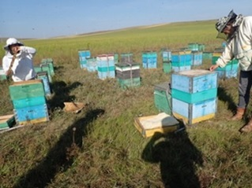
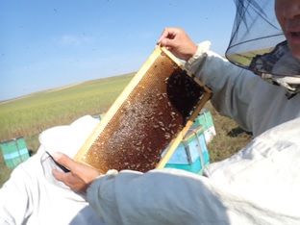
We realize that Japan's beekeeping technology was clearly lagging behind the rest of the world.
To improve his beekeeping techniques, he met with a Mongolian beekeeper and learned how to increase bees using more organic methods.
6

Slide 7
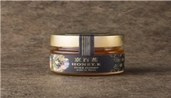
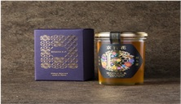
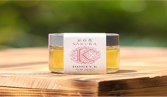
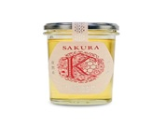
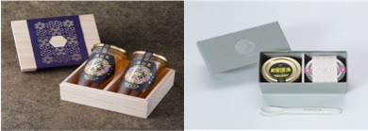
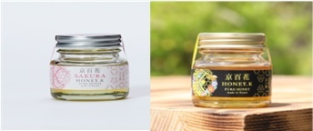
KyoHyakka 120g
KyoHyakka 250g
KyoHyakka Cherry Blossom 120g
KyoHyakka 250g
OEMラベル製造可能
Others Set in wooden box Gift box
Jar 50g
7

Slide 8
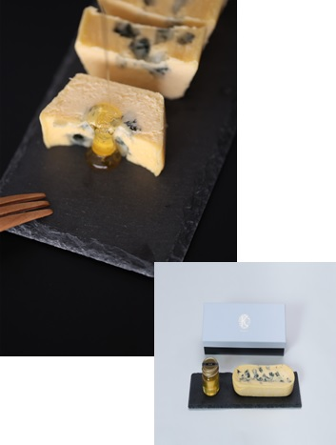
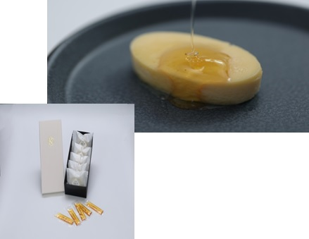
KyoHyakka no Shizuku Cheesecake Mascarpone Cheese Cake 5p
KyoHyakka no Shizuku
Cheesecake
KyoHyakka no Shizuku Cheesecake Blue Cheese 1 bottle
We want to create the finest Kyoto sweets using the natural flavors of Kyoto.
*Yoshimoto Kogyo collaboration products
8

Slide 9
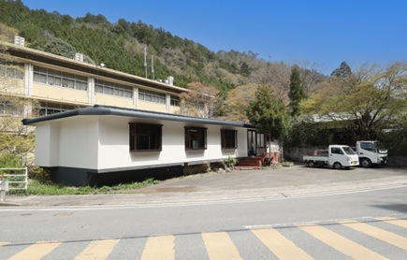
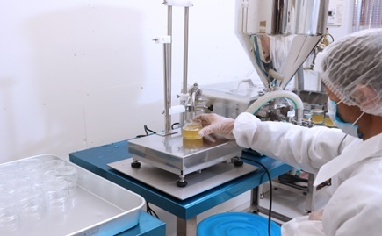
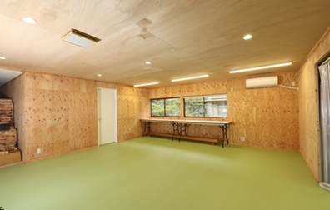
Keihoku Plant
JFS-B standard Factory to be acquired in September 2023
Our honey has a sugar content of 78 degrees or less.We return the honey to the hive only if it has a rich floral aroma and good taste.The bees are allowed to collect more nectar from the flowers and let the water escape to raise the sugar content.Only the honey that meets the requirements of the tasting is carefully selected and bottled.We carefully select and bottle only the honey that meets our tasting requirements.
The process is completely unheated and natural filtration is done with a lot of time and effort.The process is completely unheated and naturally filtered.For hygienic reasons, we use a filling machine only for bottling.
9

Slide 10
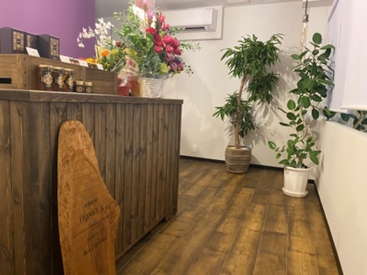
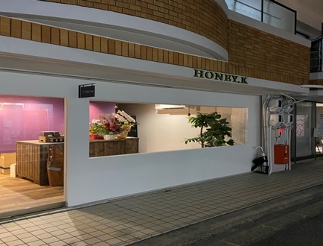
Keihoku Plant ORG office and Honey K store
Kita-ku, Kyoto
10

Slide 11
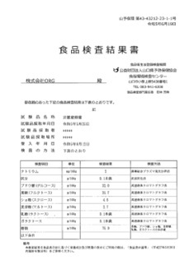

Food inspection 206 items of pesticide residues
(including glyphosate detected)
OEM label production available
Bacteria tested
(no problems)
In sugar analysis Fructose (fructose) proved to be the most abundant
11

Slide 12
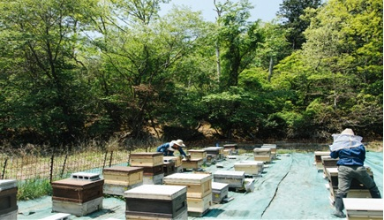
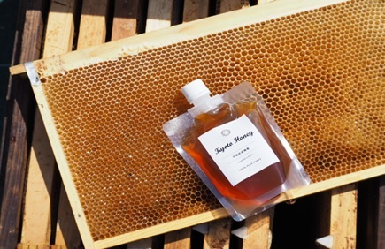
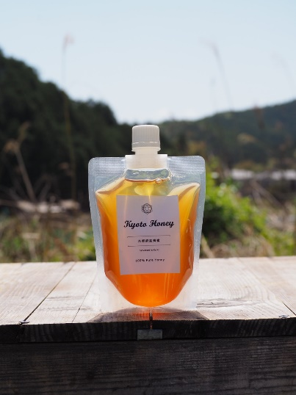
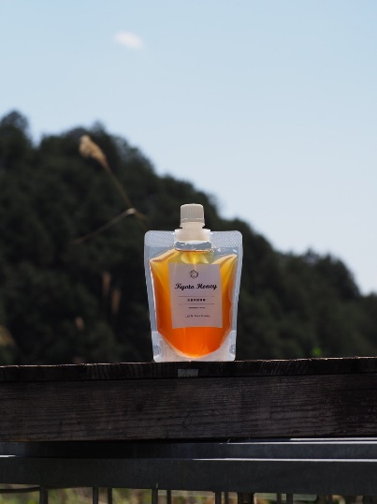
Honey produced in Kyoto, Japan, where the honey is collected and the quality of the honey is carefully selected.
ORG Co. KYOTOHONEY
OEM label production available
in a pouch 180g, 300g
12

Slide 13
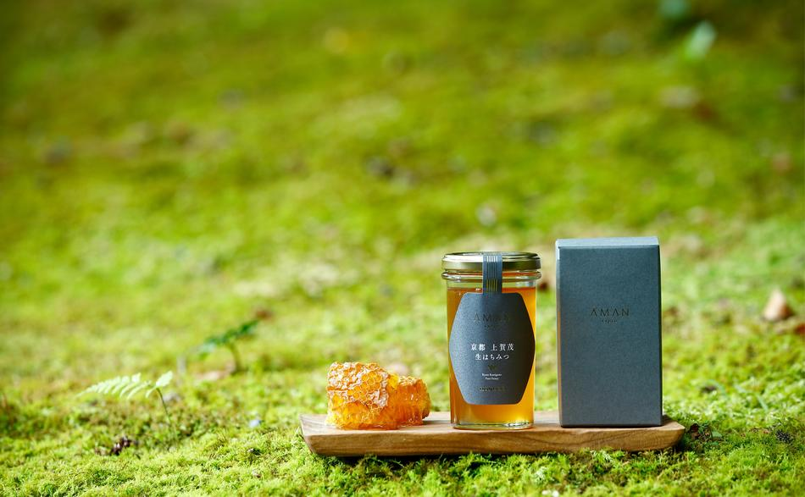

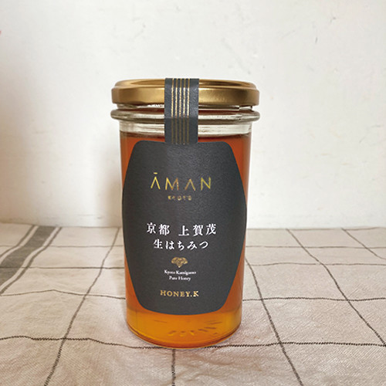
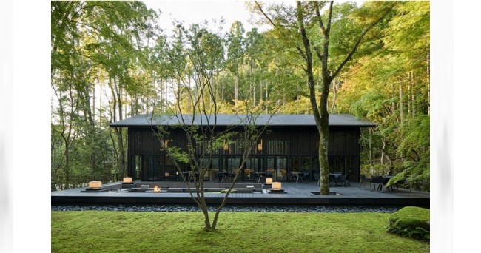
Aman Kyoto and double name honey

Slide 14
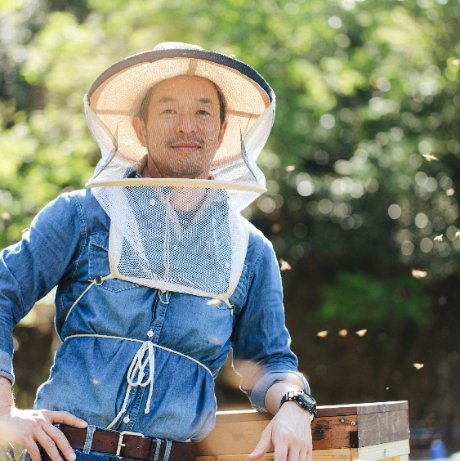
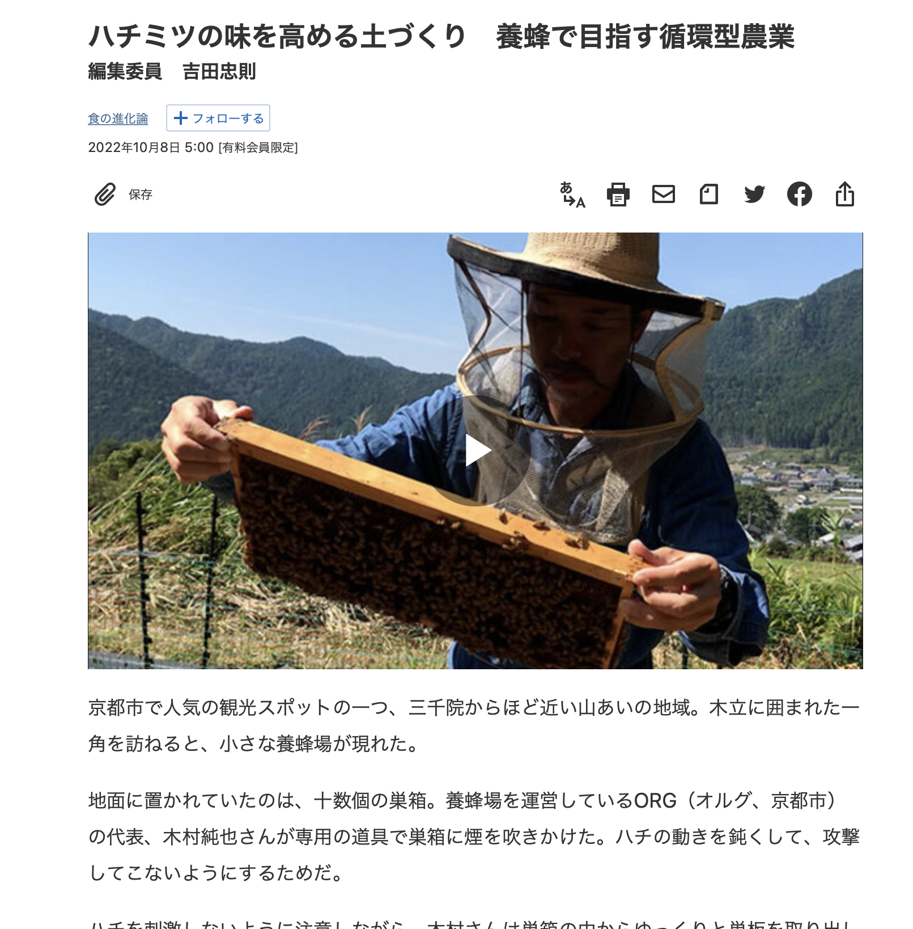
Agro-Environmental Designer Junya Kimura
Profile
career
  In 2014, he established Kyoto Nohan Co.
  Since then, he has not only sold fertilizers, but also provided on-site guidance on fertilization and crop cultivation as a production assistant.
  In addition, to improve production technology, he dispatches lecturers to production corporations and agricultural cooperatives throughout Japan as a study group, and also holds seminars to provide live information such as field knowledge.
  2019 Establishment of ORG Co.
  While utilizing the relationship with Kyoto Nohan, ORG provides further multifaceted consulting on the environment surrounding agriculture.
  In Kyoto, he is involved in beekeeping business as an activity to protect agriculture and environment.
  Production consulting is active both domestically and internationally.
Beekeeping business introduced in the Nikkei News electronic edition

Slide 15


Company Profile
Name | ORG Co.
Founded | 2019
Location | 〒603-8341 19-27 Komatsubarakitamachi, Kita-ku, Kyoto
delegate | Junya Kimura
Tel/Fax | ℡:075(463)0331/Fax:075(463)0332
Business | Agricultural consultants, beekeeping, food production and sales, etc. Kyoto Honey Brand "HONEY.
Client Banks | Kyoto Bank

