Slide 1

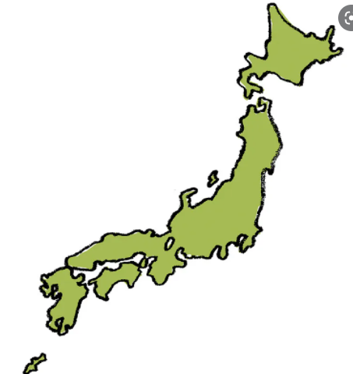




We deeply care of the delivery till our customer to receive products.
Your doorsteps
Day |  | N | ~N+2 | ~N+3~10 | ~N+6~20
Events | Customer | Place order,Thank you!! | Tracing Number to be noted to customer by email |  | Import Customs
 | Nature's Japan |  | Issue a tracing number Pick and Dispatch
 | Transpoter |  |  | Int'l Transportation | Delivery to cutomer's door

